Slide 1
South West Net Zero Hub 5i Heat Network Project – Webinar 1 - Influence

Slide 2
Introduction to the 5i Project Sam Moore Project Manager SW Net Zero Hub

Slide 3
Housekeeping
Today’s 2 hour session will be recorded for sharing
There will be three dedicated sessions for questions
Q&A is allowed during speaker presentations in the chat function
Any unanswered questions please raise your virtual hand in the Q&A session at the end of all of the presentations and I will come to you in turn
All presentations will be shared with all attendees as a pack
Follow up support is available from the Net Zero hubs

Slide 4
Agenda
1500: Welcome, Introductions, Setting the Scene
Break out rooms
Speaker one: Intro to District Heating plus Heat and Buildings Strategy
Speaker two: Low carbon heat alternatives and Recoverable heat mapping
Q&A
1600: Break
Speaker three: A Local Authority example
Speaker four: A quick guide to geothermal, including the stakeholders involved in delivering the Eden Geothermal project
Q&A
Wrap up discussion
1700: Finish

Slide 5
South West Net Zero Hub
The South West Net Zero Hub provides impartial advice, technical support and funding to public and not-for-profit organisations, to develop projects that accelerate emission reductions and enable the transition to a more sustainable future.
Gov
(Dept for
Energy Security
& Net Zero)
Net Zero
Hubs
Local
Councils &
Public Sector
Third
& Private
Sectors

Slide 6
South West Net Zero Hub
Government Net Zero Strategy established 5 regional hubs with core objectives:
Attract commercial investment and help LAs and other local public sector bodies to develop investment models which accelerate progress to net zero
Continue to increase the number, quality, and scale of local Net Zero projects being delivered across the region in line with national targets and strategies, including supporting the early-stage development and delivery of projects.
Collaborate with the Department of Energy Security & Net Zero to develop & support Net Zero elements to wider programmes & initiatives including Levelling Up
Support a national knowledge transfer programme to improve information sharing, training & evaluation
Raise local awareness of opportunities & benefits of local Net Zero investment

Slide 7
Key Opportunity Areas

Slide 8
Introduction to District Heating and the Heat and Buildings Strategy Mark Howard Heat Networks Specialist Department for Energy Security and Net Zero

Slide 9
Heat Networks and Heat Network Zoning
May 21 2024
Mark Howard – Heat Networks Delivery Unit

Slide 10
What is a heat network?
Heat networks use highly-insulated underground pipes to distribute heat from centralised sources to a variety of different customers, such as public buildings, shops, offices, hospitals, universities and homes.
This could be across entire cities or to a selection of neighbouring buildings.
In high density urban areas, they are often the lowest cost, low carbon heating option. Those currently powered by gas can be converted to other heat sources in the future.

Slide 11
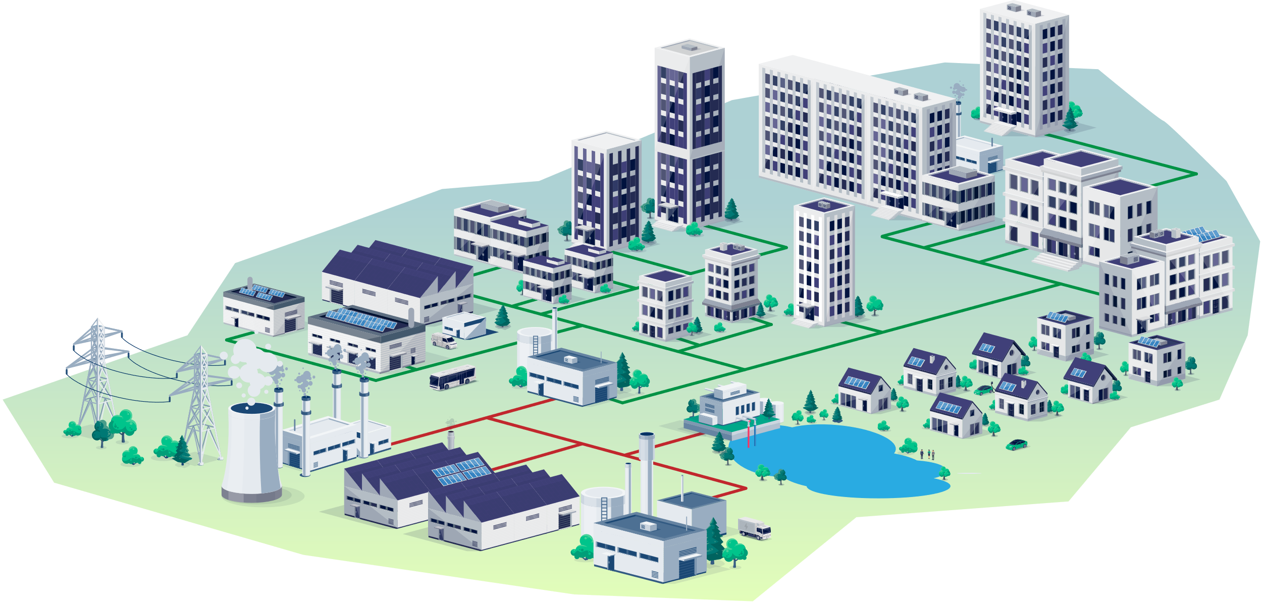
Heat consumers connecting to heat networks could include …
Schools and colleges
Hospitals
Hotels and leisure
Public buildings
Offices and commercial space
Industry
Communally-heated residential blocks

Slide 12
Producers of waste heat supplying heat networks could include…
Schools and colleges
Hospitals
Hotels and leisure
Public buildings
Offices and commercial space
Industry
Communally-heated residential blocks
Industry
Power generators
Data centres
Water and waste treatment sites

Slide 13
Heat Networks – today to 2050
Heat networks currently provide almost 3% of UK heat demand and with Government support could provide 20% of heat demand by 2050.
They can unlock otherwise inaccessible large-scale renewable and recovered heat sources such as waste heat from industry and heat from rivers and mines.
They deliver broader system benefits as they can run during lower peak times and can take advantage of lower carbon electricity and reduce the investment needed in local energy grids.
The investment potential presents between £60 and £80 billion by 2050 and is considered the biggest heat network investment opportunity in Europe

Slide 14
Heat network zoning will fundamentally transform the development of heat networks in towns and cities across England

Slide 15
Heat network zoning will designate areas where heat networks are expected to provide the lowest-cost, low carbon heating.
It will give local communities the tools to accelerate the development of heat networks in their towns and cities.
We want to give developers and investors more certainty about the number of likely connections to networks to help unlock the investment needed to build them.
This will remove the barriers to greener, cheaper heat that currently limit the scale and pace of developing heat networks and encourage investment.
This will allow for large-scale strategic heat networks to be built in towns and cities across the country.

Slide 16
How will zoning be delivered?
Enabling legislation in the Energy Act 2023
Consultation on heat network zoning – closed 26 Feb
Establish zoning co-ordinators and a national authority to oversee the process and support local zoning co-ordinators
Where will zones be and how will this be communicated?
Potential zones identified throughout England via a national methodology
Local refinement before zones designated
Zone information available via a digital portal
What is the process via which zones will be built?
Standardised routes for identifying heat networks developer in each zone
What lessons can we learn from early pilots and activity?
Advanced work to ensure initial batch of zones are in construction by end 2025

Slide 17
Transform the market
Introduce heat network zoning
Attract and enable private investment
Collaborate with UK Infrastructure Bank
Publish heat network strategy
Strengthen supply chain and skills base

Slide 18
Protect consumers
Introduce Ofgem as new regulator
Deliver Energy Bills Discount Scheme
Finalise step-in arrangements
Support price rebalancing

Slide 19
Improve and decarbonise
Deliver Heat Networks Efficiency Scheme
Introduce Technical Standards regime
Support decarbonisation and new low carbon heat sources
Streamline commercial and construction processes
£5m Heat Training Grant to upskill heat networks engineers

Slide 20
Build the pipeline
Deliver the Green Heat Network Fund
Introduce South Westminster Area Network
Collaborate with local authorities on Advanced Zoning Programme
Continue to provide Heat Network Delivery Unit support

Slide 21
Low carbon heat alternatives and Recoverable heat mapping Aisling Crowley Heat Decarbonisation Consultant Ricardo

Slide 22
Recoverable Heat
Using the recoverable heat map for heat network planning
21/05/24

Slide 23
Intro & Session aims
Recoverable heat tool: Masterplanning
Recoverable heat & HN Feasibility
Stakeholder mapping
Breakout session
Wrap up
Masterplan
Stakeholders
Feasibility
AGENDA

Slide 24
Benefits: Recoverable Heat in Heat Networks
Recoverable Heat Project Development 21/05/2024
Developer
Customer
Recoverable Heat Facility
Local Authority
Increase EE of network,
More attractive to investors
Cheaper heat
Additional revenue
Public image
Compliance
Net zero targets
Local jobs
More HNs in the ground

Slide 25
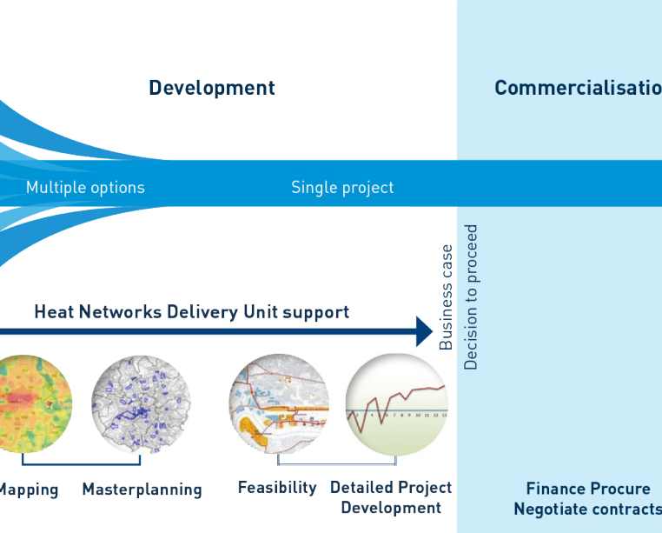
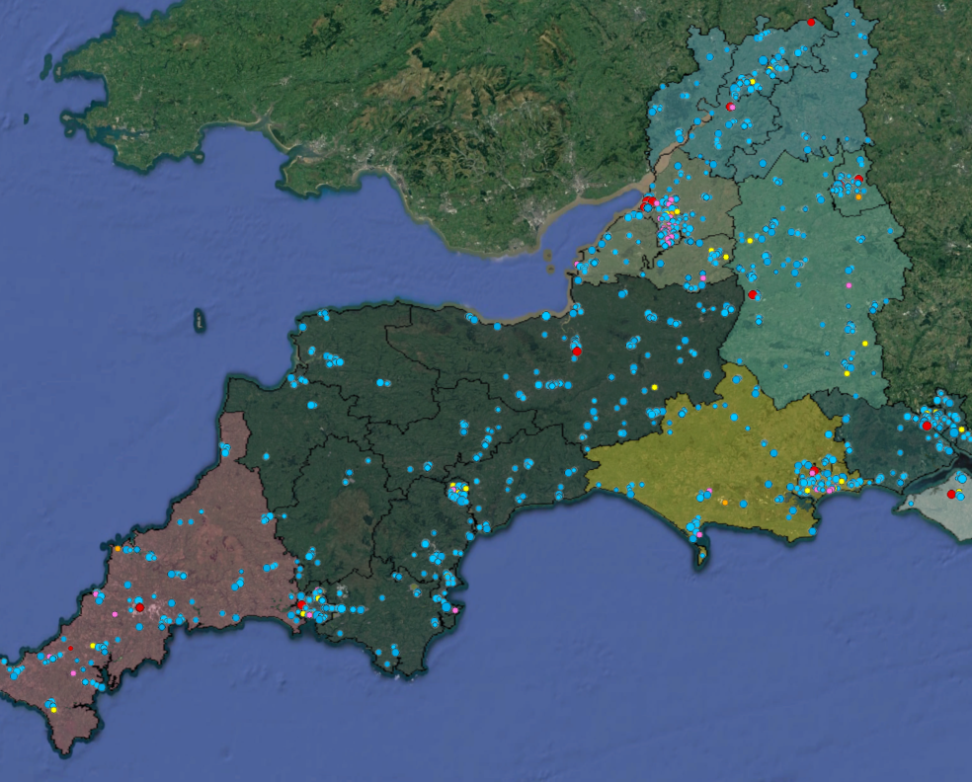
Masterplanning
Figure: HNDU

Slide 26
Feasibility
Recoverable Heat Project Development 21/05/2024
Technical
Commercial
Economic
Quantity/Grade/Medium of waste heat?
Who owns the site?
What is the length of contract?
Seasonality/reliability of heat source?
Cost to recover heat?

Slide 27
Stakeholder Mapping
Recoverable Heat Project Development 21/05/2024
Waste Heat Facility
Major Heat Users
EfW operators, Power stations
Refineries
Key anchor loads
Regulating Bodies
Local Authorities
Planning Authorities
Environment Agency
Existing relationships/flows of influence?

Slide 28
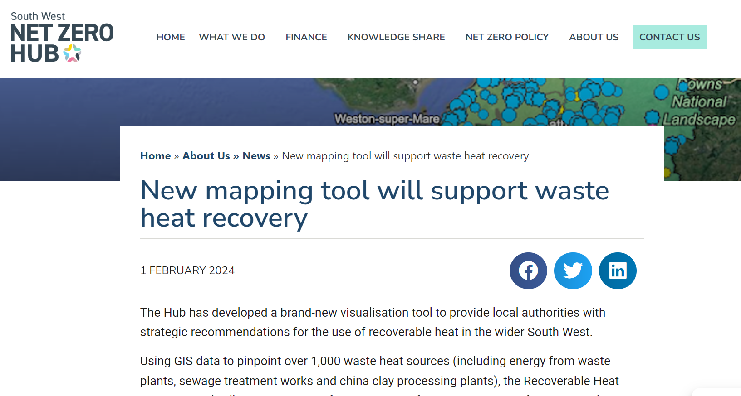
Takeaways
Many factors needed to make a Heat Network happen
Key is getting all parties to interact
Recoverable heat map alongside stakeholder engagement -> to plan & develop new projects
Mapping tool found on the SWHZH website
Contact Ricardo for further support:
Aisling.Crowley@ricardo.com
Seamus.Rooney@ricardo.com

Slide 29
Q&A Chair – Sam Moore

Slide 30
Break

Slide 31
A Local Authority example Jon Selman Net Zero Delivery Officer Plymouth City Council

Slide 32
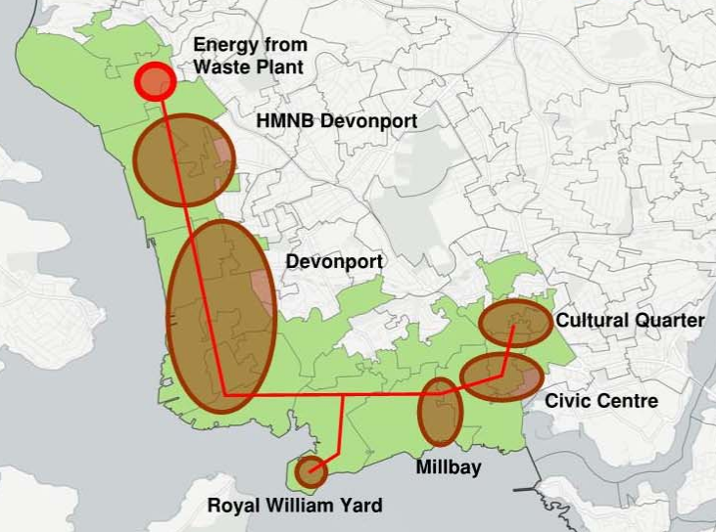
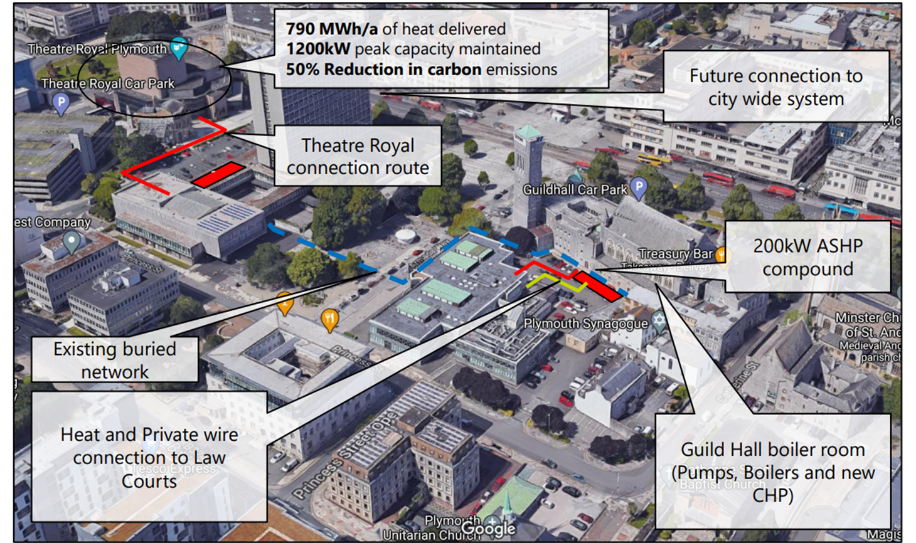
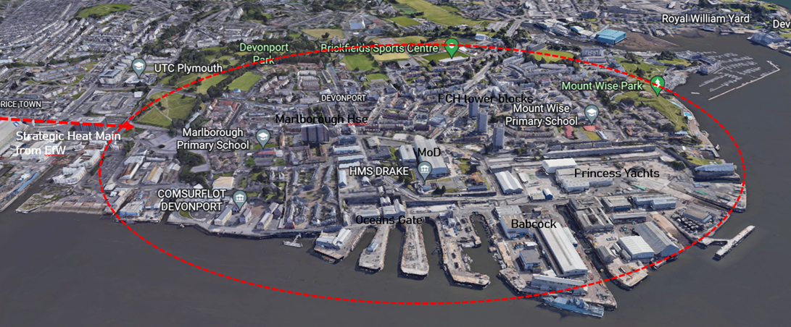
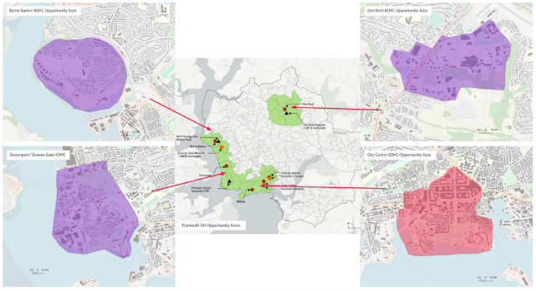
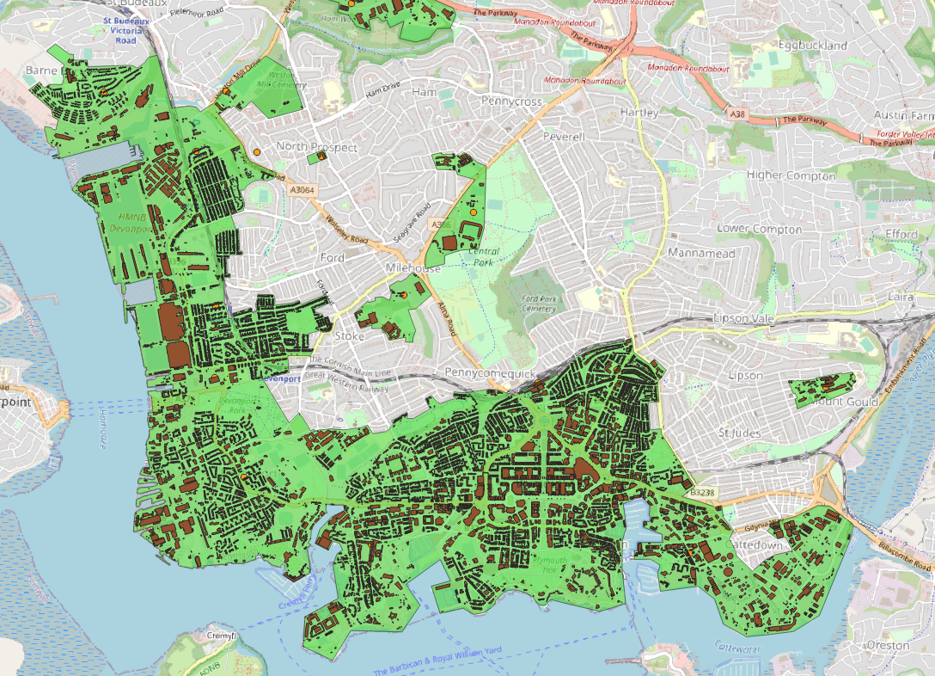
Plymouth Heat Network Journey
City Wide Energy Strategy
Heat network opportunity areas adopted into JLP
Strong policy for futureproofing
Civic Centre & Millbay
Phase 1 Civic (Salix) and Millbay (HeatNet) enabling works
Phase 2 Civic Business Case approval & GHNF application success
HNDU refresh/
Devonport Feasibility Study
LA vision of heat off take expansion
MoD site modernization
Oceangate developments
Procurement of partner Plymouth Heat JVC
Roll out of Heat Network scheme
Total Zone heat demand of ~340 GWh/a and ~150GWh/a of mandatable loads
2023- 2025
2025
2013
April 2019
2019- 2022
2019- 2024
2023
2017
2024
2025- 2050
ICE UK and WSP studies
Climate Emergency DeclarationD
Net Zero national targets
Local Targets
HeatNet and D2Grids EU projects
Millbay
Civic Centre
Geothermal wells
Waste Heat from cooling
Heat Network infrastructure
BEIS Heat Network Zoning Pilot and AZP
Plymouth one of 28 and 19 pilot cities
BEIS Gov: Heat Network Zoning Legislation
Legislation for mandating new developments to shared low-carbon energy infrastructure and Regulation of Heat

Slide 33
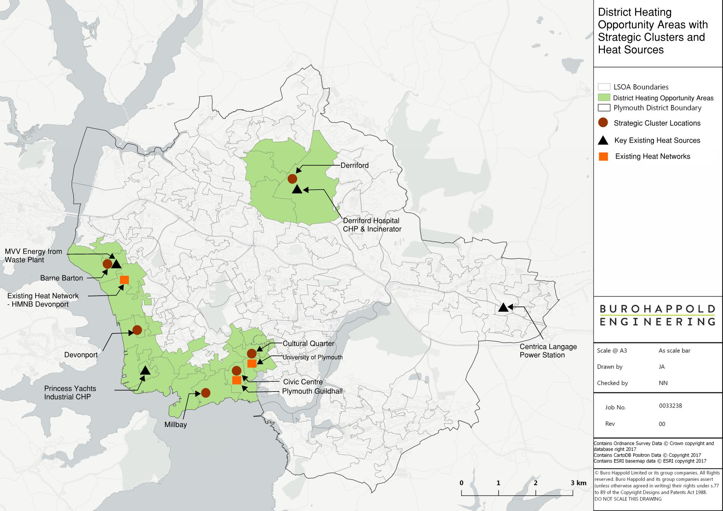
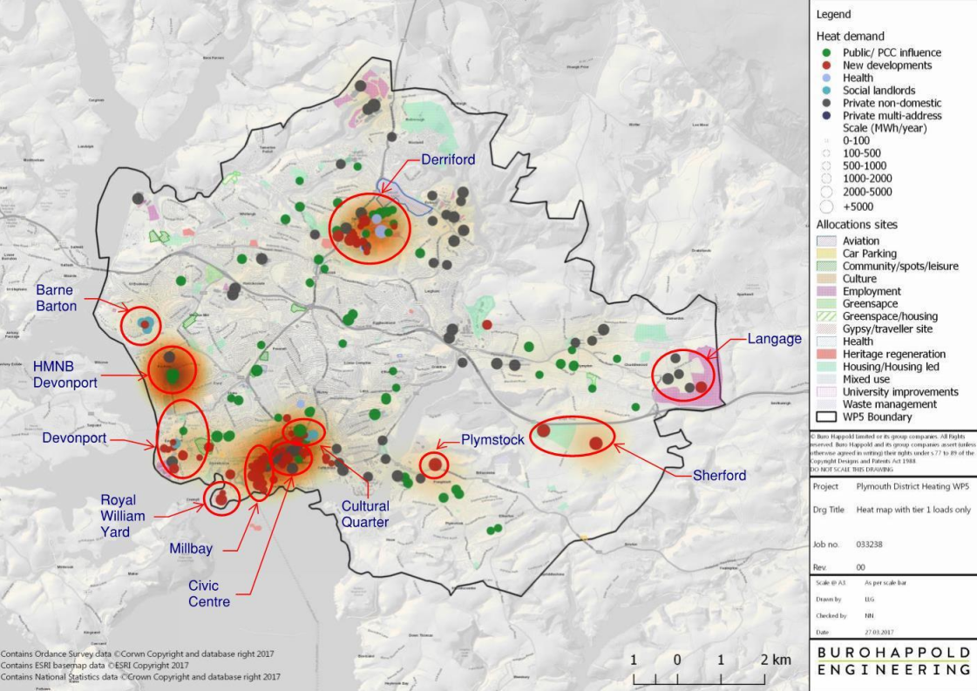
Plymouth & SW Devon Joint Local Plan
JLP District Energy Opportunity Areas
Joint Local Plan Policy
DEV 32.6 Developments will be required to connect to existing district energy networks in the locality or, where there is a future network planned, to be designed to be capable of connection to that network. Where appropriate, proportionate contributions will be sought to enable a network to be established or completed.

Slide 34
Existing connections- negotiated through planning

Slide 35
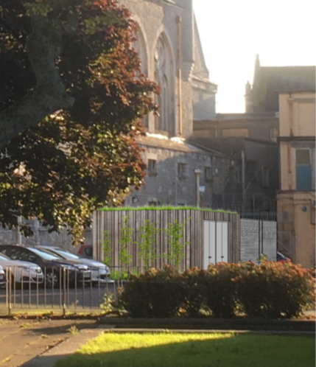
Civic District Energy Scheme
Expands PCC’s existing heat network to Civic, Theatre & Courts
Uses heat pumps
Theatre Royal and Combined Courts difficult to decarbonise individually
Carbon savings 161T/a
Civic Cluster

Slide 36
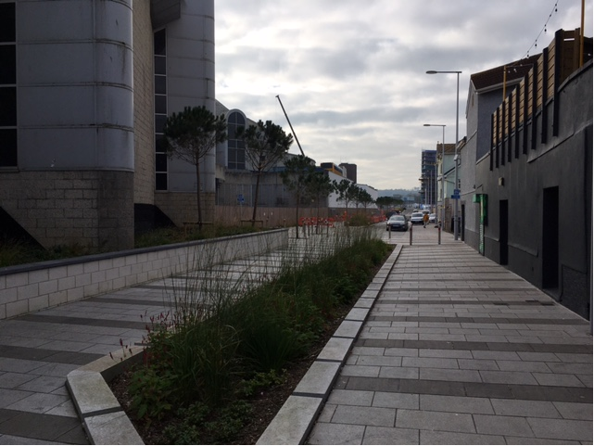
Millbay 5th Generation Heat Network
Resilient to climate change- provides cooling and heating
Rejected energy from cooling is recovered and shared, reducing primary energy and providing an energy exchange.
Low temperature approach, balanced by other renewable sources.
Flexible- plug and play (decentralised)

Slide 37
Energy Security Act- Heat Networks
Regulations
Heat Network Regulations (s.216 Energy Act)
Amendment or Repeal of Primary Legislation Regulator’s Duties Regulated Activities Designated Documents | Conditions of Heat Network Authorisations Conditions of Installation and Maintenance Licences Enforcement
Zones Regulations (s.222 Energy Act)
Designation of Heat Network Zones Authority Designation of Zone Coordinators | Designation of Zones Connection Requirement - Mandation Rules (including exemptions)

Slide 38
Plymouth Heat Network Zonal Opportunities
Proposals for Heat Network Zones
Existing JLP District Energy Opportunity Areas
Derriford area

Slide 39
Advanced Zoning Programme- ‘Southern Waterfront Zone’
Advanced Zoning Pilot
Scheme assessment
Full development of Southern Waterfront zone:
204 GWh/ yr heat demand
37 Km pipework
26,000 tCO2/ annum reduction
Key waste heat sources
Phasing approach

Slide 40
Derriford Potential Zonal approach
Partial development of Derriford zone:
30 GWh/ yr heating demand
16 GWh/ yr cooling demand
3 Km pipework
5,300 tCO2/ annum reduction

Slide 41
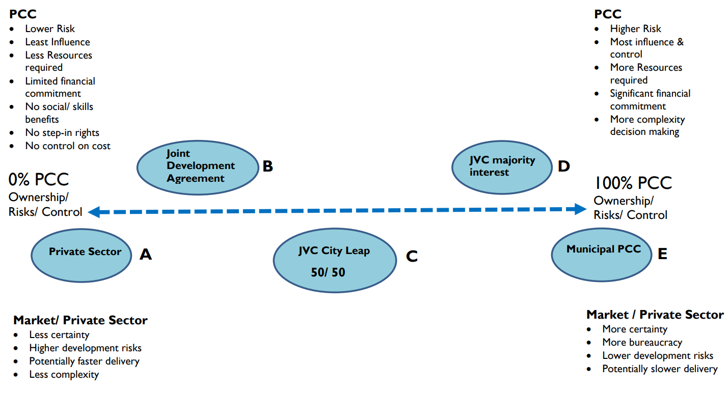
Delivery Approach- Balance of risk and reward
Scale of investment needed for zonal roll maybe prohibitive for many Local Authorities
Some LA involvement useful to maximise local benefits
New procurement approaches can be shorter to engage Development Partner
Supply chain constrained and needs to expand

Slide 42
A quick guide to geothermal, including the stakeholders involved in delivering the Eden Geothermal project Gus Grand Chief Executive Officer Eden Geothermal

Slide 43
Energy as secure as the rock beneath your feet
Gus Grand, ggrand@edengeothermal.com May 2024

Slide 44
Enough heat for a rainforest…
The Eden Geothermal Project: a £22.3m industrial research project, co-funded by the European Union through the European Regional Development Fund, Cornwall Council and GCP Infrastructure Investments Ltd.
We have drilled a deep geothermal well in granite to provide the Eden Project with geothermal heat for its Biomes, new plant nursery and other buildings. This is the first deep geothermal project to come online in the UK since Southampton in 1986.
Heat is being supplied at ~72 degrees, 10 l/s via a single-well heat exchanger (coaxial system – the deepest in the world) and 4km heat main which combine to form a heating network linking the geothermal well site with heat loads at the Eden Energy Centre (Biomes, offices) and Nursery.

Slide 45
Geothermal concept

Slide 46
About a third of constituencies have geothermal prospects, ~half Local Authorities, 100+NHS hospitals
Notes:
1/3 UK constituencies ~227/650 have geothermal resources beneath them. ~ 50% of Local Authorities

Slide 47
Geothermal provides baseload energy. Capacity <93 % if load management allows it.
It complements ground source heat projects and can improve COP.
Direct heat projects take the strain off the grid, and mean that less investment is needed into it. Can be undertaken without grid upgrades.
The heat can be cheap: $26/MWh levelized cost in France, average across Europe $39/MWh, and as secure as the ground beneath the institution. No geopolitics, no fuel supply issues.
It can be retrofitted in urban areas. Paris has over 55 projects, including Orly airport.
Skills and equipment to scale up fast are available in the O&G industry.
Low impact. The smallest surface foot print of any energy source. 93% lifetime emissions reduction on gas heating. Zero emissions/particulates in operation.

Slide 48
Why Cornwall,,why Eden Project?why Eden Project?

Slide 49
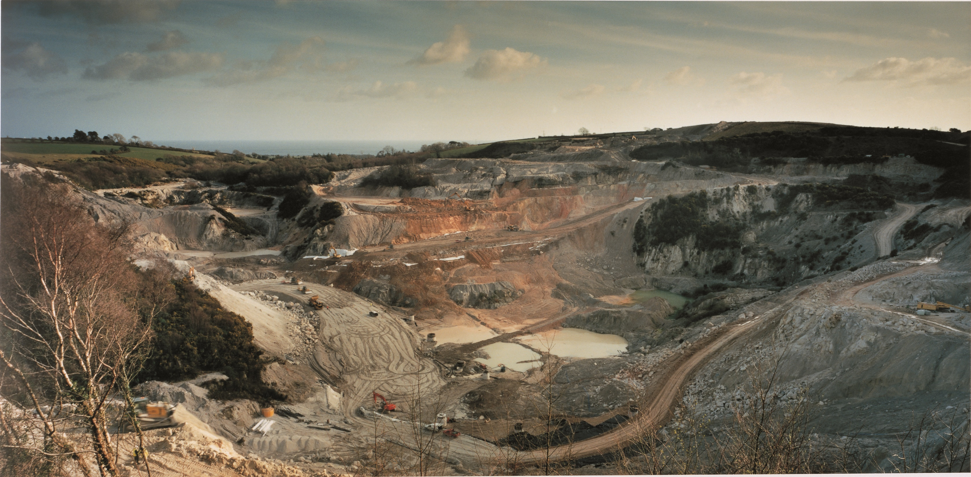
A place where the impossible doesn’t seem so…

Slide 50
Eden Project, environmental project, educational charity, visitor destination with c. 1m visitors/year prior to the pandemic. A place where anything can happen.

Slide 51
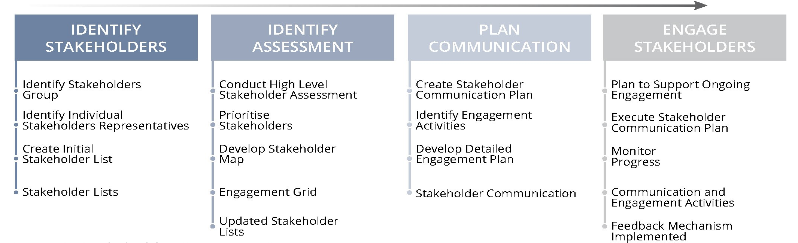
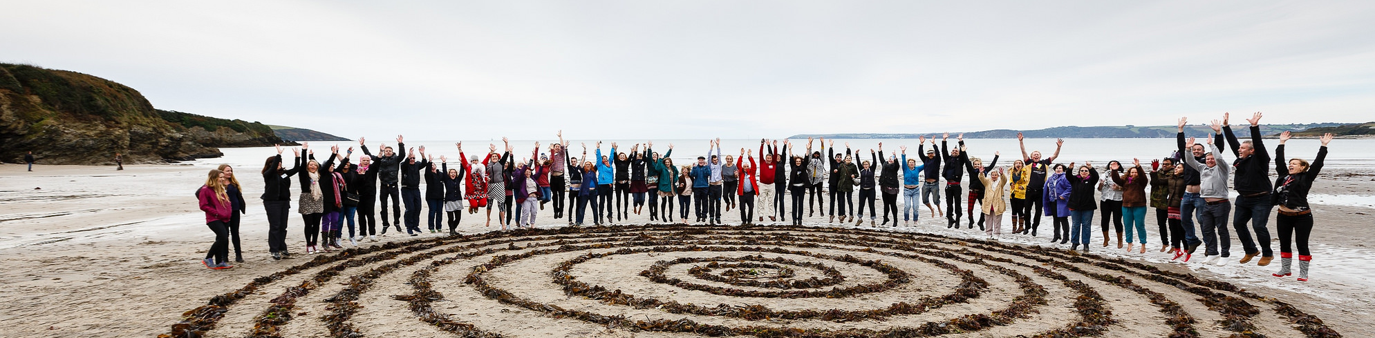
Stakeholders, Community Engagement & Outreach

Slide 52
Drilling at Eden Project: May to December 21
Notes:
Procurement:

Slide 53
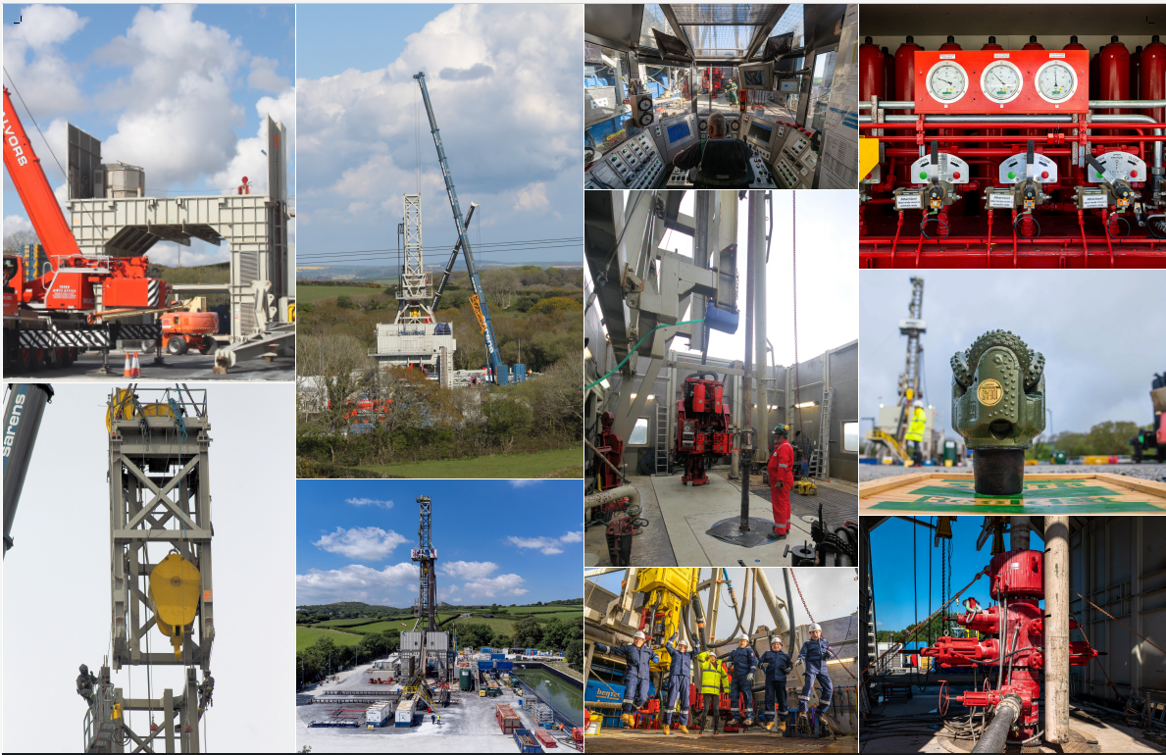

Slide 55
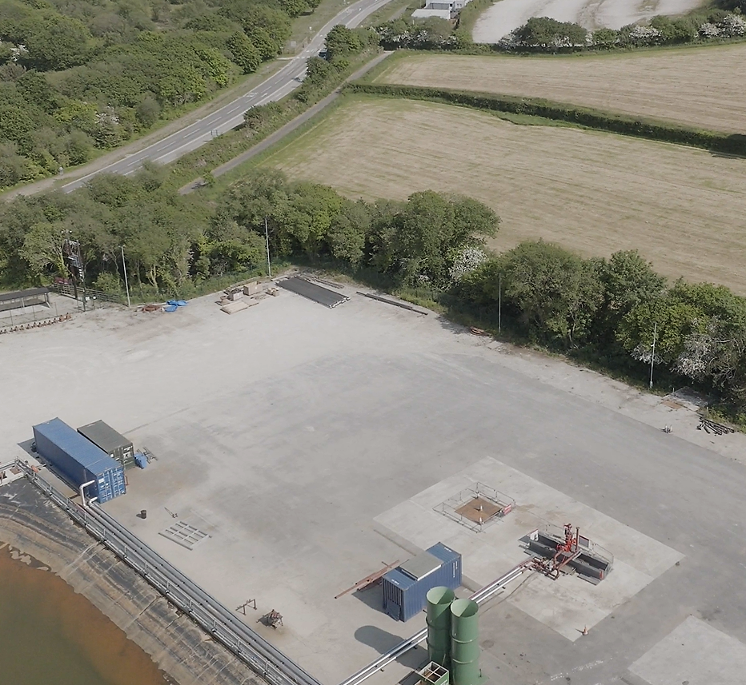
The smallest final surface footprint of any energy source…

Slide 56
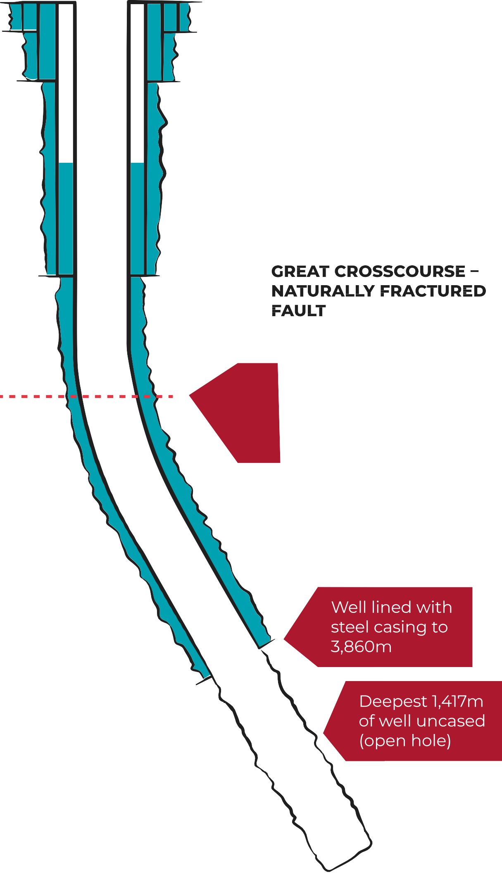
Coaxial concept: Eden Project for now. Grid offer December 2036 . Recent improvements in drilling costs mean case is improving.
0m
1,000m
2,000m
Well vertical to 1,700m then drilled directionally to intersect Great Crosscourse fault
3,000m
4,000m
4,871m

Slide 57
Q&A Chair – Sam Moore

Slide 58
Wrap up discussion Sam Moore

Slide 59
And finally...
Thank you for your time today
We will be making the recording of today available on our website and on the website of other Hubs to share learning on this topic
Next event 18 June : 5i Heat Network Project
Please do consider signing up to our newsletter (every two months): South West Net Zero Hub Newsletter
Email: sam.moore@WestOfEngland-CA.gov.uk

