Slide 1
South West Net Zero Hub
Able to Pay Retrofit Loan Fund

Slide 2
Introduction
Justin Olosunde
Hub Funding & Investment Manager
SW Net Zero Hub

Slide 3
Housekeeping
Today’s 2 hour session will be recorded for sharing
There will be a further 20 minutes at the end of questions
Q&A is allowed during speaker presentations in the chat function
Any unanswered questions please raise your virtual hand in the Q&A session at the end of all of the presentations and I will come to you in turn
All presentations will be shared with all attendees as a pack
Follow up support is available from the Net Zero hubs

Slide 4
Agenda
Able to Pay Retrofit: A South West Journey Stage One & Two – David Lewis
Able To Pay Finance – Stage Two - Strategic Business Case – David Lewis
Able To Pay Finance – Stage Two – Economic Case & Modelling approach - Ben Madden & Rob Honeyman
Able To Pay Finance – Stage Two - Commercial and Financial Case – Justin Olosunde
Able To Pay Finance – Stage Two - Management Case – Ben Madden
Primary Risks – Justin Olosunde
A Combined Authority Perspective - Kieran Highman
Next Steps – David Lewis

Slide 5
South West net Zero Hub
The South West Net Zero Hub provides impartial advice, technical support and funding to public and not-for-profit organisations, to develop projects that accelerate emission reductions and enable the transition to a more sustainable future.
Gov
(Dept for
Energy Security
& Net Zero)
Net Zero
Hubs
Local
Councils &
Public Sector
Third
& Private
Sectors

Slide 6
South West net Zero Hub
Government Net Zero Strategy established 5 regional hubs with core objectives:
Attract commercial investment and help LAs and other local public sector bodies to develop investment models which accelerate progress to net zero
Continue to increase the number, quality, and scale of local Net Zero projects being delivered across the region in line with national targets and strategies, including supporting the early-stage development and delivery of projects.
Collaborate with the Department of Energy Security & Net Zero to develop & support Net Zero elements to wider programmes & initiatives including Levelling Up
Support a national knowledge transfer programme to improve information sharing, training & evaluation
Raise local awareness of opportunities & benefits of local Net Zero investment

Slide 7
Able to Pay Retrofit: A South West Journey
David Lewis
Project Development Team - Senior Project Manager
SW Net Zero Hub

Slide 8
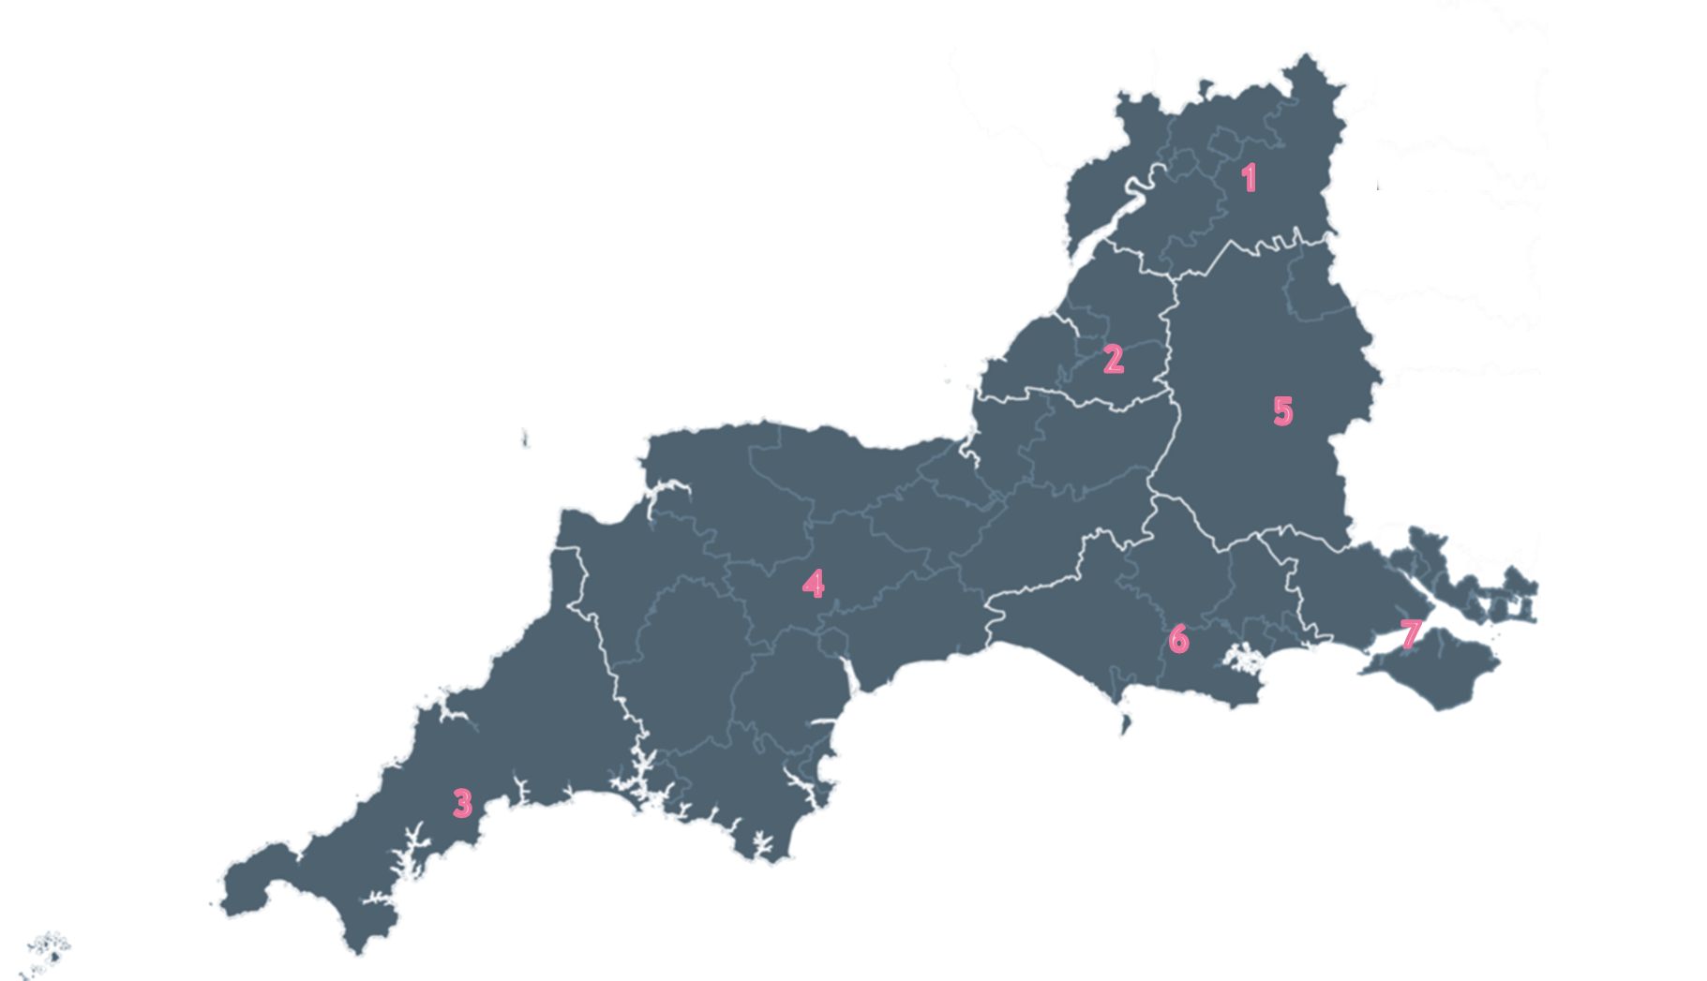
Able to Pay retrofit: A South West Journey
Carbon
Buildings remain the second biggest emitter of carbon on a national scale, accounting for 17% of 2022 carbon emissions
Scale of the issue
65% of homes in the UK are owner-occupied.
Learnings from the delivery of LAD II
Potential economic value
£17 billion

Slide 9
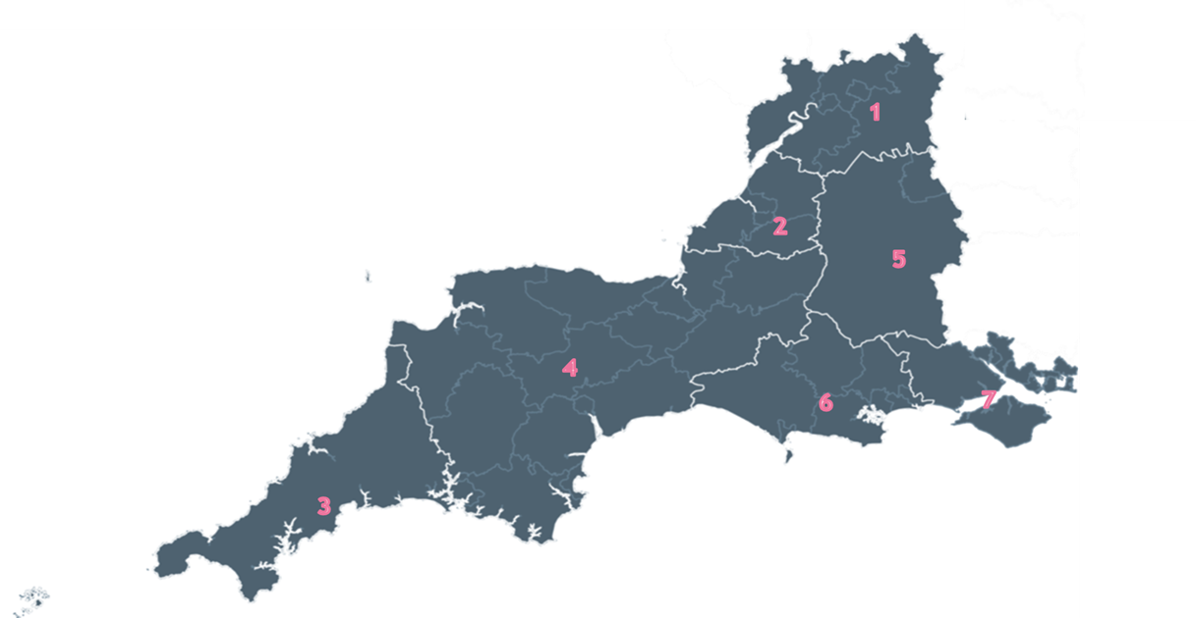

Able to Pay retrofit: A South West Journey
Retrofit Finance
Skills & Supply Chain
Archetypes

Slide 10
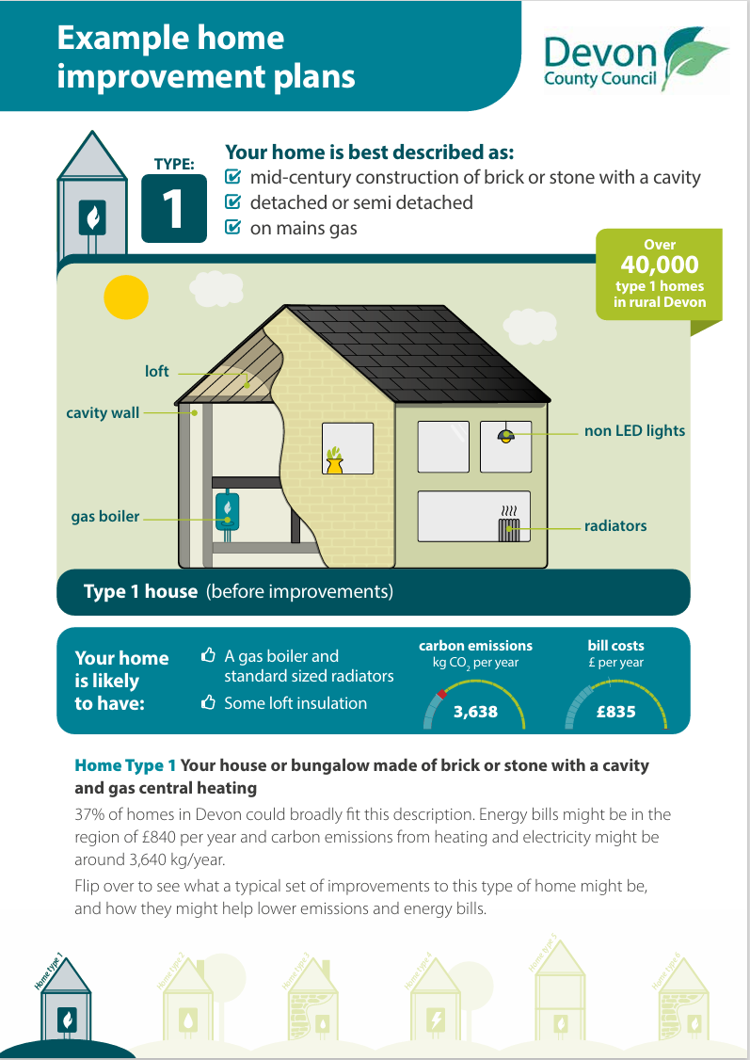


Devon Archetypes Project
93.7% of the homes in the rural areas of Devon that have EPCs are covered by the twelve Home Types, totalling about 104,000 properties.

Slide 11
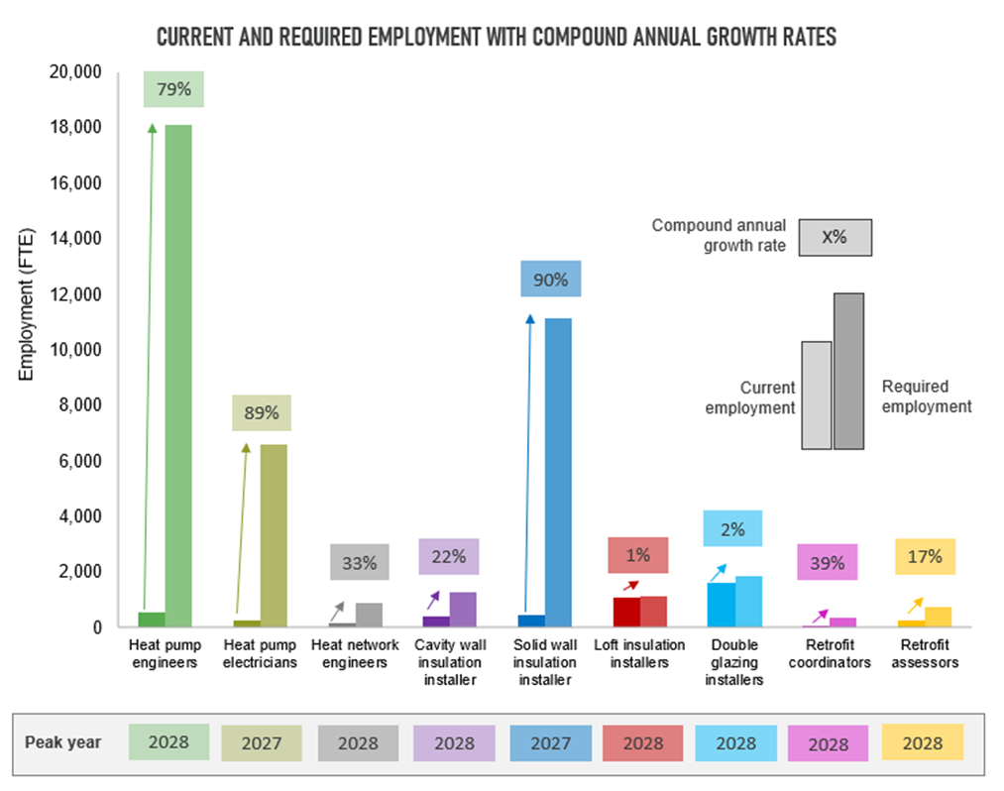
Skills and Supply Chain Development
To reach net zero by 2030 the South West must train:
Over 10,000 extra solid wall insulation installers by 2028
Over 17,500 extra heat pump engineers by 2027
To reach net zero by 2050 the South West must train:
Over 3,300 extra solid wall insulation installers by 2036
Over 8,700 extra heat pump engineers by 2040

Slide 12
Able To Pay Finance – Stage One

Slide 13

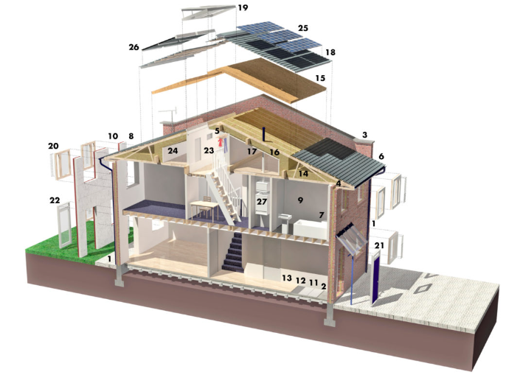


Able To Pay Finance – Stage One

Slide 14
Able To Pay Finance – Stage One
The proposed Fund would cover the geographic area of 21 Councils in the SW of England – Supporting Lendology
A modelled Value of £100m;
Be financed through a combination of public and private capital;
Operate on a loan fund basis for 10 years lending plus 5 years run off;
Lending secured through a title restriction placed on the property in question
Offer a low or even nil interest rate solution to the ATP market.
Static 10-year fund NOT revolving

Slide 15
Findings
VIA Analytics Limited leads a team including Daedalus Environmental Limited and Amberley Advisory
Loans are typically secured in some way, rarely interest free
In practice, it appears that loans will typically be in the £10k - £15k range, repaid over 10-15 years to maximise affordability (and assumed at an interest rate of c 4%)
£100m represents a small proportion of the identified opportunity – should be considered a pilot project but given the scale of overall opportunity (and assuming access to good market intelligence) there should be scope to focus attention on relatively ‘easy wins’
That subsidy requirement is estimated in the region of £45m over 10 years
The positive impact of carbon savings on society - estimated to be in the region of 450,000tCO2 over 10 years.
Direct energy cost savings to households - a total saving in household energy bills of around £70.0m (undiscounted) is estimated over 10 years.
The GVA of estimated employment impacts – associated with the jobs that would be created and / or sustained in the installation of retrofit measures financed by the Loan Fund. - £31Million
Initial cost benefit analysis suggests a (strong) cost benefit cost ratio (‘BCR’) of 2.4:1 associated with a public sector investment on that scale

Slide 16
Able To Pay Finance – Stage Two

Slide 17
Able To Pay Finance – Stage Two
Project Assumptions
Fund size: £100million+
Geographical area: SWNZH SW region
Blended fund Public/Private
Revolving not static fund - First 10 years revolving – yr. 11 year 20 is run off period investor distribution yr. 11 onwards.
The modelling and business case based only on homeowners
The study would model 3 scenarios BAU/Grant/blended fund
The fully functional model is capable of modelling all variables i.e. £100 million and £15million varying % of public and private funding
We recognised that we could not cover all scenarios with the budget available for example in-depth demand modelling
Increased and wider engagement – UKIB, GFI, DESNEZ & West of England Combined Authority
Special note should be made of the current Retrofit Accelerator Programme in the West of England Combined Authority, although other programmes may also exist in the region.
Green Book compliant: The establishment of this proposed fund would require significant support from local and national government. To that end all the following sections and related outputs and overall business case of this report should be based on Green Book terms and methodologies.

Slide 18
Expected Project outcomes
The overall viability and validity of the fund as a possible financial solution to stimulate and support households who wish to retrofit their homes as an alternative to current market options, i.e., mortgage providers.
Fully unencumbered (no hidden code etc) financial model (s) with accessible interface to be delivered in Excel format.
To provide full Green Book business case and full financial modelling of the proposed fund and associated parameters of lending etc.
To detail sufficient evidence to allow engagement with local and national government and private sector to establish such a fund either at regional or national scale.

Slide 19





Procurement
Gemserv/Thermly/Amberside/Lux Nova/ Brown Jacobson
Gemserv – overall project lead
Thermly - Project Lead on Financial Modelling/Market Analysis
Amberside - Investment Advisors
Lux Nova - Legal Project Lead/ Energy Efficiency and Clean Energy Programme Design Specialist
Brown Jacobson - FSMA and Consumer Credit/ Financial Services and Regulatory

Slide 20
The West of England Combined Authority (CA)
Direct support and engagement with CA
Shared project team
Future application of report findings and model with Retrofit West Initiative regarding finance project elements in 24/25
Separate legal report for CA (not publicly available)

Slide 21
Able To Pay Finance – Strategic Case

Slide 22
Green Book Business Case
Strategic
Economic
Commercial
Financial
Management

Slide 23
Strategic Business Case
Strategic –
    Strategic overview of the SW Region,
    Govt Policy and Programmes,
    Incentives and barriers to uptake of retrofit,
    Establishing strategic objectives and outcomes for the overall study,
    Retrofit challenges in the South West,
    Available current funding programmes for retrofit support,
    Defining the target audience for the fund,
    Permitted technologies,
    Minimum loan levels and affordability,
    Strategic outputs of fund mobilisation (economic and social)

Slide 24
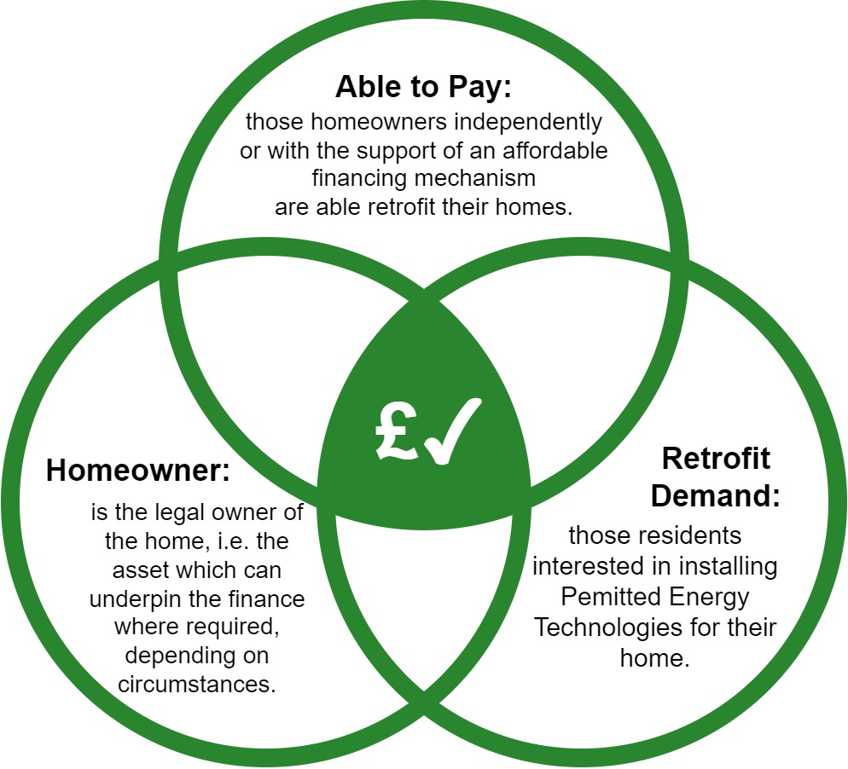
Strategic Business Case
This pilot is an able to pay focused exercise designed in principle to support that portion of the population who contribute the most to residential emissions. It is not fuel poverty, or near fuel poverty, focused.
TENURE:
Owner occupiers only for the purposes of the pilot
MEASURES:
Where required a title restriction can be imposed but no second charges on property
Must include at least one Primary Measure with any number of Secondary measures then permitted. Cost of repairs needed to facilitate measures can also be included in loan amount.
PAS2030/2035 driven for complex combinations of measures, with RC required, but with flexibility for simpler measures (e.g. PV and battery). All renewables must be MCS certified
Minimum value of measures £7.5k, loan intended to sit alongside Boiler Upgrade Scheme to cover residual balance where required

Slide 25
Strategic Business Case
Primary Measures
At least one primary measure is assumed included within the household technology mix:
Solar PV
Domestic energy storage / batteries (where PV is a measure)
Air source heat pumps
Ground source heat pumps
Solid wall insulation (both external and internal)
Solar thermal panel systems
Hard to treat cavity wall Insulation (an EWI type solution is assumed for modelling purposes)
Flat roof insulation – where this is the majority of the roof space
Secondary Measures
The value of Secondary Measures is typically lower than Primary Measures, they are unlikely to need finance when installed individually, and even if financed the cost of administering the loan is likely to be disproportionately high. For this reason Secondary Measures are included in the mix only where at least one Primary Measure is included.
Cavity wall insulation
Party wall insulation
Standard loft insulation (at joist)
Energy efficient fixed lighting
Heating system controls / Home Energy Management Systems
Room in roof Insulation
Tank insulation
Draughtproofing
Double/triple glazing

Slide 26
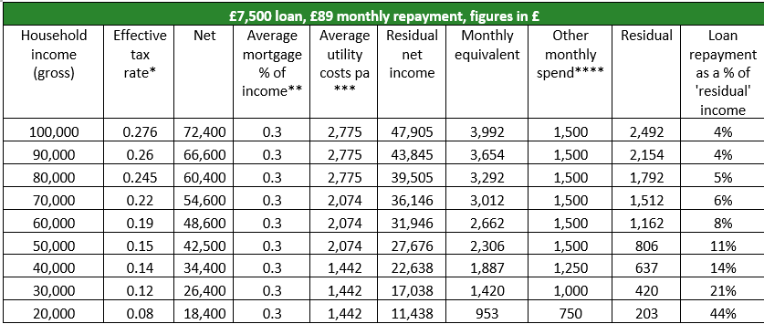

Strategic Business Case
AFFORDABILITY:
Household income > £40k
Underpinned by high level affordability analysis – i.e. repayments are affordable 10-year term for average loan size
  Estimated as <15% residual income calculated after deductions for average mortgage, utilities costs, and other spends.

Slide 27
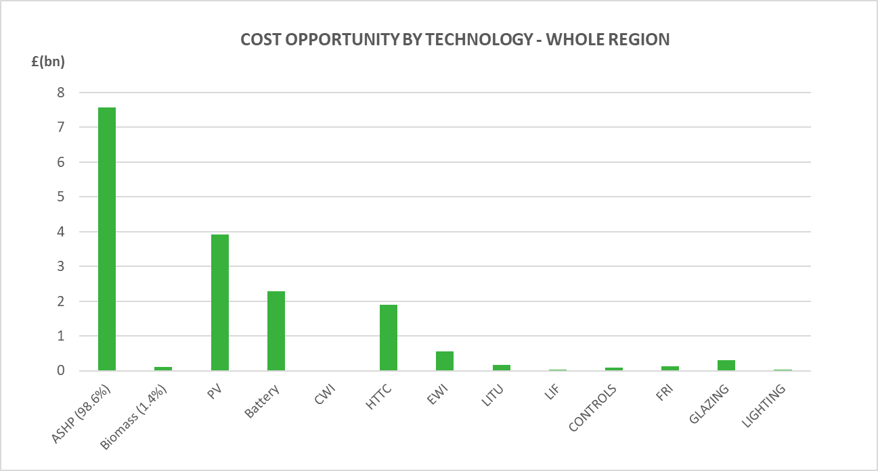
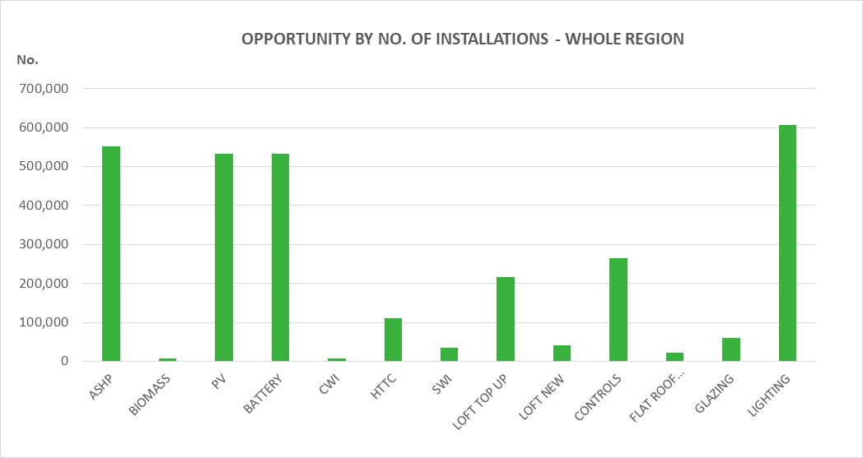
Strategic Business Case
    The total opportunity for investment in retrofit across the 37 authority areas is estimated to be around £17.1bn. There is clearly ample scope for an Able to Pay Loan Fund within the target region. A fund value of £100m will be a first step in supporting the residential sector to become net zero.
A significant proportion of the fund could be spent in the transition to clean heat – for which we have currently assumed heat pumps will make up most of that transition. The decarbonisation of heat – which should be undertaken with sensible energy efficiency measures – therefore offers the largest opportunity for the fund

Slide 28
Able To Pay Finance – Stage Two
Economic Case & Modelling approach
Ben Madden & Rob Honeyman
Senior Consultant & Head of Analysis
Gemserv

Slide 29
Economic Business Case
Strategic
Economic
    Investigates the economic rationale for Government intervention in encouraging finance solutions and domestic retrofit and compares investment scenarios compared to a Business-as-Usual scenario. This section will also evaluate
    3 x scenarios BAU, grant funding and blended finance
    Quantifying carbon savings, SNPV
    Scheme design and management options. Fund structure analysis based on strategic objectives
Commercial
Financial
Management

Slide 30











Methodology
Archetypes
Scenario 0
Constructing 5 archetypes based on Census and National Energy Efficiency Data Framework
Extrapolating current trends in energy efficiency and low carbon measure deployment, utilising MCS, Boiler Upgrade Scheme and ECO data.
Capital cost
Heating Systems
Cost of energy supply
Based on the Gemserv heating system model, using CCC and Government values and cost assumptions
Option 1
We assessed the potential economic implications of a Boiler Upgrade Scheme-like public grant scheme.
Admin cost
Power Systems
Combining electricity demand profiles with solar PV generation, import and export
Carbon cost
Building fabric
Option 2
Drawing in public and private fund, Option 2, an able-to-pay loan scheme would reach more households.
Air quality
Reduction in energy demand of the building – therefore fuel bill savings. Measure viability assessed.
Inputs
Techno-economic modelling
Scenarios
Results

Slide 31

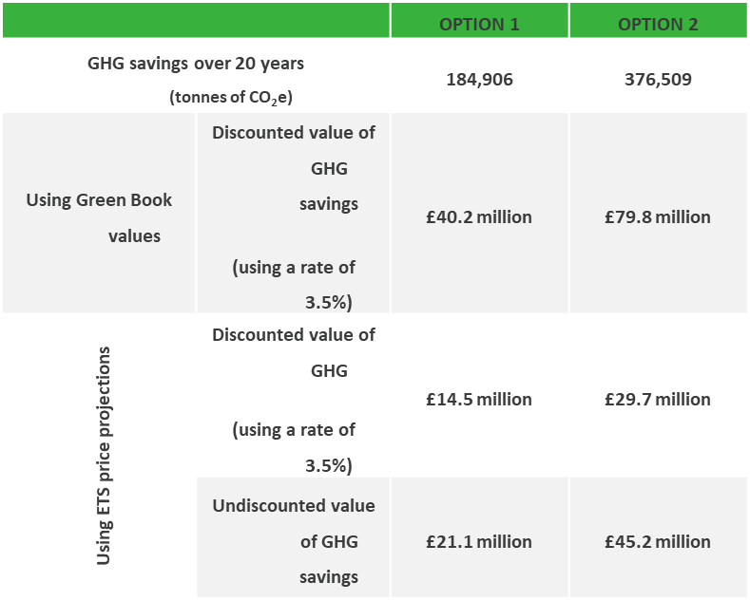
Economic – monetised benefits
    Social costs and benefits of the two interventions relative to no government intervention (Business As Usual Scenario).
Social Net Present value compared to the Business As Usual Scenario
MILLION £, 2022 | Option 1 Public grant | option 2 blended fund
Capital Costs | -68.1 | -139.2
Avoided Cost of Energy Supply | 162.4 | 260.80
Value of GHG Emission Savings | 40.2 | 79.8
Value of Air Quality Improvements | 6.7 | 10.6
Total SNPV | 142.2 | 212.0
Scenario | Option 0 BAU | option 1 Public grant | Option 2 blended fund
subsidy (undiscounted) | £0 | £34,000,000 | £34,000,000
subsidy (discounted) | £0 | £31,765,794 | £27,145,290
ghg emission savings | 0 tonnes of CO₂e | 184,906 tonnes of CO₂e | 376,509 tonnes of CO₂e
carbon effectiveness of subsidy (kgCO₂e / £ subsidy) | N/A | 5.8 | 13.9

Slide 32
Economic case
Also supported by:
Risk and sensitivity analysis
  Increasing and decreasing carbon value assumptions
  Increasing and decreasing the long run variable cost of energy supply for gas
  Assuming that only oil heated households take up support
  Assuming an additionality rate of 70%
Non-monetised benefits including:
  Consumer familiarity and perceptions – Increased installation levels in the South West could lead to increased awareness of low carbon and energy efficiency measures. Increased familiarity and positive perception of these technologies could trigger further deployments in the ATP market;
  Energy security and resilience benefits – reduced energy demand as a result of government intervention may improve security of supply and the energy system’s resilience to supply and demand shocks;
  Learning and economies of scale – With increasing deployment rates and increasing employment effects, learning and productivity gains could translate into cost down over time;
  Health benefits – Warmer homes may have significant health benefits that can translate to decreasing absenteeism and decreasing costs for the NHS;
  Fuel poverty – Fuel poverty relates to households that spend a high proportion of their income on home heating. Government intervention may help households living in fuel poverty by reducing energy bills.

Slide 33
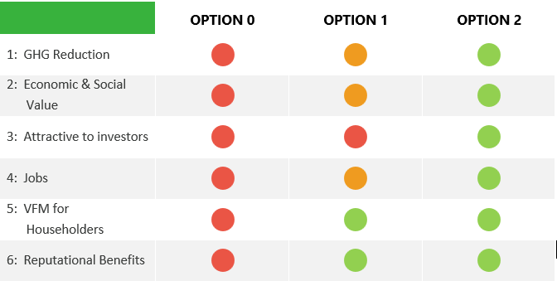
Economic

Slide 34
Able To Pay Finance – Stage Two
Commercial and Financial Case
Justin Olosunde
Hub Funding & Investment Manager
SW Net Zero Hub

Slide 35
Commercial Business Case
Strategic
Economic
Commercial
    Commercial viability of the fund
    Legal Structure
    Fund management
    Private sector investment
    FSA & Consumer Credit Act
    Procurement Fund Management/Consumer Credit
Financial
Management

Slide 36
Commercial Case
Supported by legal advice, provided by Lux Nova and Browne Jacobson
Covers:
  Commercial Viability
  Procurement Approach
  Payment and Charging Mechanism

Slide 37
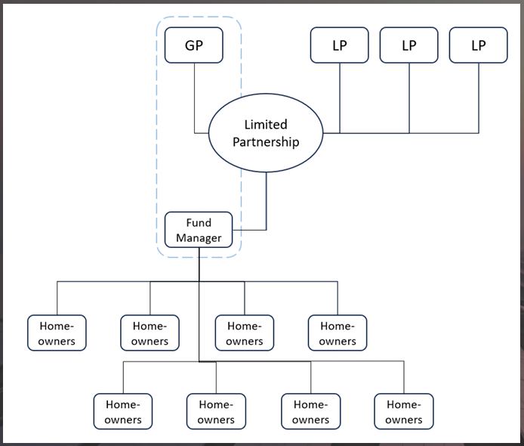
Commercial
Limited partnership structure

Slide 38
Commercial Headlines
Limited Partnership Structure: to proceed, there are several factors to be answered and understood:
  The role (if any) of each of the Combined Authority, SWNZH and DESNZ within the Limited Partnership;
  Whether the Combined Authority, SWNZH, DESNZ and/or other stakeholders will be investors into the fund;
  The requirements of the investors (both public and private);
  Whether and how monies, including interest, will be recycled back into the scheme (this is partly discussed within the Financial Case)
Necessary to procure Fund Manager and Consumer Credit Lending separately due to different FCA accreditations required
  Fund Manager first, then Consumer Credit lender with Fund Manager input in procurement process
Payment and Charging:
  Fund Manager: Fixed annual fee, incorporating Service Levels/KPIs etc
  Consumer Credit Lender receives administration fee for set-up of consumer loans, plus monthly loan management fee

Slide 39
Financial Business Case
Strategic
Economic
Commercial
Financial
    Segregated but linked inputs and workings schedules feeding into financial outputs;
    Core financial outputs (profit and loss and cash flow projections) automated and generated on an annual and detailed monthly basis, together with underlying funding schedules illustrating investor cash flow profiles;
    Financial outputs generated in respect of both the ATP Fund and the Fund Manager, given the proposed Limited Partnership structure;
    Modelling over a timeframe of up to 25 years, allowing for both an active lending period and a loan book run off period;
    Explicit integration of the strategic case and market review findings, in the form of a direct read across to the retrofit measures;
    Flexibility around funding structure - in particular, enabling the model to illustrate revolving fund principles and alternative scenarios in relation to the cash flow waterfall, or hierarchy where investor funds are drawn down and subsequently the returns generated back into the Fund are distributed to investors;
    Enabling sensitivity analysis to be carried out on a number of key input assumptions (for instance, loan default rates or pricing of loans to borrowers); and
    Transparent build offering unencumbered access to financial model workings, with no hidden code or macros.
Management

Slide 40
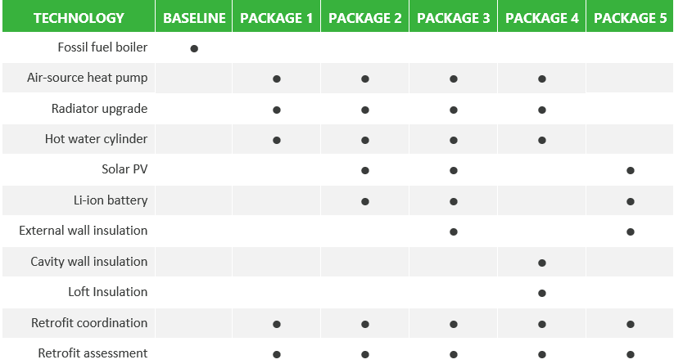
Financial
For the purposes of developing a detailed financial model, we have developed a number of typical packages to use as baseline loan values:

Slide 41
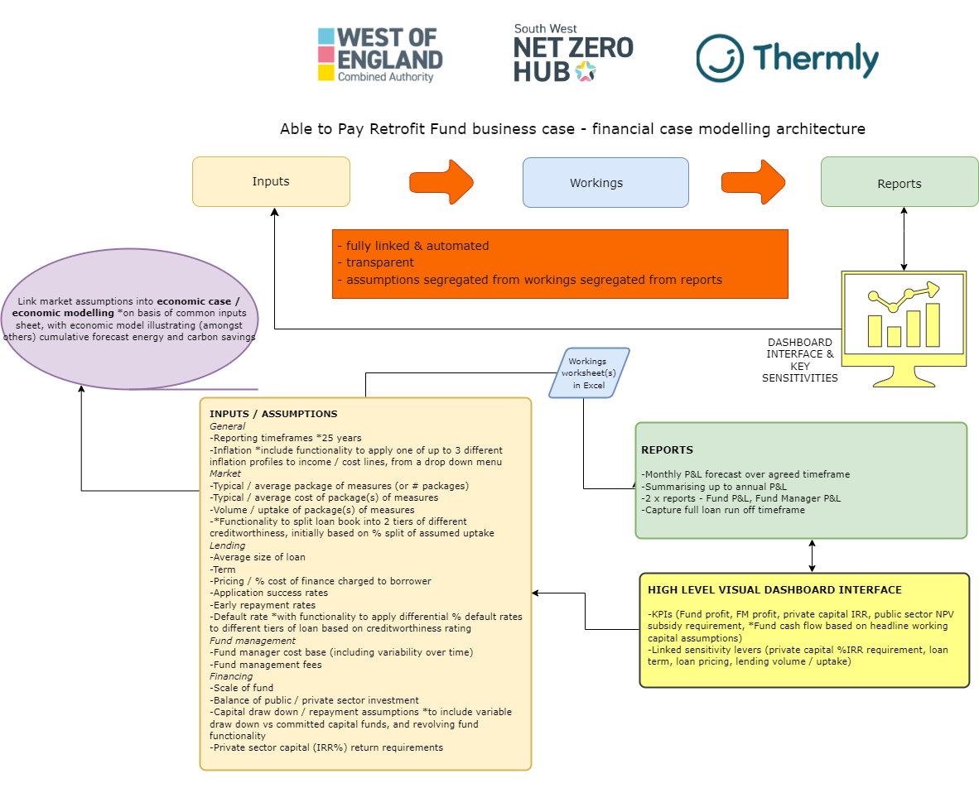
Financial Model design

Slide 42
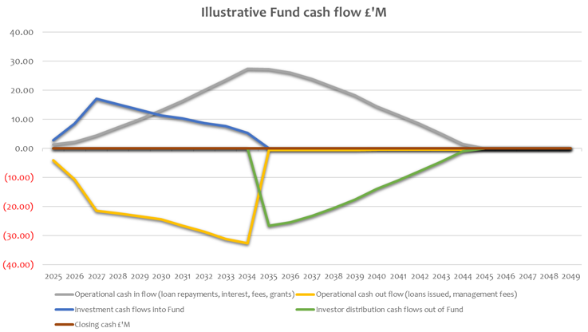
Illustrative Cash Flows
Financial Implications – cash flow forecasts: this diagram shows the following:
a 10-year period of loans being actively issued (yellow line)
investment cash flows (blue line) to fund the loans
loan and interest payments over time, utilising the revolving fund principles (grey line)
investor returns are distributed (green line).

Slide 43
Financial returns
Financial Implications – Funding:
The financial model produces a pre-tax profit of just under £52m, inclusive of an assumed £10m income from public sector grants. This reflects an assumed level of subsidy to meet (but not exceed) the estimated private sector target return on capital (IRR%) of 8%.
On this basis, the forecast returns on investment in the ATP Fund are as follows:
Private capital - £60m funding investment, £31.2m net return, 7.9% IRR
Public capital - £40m funding investment, £20.7m net return, 3.2% IRR
Public sector funding totals £74m, incorporating £40m public investment in the ATP Fund, plus an estimated £34m grant to support FM operations and underpin Fund profitability. Using the total forecast returns for the public investment of c £61m, then the value for the public sector subsidy reduces to c £13m
All prices October 23 in line with the Published Business Case term market rates now Circa 1% lower

Slide 44
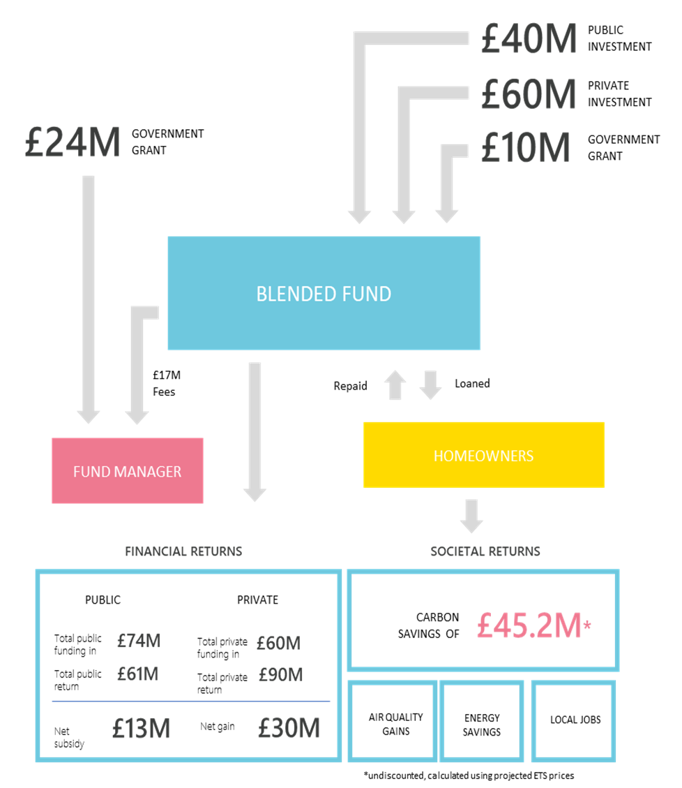
Headlines
    ~3%IRR for the public sector,
    ~8%IRR for the private sector,
    ~6% interest on the loan.
    ~£13 Million Net subsidy is UNDISCOUNTED
    NOT all of the investment is required at fund setup, given the 20-year life-cycle of the fund. This net public sector subsidy, through enabling wider investment, is calculated to save 376,000 tonnes of CO2e savings over the lifetime of the fund, as well as other non-monetised benefits.

Slide 45
Able To Pay Finance – Stage Two
Management Case
Ben Madden
Senior Consultant
Gemserv

Slide 46
Green Book Business Case
Strategic
Economic
Commercial
Financial
Management
    The Management Case assesses whether a proposal can be successfully delivered by the organisation and its partners. It sets-out the arrangements for delivery, monitoring and evaluation of the scheme, specifically elements such as: project planning, governance structure, risk management, communications and stakeholder management, benefits realisation and assurance

Slide 47
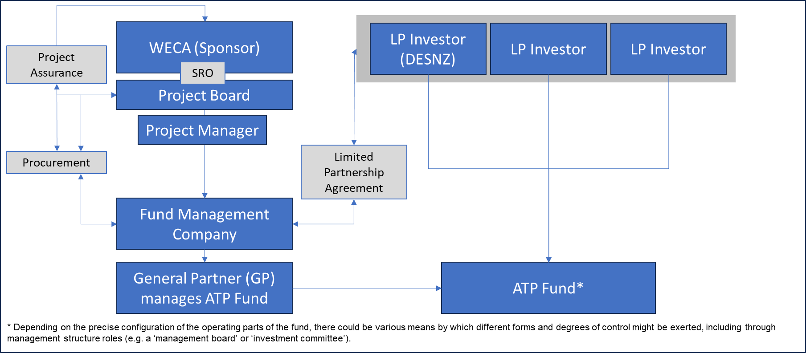
Management Case

Slide 48
Management Case
Also Requires:
Next Steps for MC
Finalise the sponsor position for the project;
Finalise the SRO position and the membership of the Project Board;
Finalise the work package for the Project Management;
Agree upon whether a benefits manager / benefits working group is required;
Agree upon the assurance framework for the project (Independent / In-House);
Agree upon where the funding is being derived from and ensure that any funders' requirements are built into the governance structure and built into the contractual arrangements of the Fund and its partners;
Develop Contingency Arrangements and Plan is the preferred proposal is not taken forward;
The above should be presented within a governance framework (project structure, reporting lines, roles and responsibilities), together with named individuals, any vacancies and plans for any future changes;
Specialist advisors: define specific work packages and expected deliverables, for example Procurement, Legal and specialist support in respect of FCA requirements and permissions;
Governance arrangements: Relationship between the Fund Manager and Lender, etc.
Specialist advisors to support Project Board, providing Commercial, Legal, Procurement expertise
Change Management Strategy
Independent Assurance
Risk Management

Slide 49
Able To Pay Finance – Stage Two
Risks
Justin Olosunde
Hub Funding & Investment Manager
SW Net Zero Hub

Slide 50
Identified Primary Risks
    This business case presents several areas of risk to the establishment of a loan fund and discusses mitigation in detail. While intricacies are discussed later on, these risks can be broadly assigned to the following categories:
Consumer interest: no loan fund can be established without suitable consumer interest and appetite resulting in uptake.
Attracting suitable public sector investment and attracting suitable private sector investment:
  The financial viability of the loan fund requires both investment and grant funding to function as intended.
  This blended fund delivers greater scale and achieves benefits that would otherwise be out of reach from the public sector funds alone. The overall benefits assessed in the economic case cannot be achieved or demonstrated without attracting suitable levels of funding from both sectors.
Appointment of suitable organisations to operate the Scheme: overall scheme management will likely comprise a party with a full suite of fund management permissions (Fund Manager), and a party with consumer credit permissions (Consumer Credit Lender). Effective procurement and management of these roles will be key for the continued success of the loan fund.
Supply chain capability and installation quality: while this fund is intended to bolster the supply chain, the overall capacity within the region remains a risk to successful operation of the fund (especially earlier on in its life cycle).
Term Interest rate risk mitigation : Drawdown of capital must be linked to timely deployment of loans and in instances where there is a mismatch term interest rate exposure must be dynamically hedged by the fund manager.

Slide 51
A Combined Authority Perspective
Kieran Highman
Senior Environment Manager
West of England Combined Authority

Slide 52


Combined Authority perspective on homeowner retrofit loan fund
30 April 2023
Kieran Highman, Senior Environment Manager

Slide 53


United on tackling emergencies
- July 2019
- May 2020
Bath & NE Somerset
- Feb 2019
- Jul 2020
Bristol
- Nov 2018
- Feb 2020
N Somerset
- Feb 2019
- Nov 2020
South Glos
- Jul 2019
- Dec 2020

Slide 54
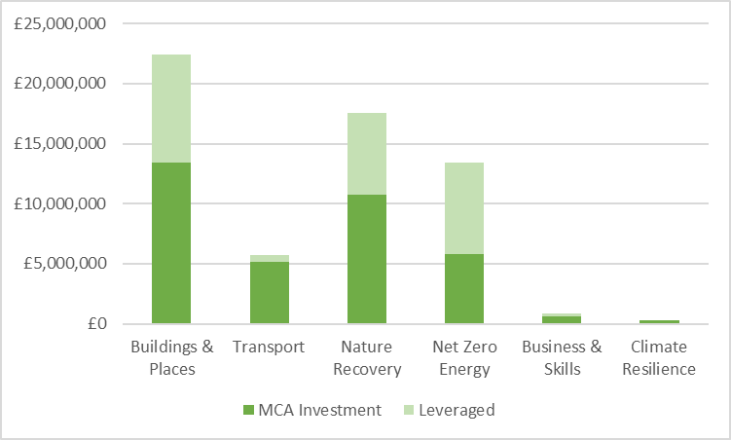
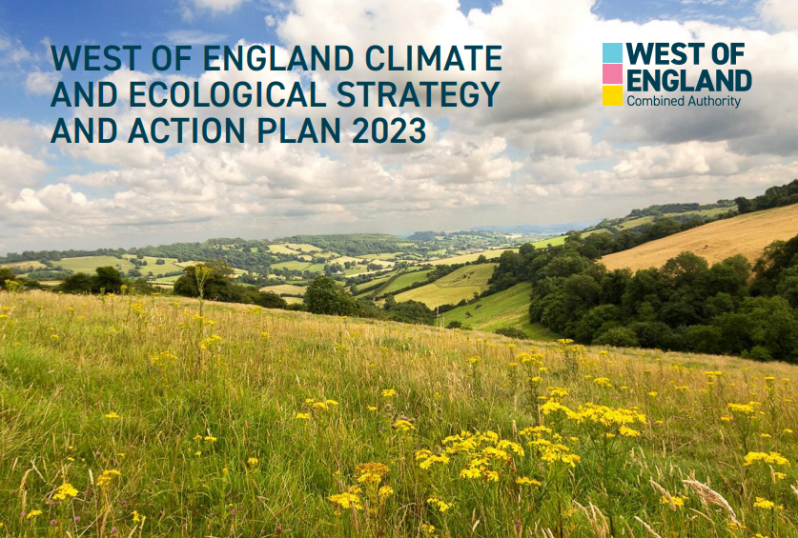
Climate Strategy
GRF Earmarked & Allocated (Oct ‘23)
Ambition for net zero and nature to be in recovery by 2030
Presents our strategy, regional challenges and actions
Comprises 6 themes, reflecting CA work areas and declarations
Take a data-led approach; not letting lack of certainty as grounds for inaction
Facilitating a Just Transition
Notes:
Further info: www.westofengland-ca.gov.uk/what-we-do/environment/climate-ecological-strategy/
Breakdown: https://westofengland-ca.moderngov.co.uk/documents/s7318/03.%20CESAP%20Oct%2023%20Progress%20Update%20CA%20Committee%20Report%20DRAFT.pdf

Slide 55
West of England Emissions
Electricity = 24%
Heating = 14%
Roads = 32% (1/3 is freight)
  Shipping, rail & aviation = 9%
  Farming & other business = 10%
  Waste & f-gasses = 10%
Notes:
CESAP provides more basic split:
42% Transport
31% Domestic
27% Organisations

Slide 56
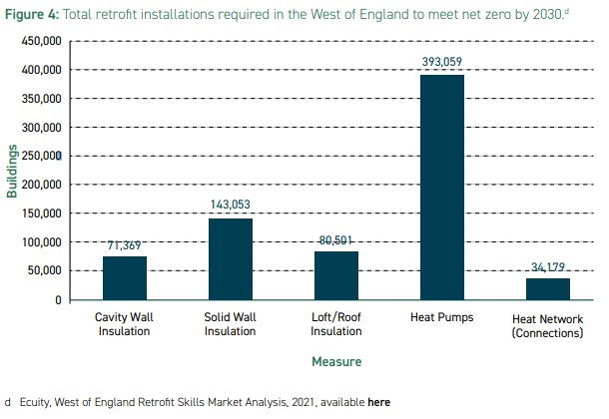
West of England Picture
c390k houses in MCA (485k wider)
Majority (250k) homes need retrofitting w/ insulation
73% to have a heat pump, 20% to be on a heat network
Current rates of c1,100 home retrofits per annum
Households spend c£800m on energy
Retrofit could deliver £522m GDP growth, requiring c£5bn capital
15% (c35k homeowners) could benefit from retrofit finance

Slide 57
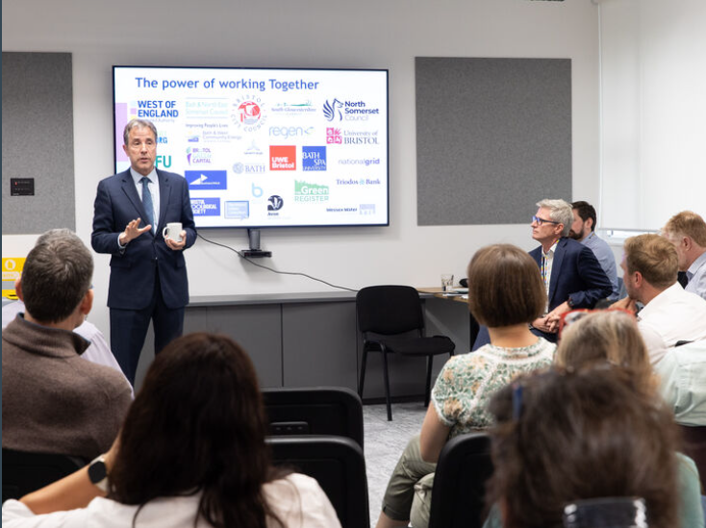

Retrofit across the region
Complimentary retrofit projects
Signposting between support
Coordination: Retrofit Strategic Steering Group
Details: https://www.westofengland-ca.gov.uk/what-we-do/environment/retrofit-sustainable-buildings-and-places/retrofit-projects-across-the-west-of-england/

Slide 58
Retrofit West Scheme
– one stop shop approach
Advice
Homeowners & private landlords
Customer journey support
Business Support
Micro & Small businesses
Building confidence in low carbon solutions
Finance
Homeowners
Low cost loans
Skills
Retrofit pathways into existing provision
Residents
£3m
£2m
£0.4m
£1.6m
CA Investment from the Green Recovery Fund

Slide 59

Retrofit West Advice
Provides advice and guidance to homeowners & landlords
Currently focused on households that can afford retrofit & interested in sustainability
Needs financial offers to expand to other parts of the population
Free, impartial advice
Discounted home assessment surveys
Quality assurance services
Funded by the Mayoral Combined Authority
Delivered by Retrofit West Community Interest Company (set up by the Centre for Sustainable Energy)

Slide 60

Retrofit West Business Support
Support for micro & small businesses e.g. repairs, maintenance & improvements
Building their confidence to be able to offer low carbon solutions such as solid wall insulation, heatpumps, solar PV etc.
Awareness raising
Networking
Informal training
Funded by the Mayoral Combined Authority
Delivered by Retrofit West Community Interest Company with consortium partners

Slide 61

Retrofit Skills
Building retrofit pathways into existing skills provision, including:
Skills Connect – interactive site
Future Bright – careers coaching
Adult Education Budget – foundation skills
Careers Hub – careers education for schools & colleges
Green Skills Bootcamps – funded courses to help career changes
Funded and delivered by the Mayoral Combined Authority

Slide 62


Retrofit West Finance
March ‘23 Committee approved £1.6m of Investment Fund into GRF
Aim to ensure all can access retrofit
Pilot load fund targeting residents not qualifying for grants and without savings
Potential use of grant to leverage in capital (c£5m as minimum UKIB ‘ticket size’)
£6m loan fund could perhaps retrofit 300 homes (at £20k per home)

Slide 63
Retrofit Loan Fund Process Plan
Partnership?
£100m loan fund or £1.6m pilot loan fund?
Find Public Partner/es:
UK IB, M10 DESNZ,SWNZH, Gov, Cas, LAs,
Public Contribution?
£100M?
Yes
No
F&D
Retrofit Accelerator Phase 3 – Retrofit Loan Fund development as per March'23 Committee
No
Yes
Secure commitment from partners: Development, roles, responsibilities…
e.g. MoU
Business Case
WoE Loan Development
Who? Set up cost? Structure?
Yes
£1.6M
Enough?
Project Public contribution:
Total Gross Public Investment £74m*
Total Public Return £60.71m
Public Subsidy (net) £13.29m
*£74m=Gross investment £40M+£24M Grant Fund Manager+£10M Grant Fund Profitability
Yes
Develop
Legal Terms?
No
Approval?
Committee
Develop
Legal Terms
Develop Scheme + F&D
Who?
Set up cost?
Private Partners? Structure?
Delivery!
Approved!

Slide 64

Next Steps
Work with UK Infrastructure Bank (UKIB) advisory support service to interrogate and plan next steps from SW Hub work
Engage other public bodies to understand appetite for public funding
Present options to senior officers, Scrutiny and Committee on how to retrofit at scale
Establish and pilot home retrofit loans together with other complimentary evidence & delivery

Slide 65

Contact us
westofengland-ca.gov.uk
Kieran.Highman or Environment@WestOfEngland-CA.gov.uk
07385 378 513
WestofEnglandCA
West-of-England-Combined-Authority

Slide 66
Next steps -SWNZH
David Lewis
Project Development Team - Senior Project Manager
SW Net Zero Hub

Slide 67
Next steps - SWNZH
Engagement with potential investors from both the Public and Private Sector continues.
  including source of funding and intentions for repayment
  attractiveness for investors, including whether the fund will be circular, the exact repayment requirements for each limited partner and shaping the overall downstream nature of the fund.
  development of the management arrangements for this fund
SWNZH undertakes consumer engagement within the target region, establishing interest for the loan fund and undertaking significant advocacy/promotion work to drive interest
  Fund is reliant upon consumer uptake to demonstrate the financial viability of the fund.
  https://www.gov.uk/government/publications/green-home-finance-expert-analysis-from-a-behavioural-perspective
  possibilities for early repayment and other fund mechanics
SWNZH must continue its work improving regional skills and supply chain availability as set out in previous reports, to support and realise this opportunity.

Slide 68
Q&A
Chair – Justin Olosunde

Slide 69
And finally...
Thank you for your time today
We will be making the recording of today available on our website and on the website of other Hubs to share learning on this topic
Please do consider signing up to our newsletter (every two months): South West Net Zero Hub Newsletter
Emails:
SWNZH
    David.Lewis@WestOfEngland-CA.gov.uk
    justin.olosunde@westofengland-ca.gov.uk
    GEMSERV
    Ben.Madden@gemserv.com (Head of Analytics)
    Robert.Honeyman@gemserv.com (Senior Consultant)
https://www.swnetzerohub.org.uk/knowledge/information-guides-and-toolkits/
https://www.lendology.org.uk/
Retrofit projects across the West of England - West of England Combined Authority (westofengland-ca.gov.uk)

