Slide 1
Smart local area energy planning Session Chair Janine Michael Deputy Chief Executive, Centre for Sustainable Energy

Slide 2
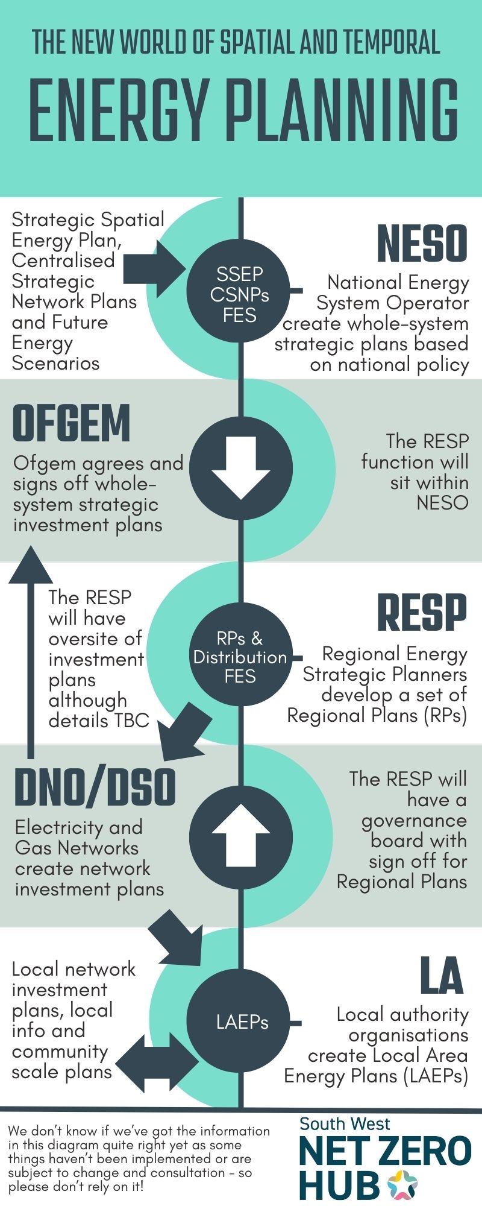
Intro to the session Janine Michael

Slide 3
Keith Hempshall Director of Local & Community Empowerment Centre for Sustainable Energy

Slide 4
Decarbonisation Pathways and Local Area Energy Planning
Keith Hempshall (Director, Local and Community Empowerment)
Centre for Sustainable Energy
25th April 2024

Slide 5
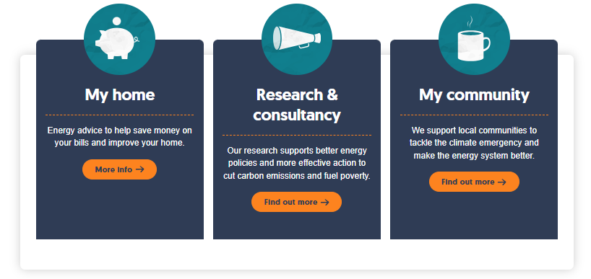
About CSE
We help people change the way they think and act on energy.

Slide 6
Net Zero Hub questions:
Can most of a Local Area Energy Plan (LAEP) be completed for a relatively small proportion of the cost?
If the technical modelling part is expensive, is it better to focus on the partnerships and models required for project delivery?

Slide 7
Why LAEP?
Requirements for energy system decarbonisation:
Collaboration
Foresight
Address interdependencies
Local perspective
Coordination of action

Slide 8
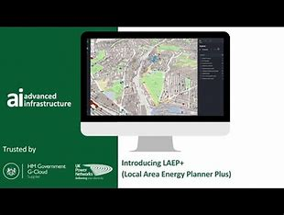
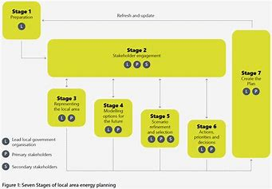
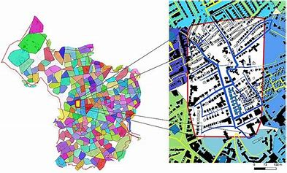
What is LAEP?
Common elements:
Understanding and representing the current local energy system
Modelling options for the future
Review and refinement of potential scenarios
Prioritisation, decision-making and strategic planning making
KEY: Underpinned by a robust stakeholder identification and engagement process

Slide 9
Key benefits
Bring into focus the scale of the challenge and opportunity
Provide a credible & evidence-based pathway
Improve alignment and coordination
Reveal the capabilities, people and steps required – and those missing
Provide confidence and credibility to investors and supply chain
Inform national government, regulators and energy networks – support required
Crucially, they are based on whole-system analysis – more complete picture
Notes:
Bring into focus the scale of the challenge and opportunity
Provide a credible & evidence-based pathway
Improve alignment and coordination
Reveal the capabilities, people and steps required – and those missing
Provide confidence and credibility to investors and supply chain
Inform National government, regulators and energy networks – support required.
Crucially, they are based on whole-system analysis – more complete picture.

Slide 10
Challenges to-date
Limited funding and support to local authorities to develop LAEPS
Largely consultancy-led
Most outputs static and one-off, rather than dynamic
Limited ownership and accessibility
Integration with (statutory) spatial and transport planning (unclear)
Patchy and evolving landscape (range of options, RESP, DNO support and engagement )

Slide 11
Question 1
Things to consider:
Prioritisation
Data
Resolution
Collaboration
Timeframes
Consistency
Completeness
Can most of a Local Area Energy Plan (LAEP) be completed for a relatively small proportion of the cost?

Slide 12
Question 2
Things to consider:
What is required for success in the longer term.
What support and collaboration might be required.
Levels of support and the quality of the existing evidence-base.
If the technical modelling part is expensive, is it better to focus on the partnerships and models required for project delivery?

Slide 13
Staying in touch with CSE
Thank You
Web: www.cse.org.uk
Email: Keith.hempshall@cse.org.uk
Subscribe to E-news www.cse.uk/newsletter
Follow us on Linkedin or on Twitter/X @HelloCSE

Slide 14
Mark Holmes Carbon Neutral Cornwall Manager Cornwall Council

Slide 15
A Place Based Energy System For Cornwall and the Isles of Scilly

Slide 16
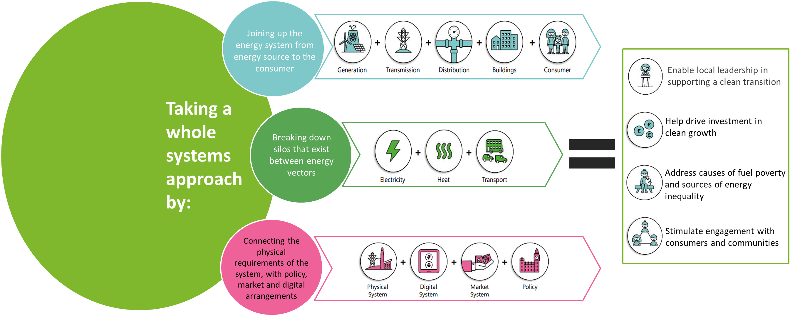
What is a Local Area Energy Plan

Slide 17
THE CIOS Local Area Energy Plan will provide solutions that will:
Define a clear low carbon pathways – Informing local plans
Providing evidence to the private and public sectors to inform major decisions on heat and the future of both gas and electricity distribution
Improved Coordination and targeting of investment in housing retrofit and energy projects / infrastructure
Establish new approaches to energy planning and market capability
Minimise Cost of delivering on Net Zero commitments through a coordinated whole system approach
Devolved responsibility to local areas and support the clean transition alongside other local planning issues

Slide 18
Programme Organisation
Client
Project Lead
Project Team
Public Engagement specialists in infrastructure, the built environment and the energy sector.
Provision of independent assurance of LAEP modelling.
Programme Manager (0.2)
Project / Contract Manager (1)
Policy Lead (0.5)
Intelligence Lead (0.5)
Engagement Lead (0.5)
Admin support (0.5)
Isles of Scilly Lead (0.5)
Specialising in business and sectoral engagement to maximise innovation, investment and local capacity-building

Slide 19
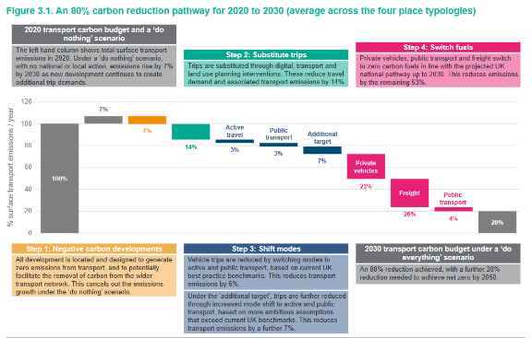
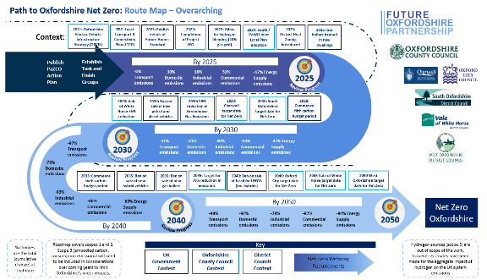
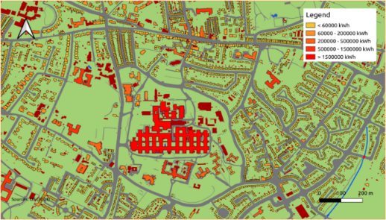
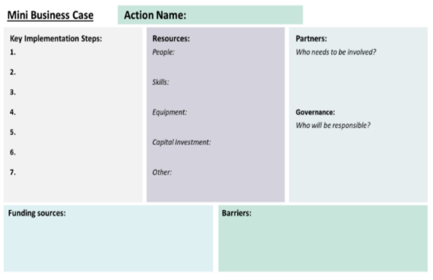
Decarbonisation pathway - Example
Expected CIOS LAEP Products
Net Zero Pathway & Route Map
CIOS Carbon Budget
On Page Delivery Plan - Example
CIOS Delivery Plan on a Page
Geospatial Map of LAEP Interventions
CIOS LAEP Mapping Layer within CC Interactive Mapping Service
Geospatial Mapping - Example
Near-Term Long-Term Components
Established list of Priority Projects and Supporting Implementation Plan
Minimum 10 x Worked Mini Business Cases
Mini Business Case – Template
Investment Strategies and Finance Engagement
Governance & Enabling Conditions

Slide 20
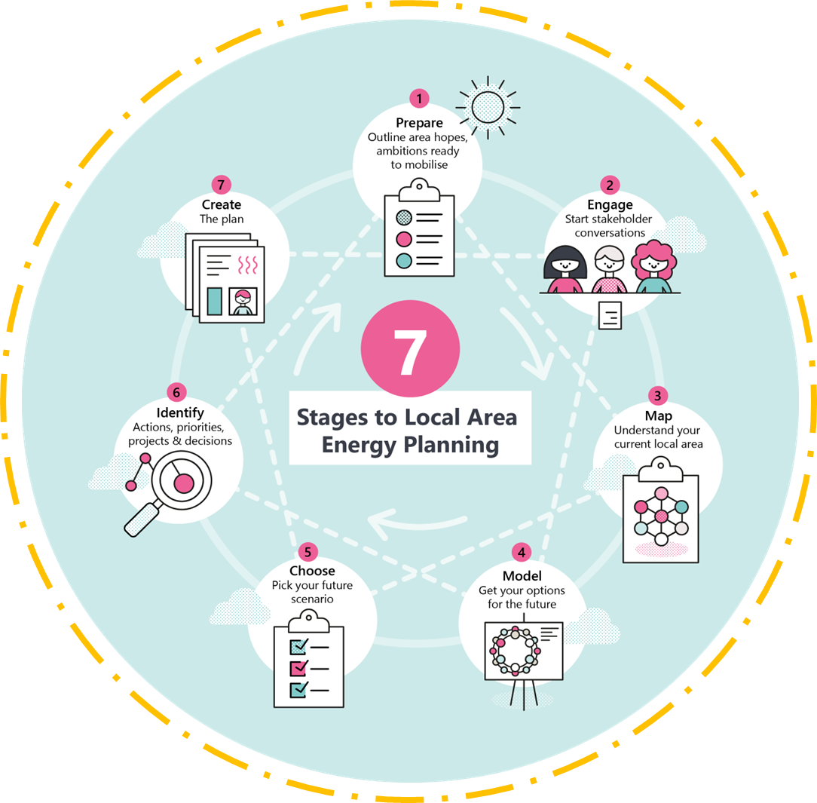
The stages of a LAEP

Slide 21
Developing an LAEP
Stage 1
Preparation
Refresh and Update (Circa 5 Years)
Stage 2
Stakeholder Engagement
(Cross Cutting Theme)
Stage 7
Create the Plan
Stage 3
Representing the Local Area
Stage 4
Modelling Options for the Future
Stage 5
Scenario Refinement and Selection
Stage 6
Actions, Priorities and Decisions

Slide 22
Category | Sources of Emissions | Inclusion
Generation | Traditional Electricity | P
 | Low Carbon Electricity | P
 | Geothermal Heat | P
Storage | Electrical | P
 | Thermal | P
 | Hydrogen | P
Industry | Electricity | P
 | Gas | P
 | Other Fuels | P
 | Large Installations | P
 | Agriculture | P
Commercial | Electricity | P
 | Gas | P
 | Other Fuels | P
Public Sector | Gas | P
 | Electricity | P
 | Other Fuels | P
Domestic | Electricity | P
 | Gas | P
 | Other Fuels | P
Road & Rail Transport | ‘A’ Roads | P
 | Minor Roads | P
 | Main Rail line | P
 | Branch Rail lines | P
 | Other | P
CIOS LAEP Agreed Scope of Emissions
The LAEP Provides the Opportunity
to Establish a Whole Systems Approach by:
Additional areas in CIOS LAEP
Forest land/cropland will be considered in the context of the trade-off with other land-uses such as generation
Maritime including shipping between IoS and mainland)
Domestic aviation between the Isles of Scilly and the mainland
Energy from waste

Slide 23
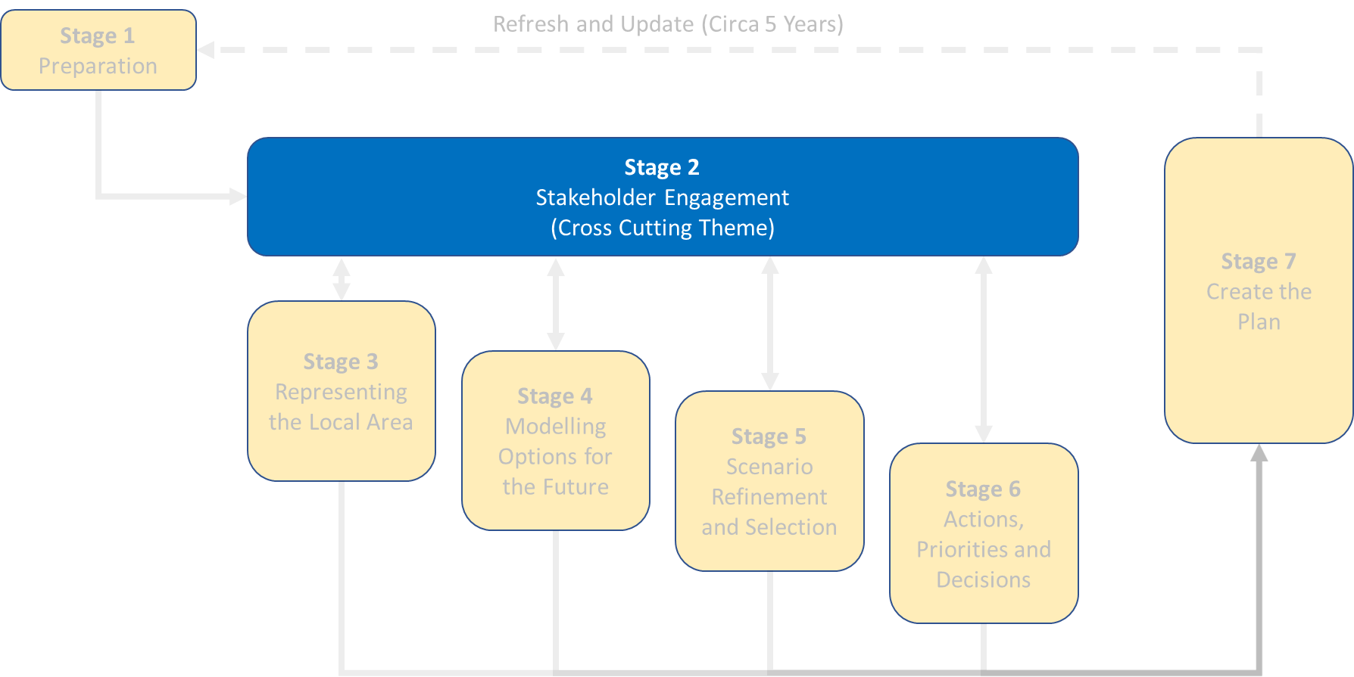
Progress to date
Trail-blazing a novel approach to co-production within energy system planning
Primary Stakeholders
Key sectoral actors
Cornwall and IoS Members
Organisations and businesses
Residents
The Local Area Energy Plan Public Survey (3,762 responses)
Insight Interviews with energy sector actors
Six Roadshow events across Cornwall and IoS
Sector Engagement
Public Call for Evidence
Residents' Energy Panel
Supporting promotion and public engagement campaign

Slide 24
Insights from Resident Engagement to date
Resident Energy Survey
84% of respondents are concerned (24% fairly and 60% very) about climate change
87% of respondents are supportive (67% strongly and 20% supportive) of the use of renewable energy for providing our electricity, fuel and heat
75% respondents agree (54% strongly and 21% slightly) that renewable energy industries and developments will provide economic benefits locally
89% of respondents agree (69% strongly and 20% slightly) that it’s important that renewable energy developments provide direct benefits to the communities in which they are located
Location of respondents to Residents’ Energy Survey

Slide 25
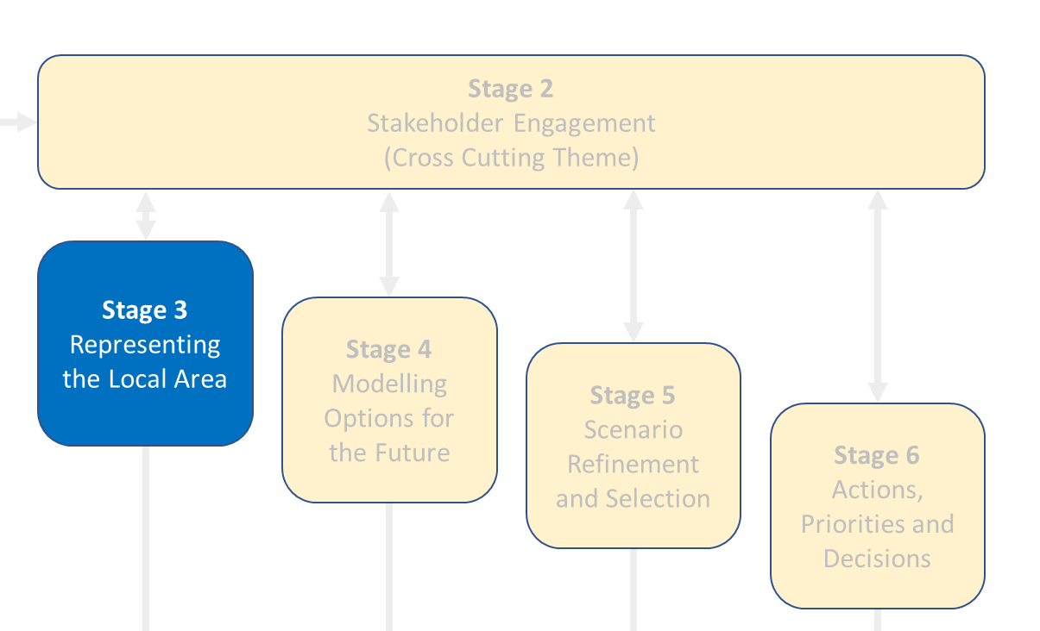
Progress to date
Stage 3: Baseline Report
Provides a comprehensive baseline representation of the Cornwall & Isles of Scilly existing Energy System capturing its assets, infrastructure, ambitions, and current plans already committed for the future

Slide 26
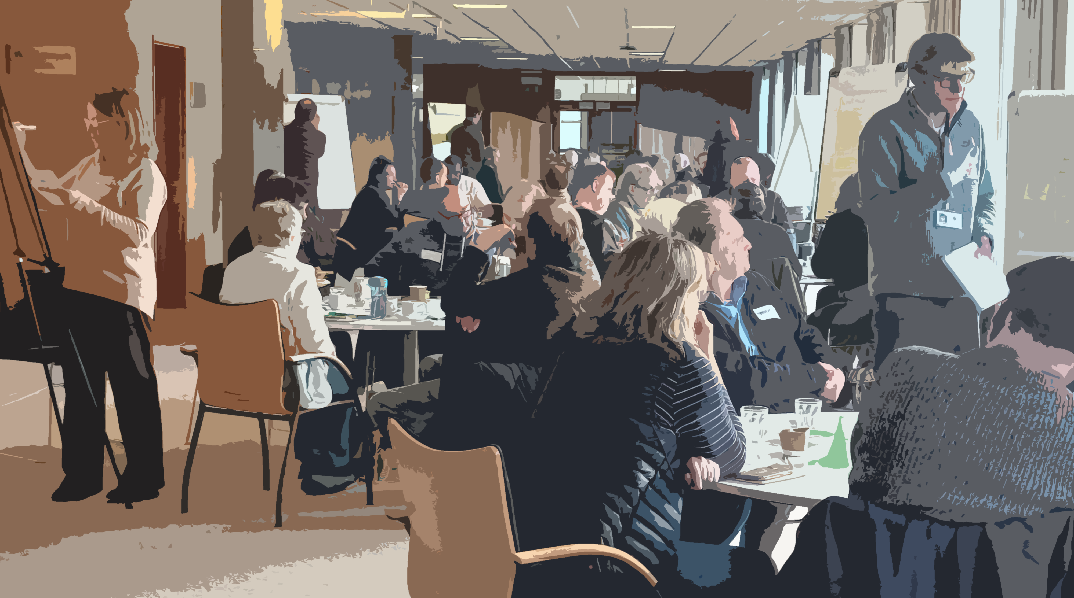
Progress to date
Residents’ Energy Panel
Panel of 50 people selected by a Sortition process to deliberate over Cornwall’s future energy system
Met over 3 full weekends in February & March
Report with recommendations expected end of May – to inform selection of preferred pathway

Slide 27
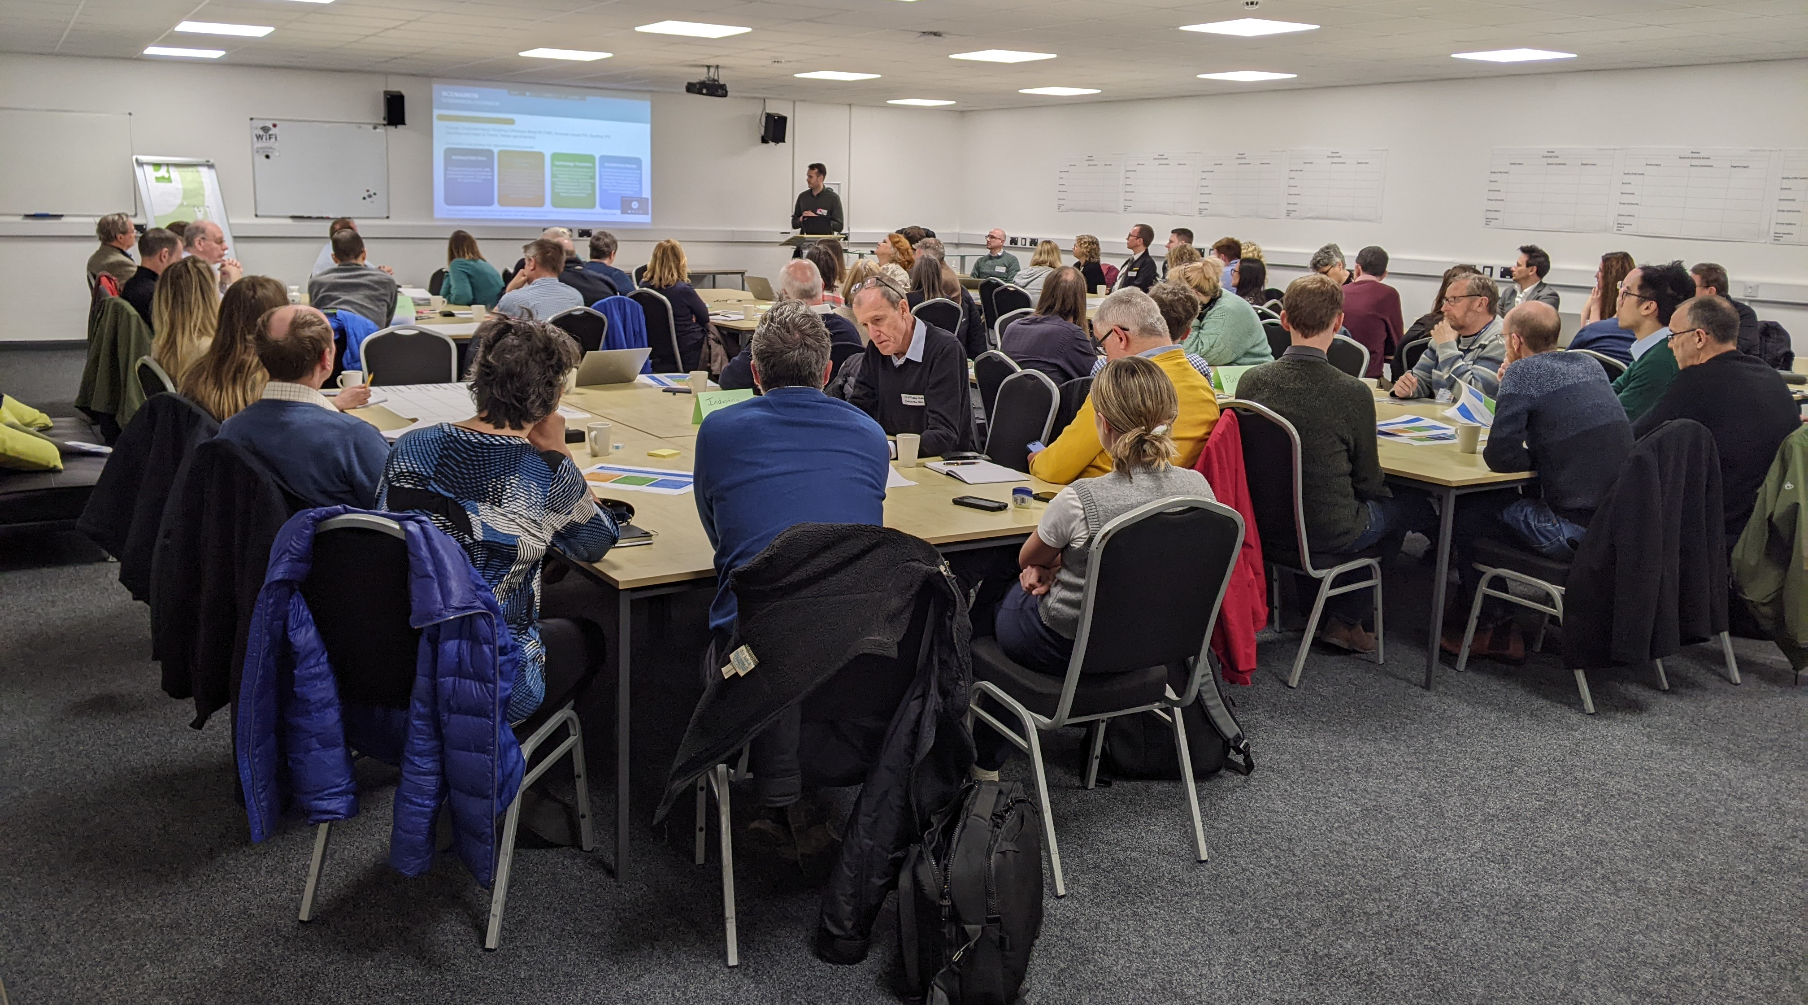
Engaging with our Stakeholders
3 stakeholder workshops held to date – scenarios, modelling and refinement

Slide 28
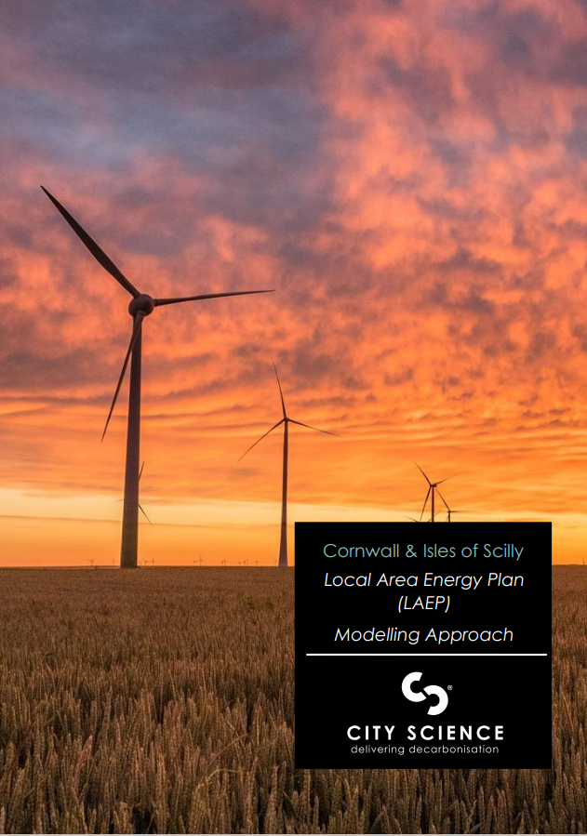
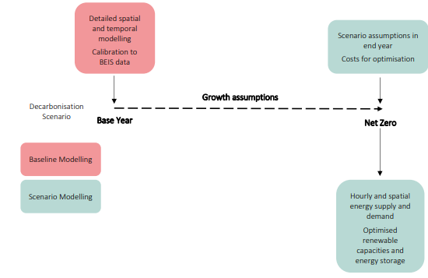
Technical Modelling
The baseline year of 2019 had been selected to match Cornwall Council's GHG Inventory and is also the most recent BEIS sub-national data unaffected by the COVID-19 pandemic.
Scenario modelling investigates potential future energy systems under various assumptions and constraints, presenting hypothetical futures but are not predictions.
Pathway modelling outlines the rate of change needed to achieve a net-zero energy system, quantifying cumulative emissions between now and the desired date.
Technical Modeling is independently reviewed by the University of Exeter
Scenario vs Pathway Modelling

Slide 29
Where are we now?
National Guidance on LAEPs stipulates that at a minimum, two nationally defined scenarios should be modelled.
A ‘Do Nothing’ scenario
National Net Zero (2050)
Do Nothing: “This scenario reflects only decarbonization activities between now and 2050 that are committed to happen (e.g., the ban on new petrol and diesel cars after 2035 and ban on gas boilers in new builds after 2028). It does not recognise policies that are not tangible and finite activities (e.g. net zero)”
National Net Zero: “This scenario should reflect the net zero target of the relevant country at the time the plan is made (e.g., currently 2050 in England). It should not take account of a locally set net zero target”

Slide 30
Where are we now?
Further to the two national scenarios, we are modelling three, locally defined scenarios.
Maximum Electricity Demand
Purpose: Tests maximum electricity grid demand for network reinforcement planning
Description: High growth projections with full electrification of heating/transport.
Accelerated Action
Purpose: Evaluates a wide range of measures which are expected to be possibilities for accelerated decarbonisation, with behaviour change and demand reduction being a key focus.
Description: Considerable success in both social/behavioural change and innovation. The date of net zero will be earlier than 2050.
Technology Transition
Purpose: Showcases the integration of innovative technologies.
Description: Highlights unique local opportunities, such as biomethane production, geothermal energy utilisation, and the implementation of FLOW, as well as broader innovation opportunities (e.g. hydrogen for aviation).

Slide 31
Where are we now? Detailed modelling at locality level

Slide 32
LAEP Next Steps
 | Q1 | Q2 | Q3 | Q4
Scenario refinement
Finalise scenario modelling
Recommended pathway selection
Member session on recommended pathway and consultation approach
Approval of recommended pathway and consultation approach
Public Consultation
Final LAEP report ahead of formal council governance
Formal adoption by Cornwall Council and Council of Isles of Scilly (IoS) and the Cornwall & IoS Leadership Board

Slide 33
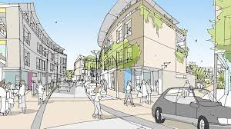
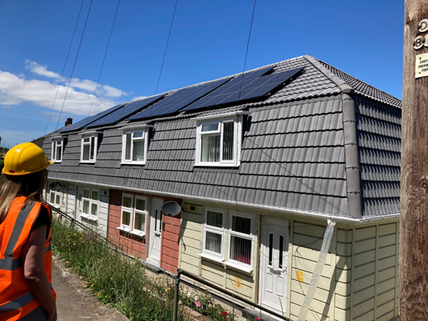
Placing net zero at the heart of the council’s strategic policy development
Development Planning Document
Development Planning Document
Local Transport Plan
Local Nature Recovery Strategy
and new approaches to adapting to a changing climate
Refresh (2050)
Housing Decarbonisation Strategy
Green Growth Strategy
Climate Adaptation Strategy

Slide 34
Lessons we are learning along the way
Leverage soft market testing. Take time to talk to the Market, identify suitable frameworks:,
Walk before you can run – Don’t compromise on mobilisation – Make sure everyone understands how the LAEP process fits together
Consider how long you might need for co-production……..and double it
R.I.R.O. – Plan ahead on what data you will need and whether you have local data sets over nationally available ones
Resourcing an LAEP is considerable, even more so when seeking to maximise engagement
Think carefully about the timing and approach of your engagement(s)

Slide 35
Fiona Campbell Head of Local Governance and Flexibility Strategy Ofgem

Slide 36
Regional Energy Strategic Planners Overview

Slide 37
Bigger picture for strategic energy planning
Scale, complexity and long lead times of new infrastructure build requires strategic planning at local, regional and national levels to ensure effective co-ordination and optimisation
National Strategic Spatial Energy Plan (SSEP) which will inform a new transmission network plan – the Centralised Strategic Network Plan (CSNP)
Strategic planning will help enhance confidence in and accelerate network investments and speed up connections to the grid
Our reform of local governance arrangements introduces a Regional Energy Strategic Planner (RESP) to optimise sub-national energy systems and maximise opportunities for decarbonisation at pace
Ensure regional planning is coherent with the wider strategic planning function of the FSO, SSEP and CSNP

Slide 38
The local governance journey
1
2
3
Summer 2023
Stakeholder responses supported overall direction of travel but intricacies to work through
Option development focused on immediate issue
April 2022 Call for Input launched
Findings identified issues of accountability and coordination
Validated case for change
March 2023 Consultation
Proposed local governance reform package of:
Role for regional system planner
Single market facilitator
Real-time ops remain with DNO
4
5
Autumn 2023
Decision to proceed with reforming local governance and creation of new roles
Autumn/Winter 2023
Proceed with creation of Regional Energy Strategic Planners and kick start detailed design phase with Mayoral Roundtable
6
7
Detailed design phase throughout 2024
Significant engagement with stakeholders to gather insights and ensure arrangements work for them
Target mid-decade implementation and specifically ensure that a strong regional context informs RIIO-ED3 setting

Slide 39
We are introducing new Regional Energy Strategic Planners, putting places at the heart of the future of the energy system
A new regional strategic planning role, delivered by National Energy System Operator (NESO)
Develop a strategic plan in each region, that takes a cross- vector view and is reflective of the regional context
Introduce a governance mechanism for RESPs to embed democratic representation and accountability within the process
Between 10 and 13 RESP regions across GB

Slide 40
Detailed design focus
Currently undertaking detailed design of the RESP role and will consult in the summer
Following that continued design and implementation activities
A new regional strategic planning role, delivered by National Energy System Operator (NESO)
Develop a strategic plan in each region, that takes a cross- vector view and is reflective of the regional context
Introduce a governance mechanism for RESPs to embed democratic representation and accountability
Between 10 and 13 RESP regions across GB
Working closely with NESO as they build their capability up and ensuring detailed design gives strong steer for delivery
Principles for the planning approach and form of the output
What data is critical to strategic plan – eg DNO data, LAEPs, other spatial data, national targets etc
What is the form and purpose of the board?
How does it provide effective oversight and influence?
Are the boundary regions appropriate for the function?

Slide 41
Agenda
P
E
S
T
L
E
Please get in touch at resp@ofgem.gov.uk if you’d like to chat further or be kept up to date on the publication of our consultation

