Slide 1
Innovations in Retrofit Advice: Retrofit, Planning & Historic Housing

Slide 2
Celia Davis
Town and Country Planning Association

Slide 3


Slide 4
Kate Royston
Tamar Energy Community

Slide 5
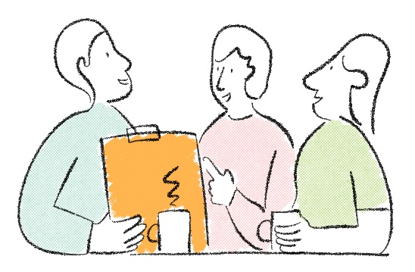
Traditional & listed buildings and retrofit
Kate Royston, Tamar Energy Community

Slide 6
Introduction to Retrofitting
Retrofitting – doing things to improve existing buildings to make them as energy efficient as possible (ideally net zero)
Whole house approach – looking at your home as a whole, and as a system
  Ongoing maintenance
  Fabric first – helping your home retain as much of its heat as possible
  Deal with damp – deal with any causes of damp and make sure ‘rainwear’ is suitable for heavier downpours
  Ventilation – making sure that the air is fresh and regularly changed
  Renewable heat and hot water system(s) with the right controls
Aim – warm, healthy home which costs less to heat and as close to net zero as possible

Slide 7
Traditional Buildings
A building constructed before 1919 is classed as traditional
Traditional buildings are generally of solid wall or solid timber frame construction
Construction often follows a local vernacular utilising local materials, construction methods and design.
According to the STBA^{(i)} traditional buildings make up about 25% of the UK’s total building stock.
Many traditional buildings have evolved over the years with alterations, additions and changes which may have impacted their character and their performance
https://historicengland.org.uk/images-books/publications/planning-responsible-retrofit-of-traditional-buildings/

Slide 8
Listed Buildings
A listed building is one of special architectural or historic interest which is included in the register held by Historic England.
Buildings can be listed at Grade II, II* or I.
  Grade I buildings are of exceptional interest - only around 2.5% of listed buildings are Grade I
  Grade II* buildings are particularly important buildings of more than special interest – around 5.8% of listed buildings are Grade II*
  Grade II buildings are of special interest – around 91.7% of all listed buildings are in this class and it is the most likely grade of listing for a home owner

Slide 9
Listed Buildings and Improvement
From Historic England:
“Listed buildings can be enjoyed and used, like any other building.
Listing doesn’t prevent any change or freeze a building in time, it simply means that listed building consent must be applied for in order to make any changes to that building which might affect its character as a building of special interest.
Listing status covers the entire building, so works which require consent might include the replacement of windows and internal alterations, for example.”
https://historicengland.org.uk/listing/what-is-designation/listed-buildings/#b5797b67

Slide 10
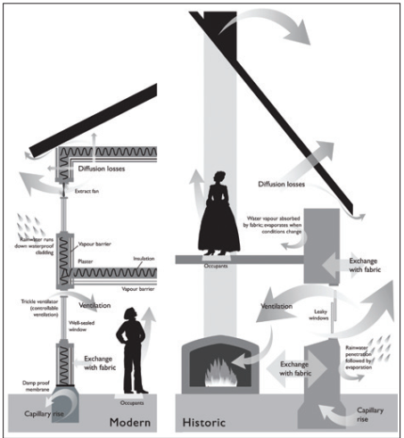
Understanding Traditional Buildings
Traditional buildings are constructed from different materials and in different structural forms compared with modern buildings and consequently they perform differently.
They usually heat up and cool down more slowly.
They deal with moisture differently, allowing rain, groundwater and internal moisture (from washing, cooking and breathing) to move in a controlled way into and through their semi-permeable fabric.
They also rely on sunshine, wind, heating and adequate internal ventilation through windows, chimneys and draughts in order to keep dry.
In good condition and with regular maintenance, the system stays in balance.
Changes to fabric performance, heating and ventilation, if not correctly undertaken, can change this balance and lead to problems of overheating, moulds and ill health
https://historicengland.org.uk/images-books/publications/planning-responsible-retrofit-of-traditional-buildings/

Slide 11
Respected, Valued and Understood
It’s a privilege to live in a traditional building – many continue to perform well – thermal mass retaining heat in winter and cool in summer
Understand, value and respect a traditional building and approach retrofit accordingly
Be clear about what you’d like to achieve and how this can be done, keeping the building in balance, ideally using natural materials
Seek advice from professionals such as a Retrofit Advisor/Assessor who is knowledgeable about traditional buildings
If listed and/or in a conservation area/national park/national landscape seek advice from the relevant authorities once you understand the opportunities and considerations yourself and have an initial plan

Slide 12
A different approach for traditional buildings?
As discussed, consideration and understanding of the building’s needs is important, but not the whole story.
“Planning responsible retrofit of traditional buildings” is a valuable resource in helping to understand this:
  “Achieving responsible retrofit often requires compromises between different values.
  It also requires a Whole Building Approach whereby there is integration of:
    the fabric measures (such as insulation, new windows, draught proofing)
    and services (particularly ventilation, heating, controls and
    renewables)
    along with proper consideration of how people live and use the building.
  All of these must be adapted to the context of the building (its exposure, status, condition, form etc). When these are integrated well, a building is in balance.”
This shouldn’t be any different to how retrofit of any building is approached

Slide 13
Home maintenance
Keeping your home in good repair
Checking guttering and down pipes (rainwater gear) at least once a year; and checking its able to support more intense rainfalls
Sorting out slipped roof tiles etc. promptly; and keeping roofs free of moss
Keeping vegetation and soil away from the walls
Cleaning the exterior including windows regularly
Maintaining windows and painting wooden windows and doors

Slide 14
Fabric First – Energy use in the home
Most energy in the home is used for space heating
Reducing this is a priority

Slide 15
Fabric First – Reducing heat loss
Heat will always try and escape to the coldest spots.
The goal is to get rid of as many cold surfaces as possible
Loft insulation (~£8/m2)
Room-in-roof insulation
Flat roof insulation (~£40/m2)
Draught management
Some airflow is important
External wall insulation (EWI)
~£125/m2
Cavity wall insulation (CWI)
~£9/m2
Internal wall insulation (IWI)
~£182/m2
Party wall insulation (PWI)
~£450/wall
Double and triple glazed windows and insulated doors with draught proofing
Rough cost per window for double glazing £650
Floor insulation
Suspended floor (~£35/m2)
Solid floor

Slide 16
Ventilation and Damp
Ventilation is very important for our health and the health of our homes; and ventilation is important for managing damp
Damp surfaces / walls will need approx. 40% more energy to warm them up. It’s important to get rid of excess moisture within a home.
Controlled ventilation includes 4 aspects:
  Air into rooms e.g. trickle vents in windows
  Extract ventilation in wet rooms – e.g. dMEVs
  Movement of air between rooms – door undercuts
  Purge ventilation e.g. ability to open windows

Slide 17
Renewable heating and hot water
Renewable – generated from a natural resource that can be renewed e.g. wind, sun, air, water
Heating systems can be upgraded once fabric is improved
If it’s done the other way around, your heating system will be too big for your needs, and will be less efficient
Example costs:
  Air Source/Ground Source heat pumps ~£12,500 per system
  Solar PV installation ~ £5000 per system
  Storage heaters ~ £1000 each (assumes renewable electricity from grid/solar PV)

Slide 18
Heating controls and heat emitters
Good heating controls are essential
The householder also needs to understand how to use them properly.
Heat emitters include radiators and underfloor heating. These should be sized to allow the heating system to be as efficient as possible.
A renewable heat pump based heating system may operate at lower temperatures and generally requires larger emitters
  A correctly sized, installed and maintained air source heat pump (ASHP) operates at 300-500% efficiency
  Electric heaters (e.g. storage heaters) are 100% efficient
  Gas and oil boilers are generally between 70-85% efficient

Slide 19
Supporting Householders in Traditional Buildings
The Far SW LEAD Consortium is offering free Retrofit Advice Visits to householders including those in traditional properties to support their retrofit journeys
Where interested a householder may then choose to self-fund a Whole House Plan; or be referred to appropriate grant funding where eligible.
Our Retrofit Advisors visiting traditional properties have undertaken the Level 3 in Traditional Buildings course
We also work collaboratively with our historic building officers to assist householders through grant funded programmes; and to enable shared learning

Slide 20
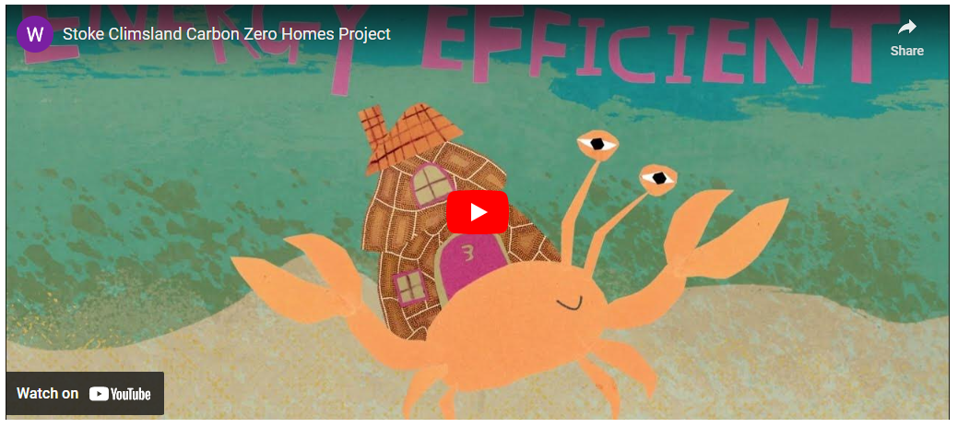
Useful Resources
A useful video to explain retrofitting and importance of a planned approach https://youtu.be/Ucf0-L8y9Q0
Planning Responsible Retrofit of Traditional Buildings: https://historicengland.org.uk/images-books/publications/planning-responsible-retrofit-of-traditional-buildings/
Devon Retrofit Guide: https://www.energysavingdevon.org.uk/document/devon-retrofit-guide/
Warmer Bedford Cottages - Guide for Residents: https://tamarenergycommunity.com/warmer-bedford-cottages/

Slide 21
Alexandra Best
Bath & North East Somerset Council

Slide 22

Barriers to Policy Communication
Alexandra Best – Conservation Officer, Bath & North East Somerset Council

Slide 23
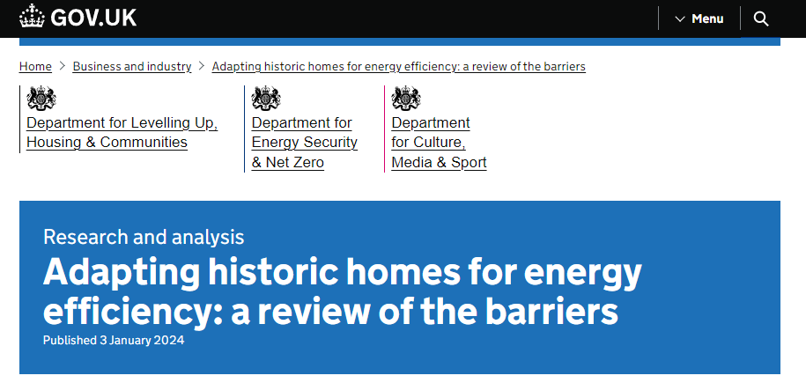
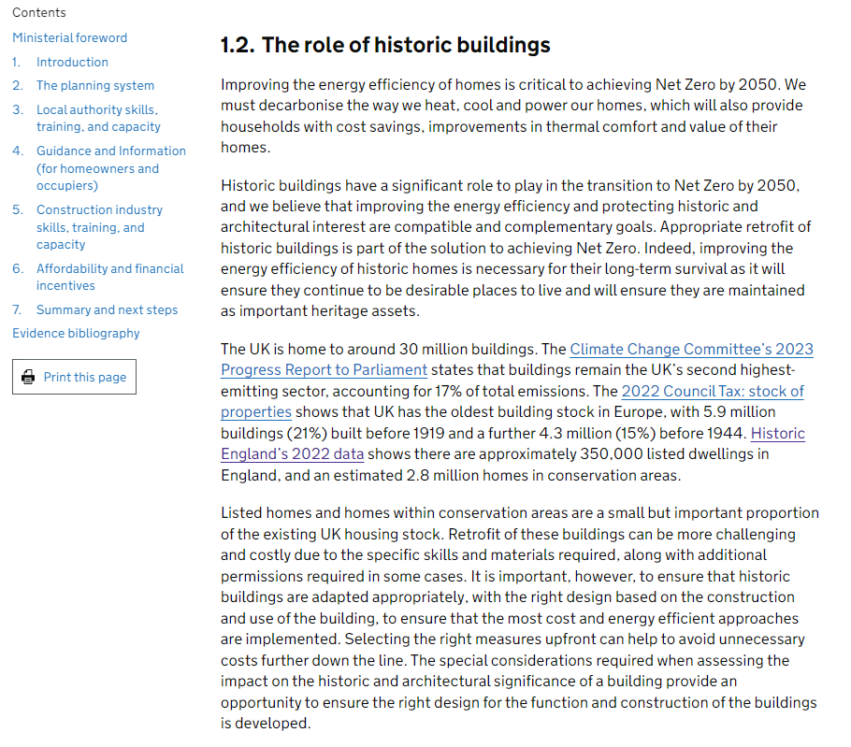
The Background – Retrofit of Historic Homes
National government review – key themes:
  The planning system
  Local authority skills, training, and capacity
  Guidance and information
  Construction industry skills, training, and capacity
  Affordability and financial incentives
Identified barriers – complexity of planning, consistency in decision making, cost, timescale, and lack of non-technical guidance.
Notes:
Ongoing activity by local authorities to produce guidance on retrofitting homes, including emphasis on traditional and listed buildings. Examples above from the last few years (2022 onwards) demonstrating growing need for guidance for homeowners, from planning and building professionals. Guidance informs not only how to implement retrofit effectively, but further planning and heritage considerations where this remains a complex factor in facilitating home upgrades, particularly where dealing with listed buildings.
2024 - national government has recognised the important role that historic buildings play in the transition to Net Zero by 2050, where 21% of total housing stock pre-dates 1919. Oldest building stock in Europe which consistently performs poorly, with buildings being responsible for 17% total carbon emissions across the UK.
HEAN published July 2024 by Historic England with comprehensive guidance about certain elements of retrofit, setting out a national position on retrofit changes and the best practice heritage approach.

Slide 24
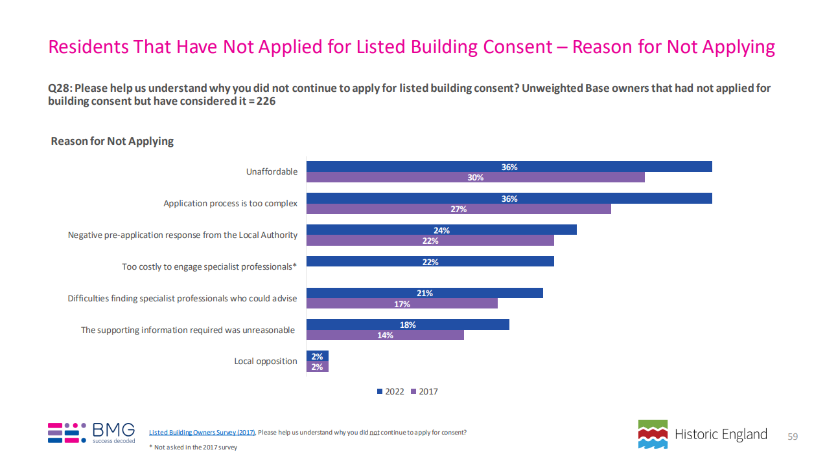
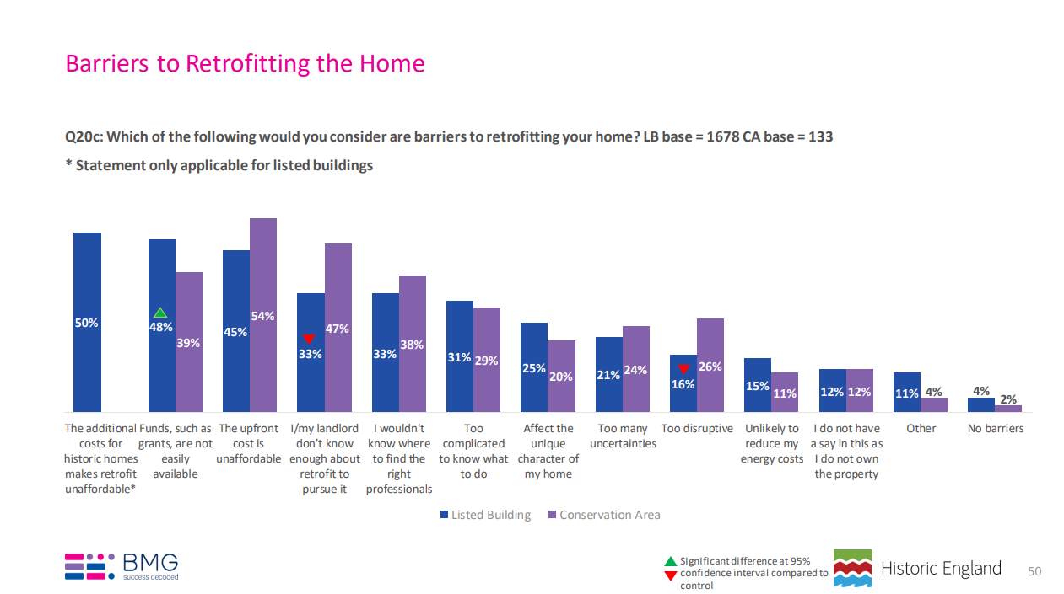
Historic England – Barriers to LBC & Retrofit
https://historicengland.org.uk/content/docs/research/listed-building-and-conservation-area-owner-occupier-survey-2022/
Notes:
Historic England 2022 survey of listed building owners and occupiers (including landlords) – seeking reasons as to why residents may not be interested in applying for LBC or retrofit projects.
Control group in conservation area.
Common answers:
Unaffordable cost/lack of funding
Complexity of application process/negative advice from Local Planning Authority (LPA)
Difficulty in finding professionals
Unreasonable supporting information
Disruptive works
Potential to affect historic character of property
Local opposition
Unlikely to reduce energy costs
Note common issues with residents within the conservation area, where buildings are similarly considered as ‘hard to treat’ – greater planning controls, and areas may contain higher concentration of listed or traditional buildings with comparable technical considerations in terms of how retrofit should be implemented (e.g. permeable materials).

Slide 25
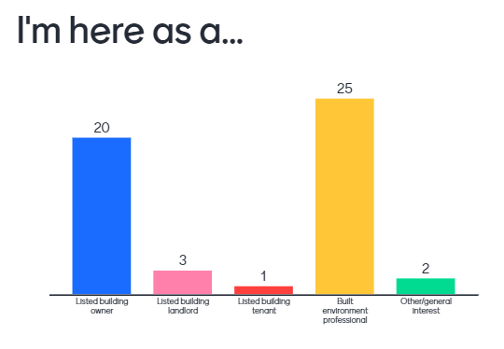
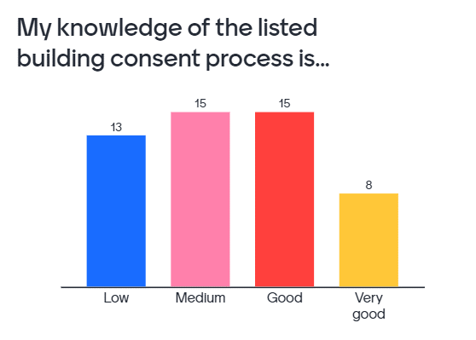
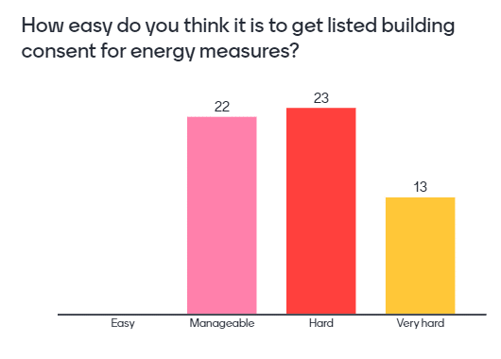
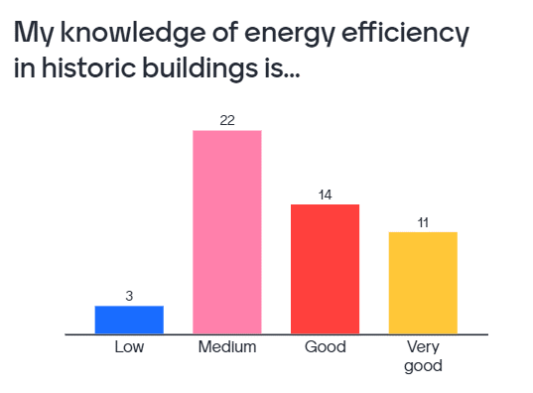
Green Heritage Homes – Project Audience & Knowledge
88% attendees were homeowners (39%) or professionals (49%)
Greater understanding of energy efficiency than LBC:
LBC – 45% good or very good, 26% low
Energy efficiency - 50% good or very good, 6% low
62% viewed getting LBC as hard or very hard.
Mentimeter Results

Slide 26
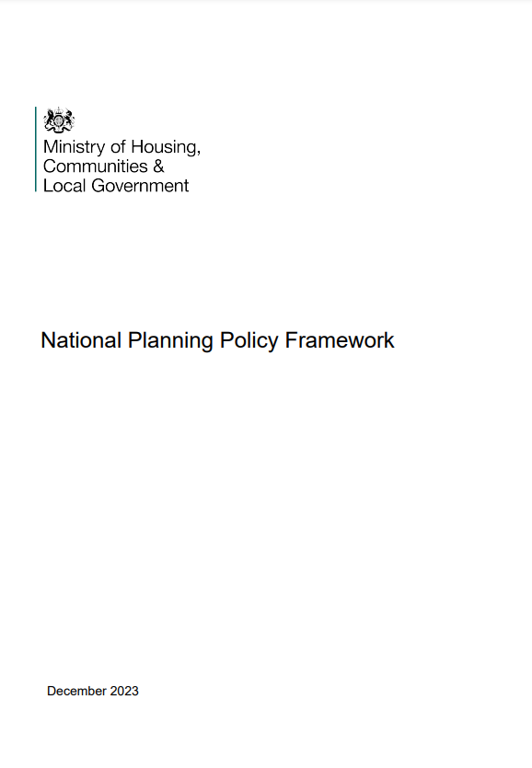
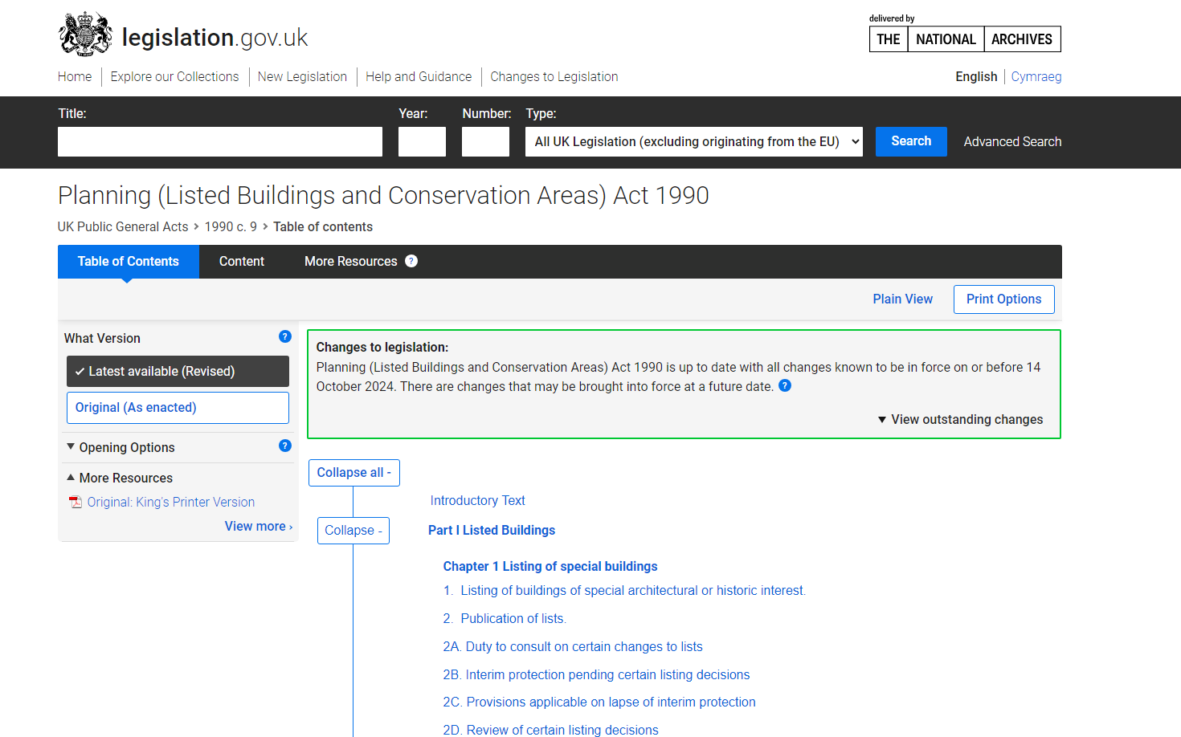
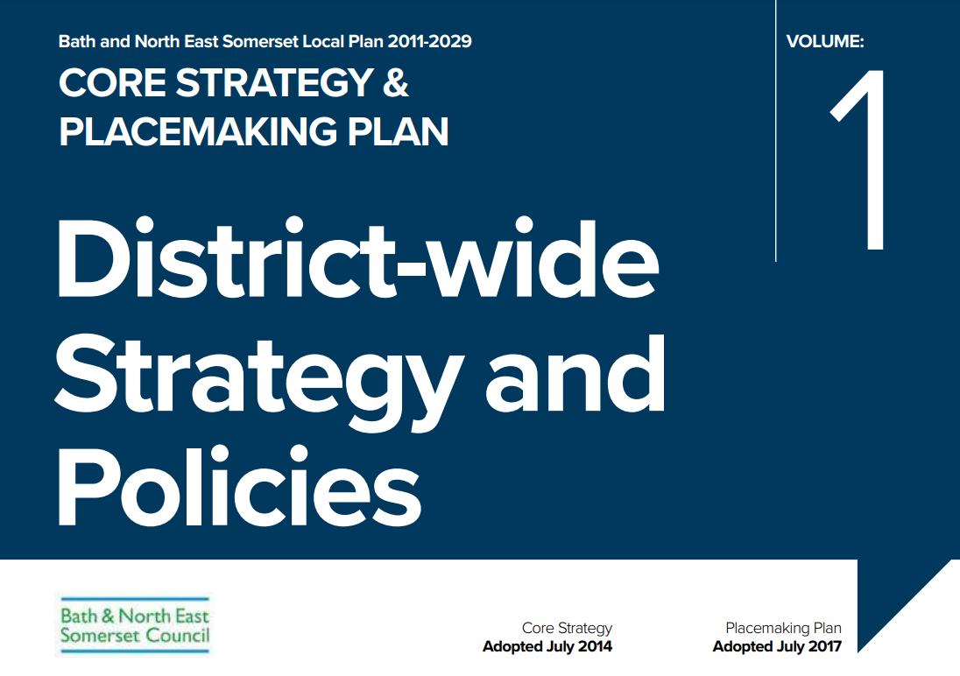
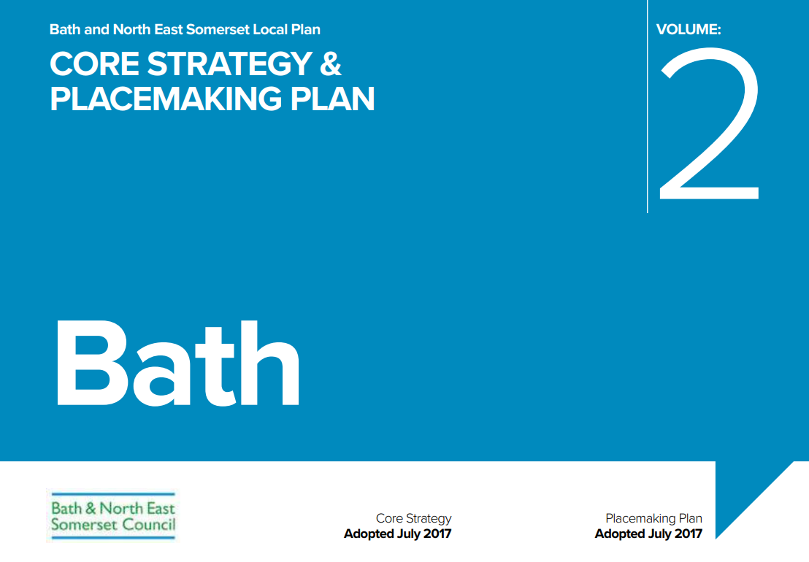
Listed Building Consent: The Planning Process
Demystifying the planning system:
  Document requirements
  What works require listed building consent
  Assessment of a listed building’s ‘significance’
  The planning balance – how a case officer assesses an application
  Local plan policy and national legislation & frameworks

Slide 27
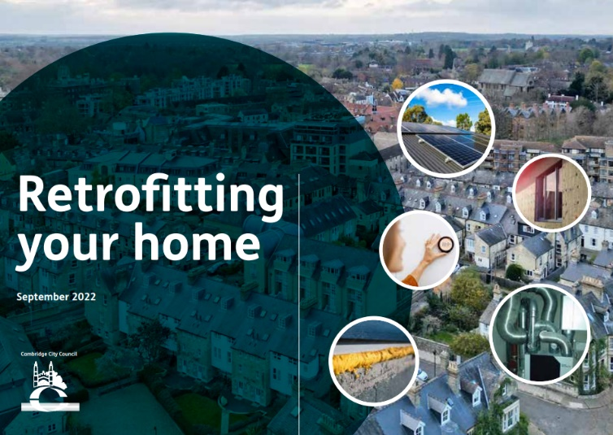
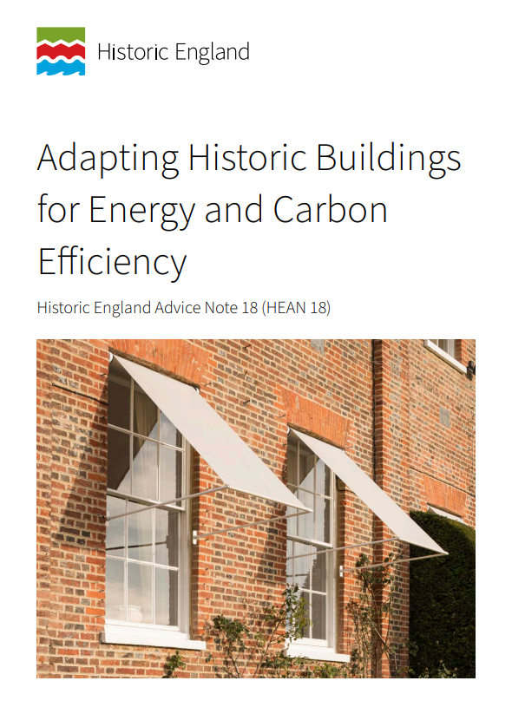

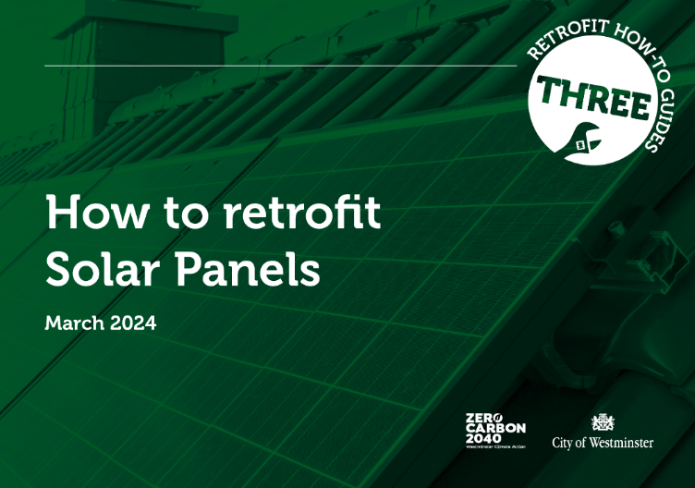
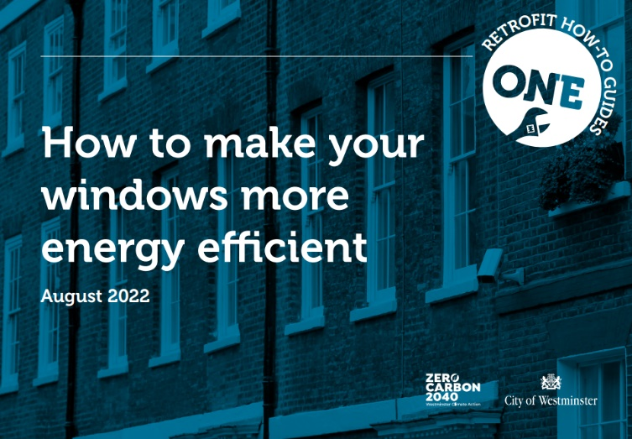
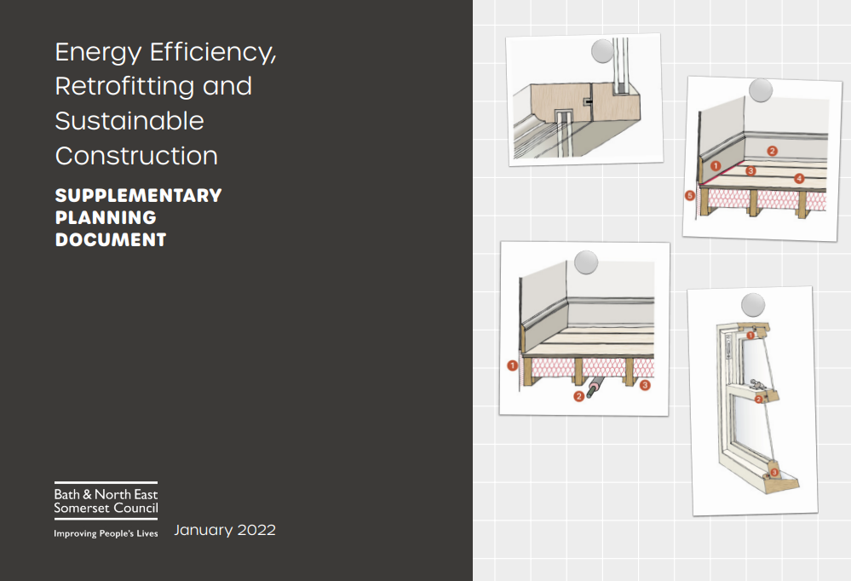

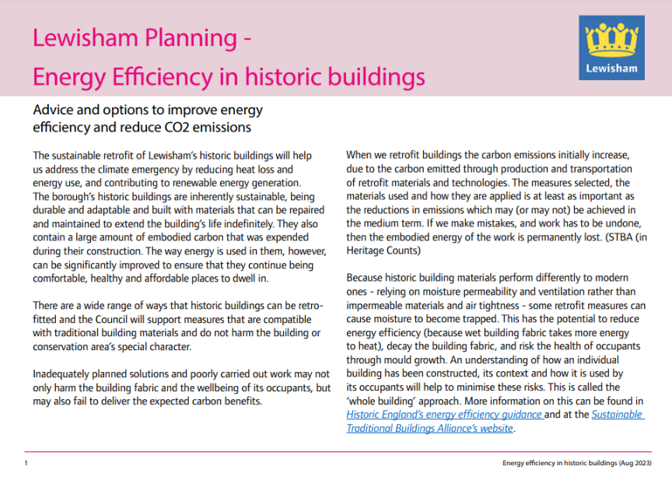
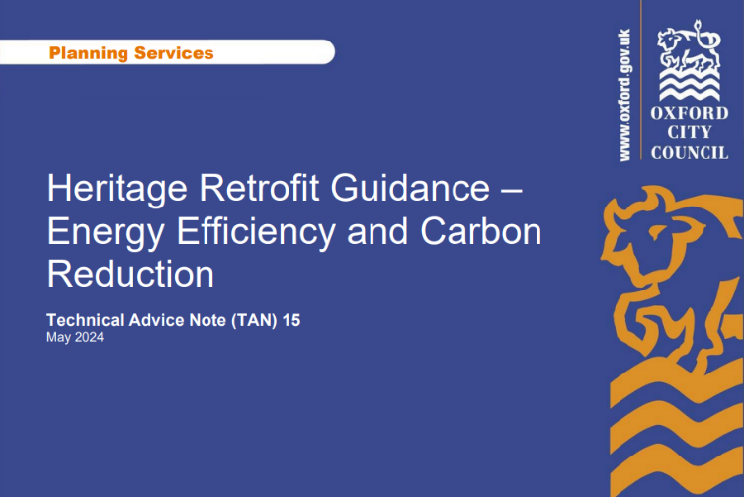
Listed Building Consent: The Planning Process
Guidance produced by organisations and local authorities
Historic England HEAN July 2024
B&NES update of SPD – Energy Efficiency, Retrofitting and Sustainable Construction SPD January 2022
Notes:
Ongoing activity by local authorities to produce guidance on retrofitting homes, including emphasis on traditional and listed buildings. Examples above from the last few years (2022 onwards) demonstrating growing need for guidance for homeowners, from planning and building professionals. Guidance informs not only how to implement retrofit effectively, but further planning and heritage considerations where this remains a complex factor in facilitating home upgrades, particularly where dealing with listed buildings.
2024 - national government has recognised the important role that historic buildings play in the transition to Net Zero by 2050, where 21% of total housing stock pre-dates 1919. Oldest building stock in Europe which consistently performs poorly, with buildings being responsible for 17% total carbon emissions across the UK.
HEAN published July 2024 by Historic England with comprehensive guidance about certain elements of retrofit, setting out a national position on retrofit changes and the best practice heritage approach.

Slide 28
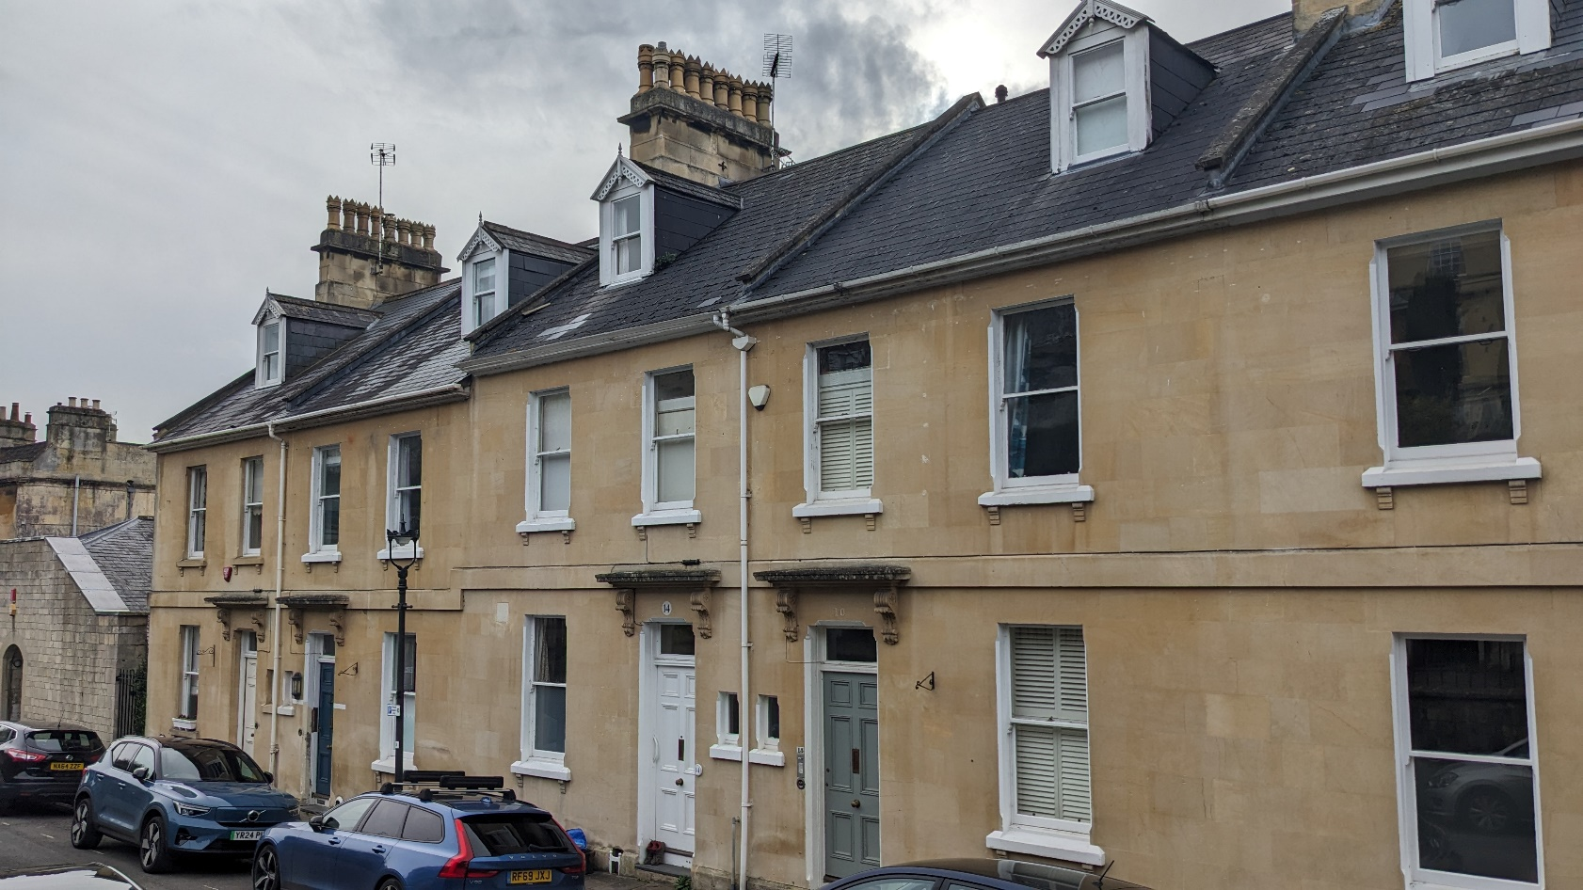
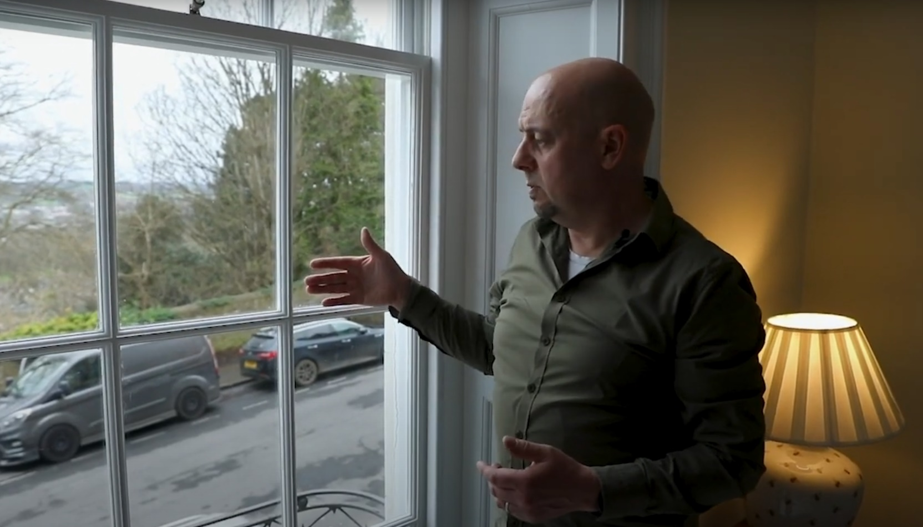
Green Heritage Homes – Key Project Actions
Creation of free accessible guidance.
Increase homeowner engagement with retrofit and heritage professionals.
Demystify listed building consent process.
Increase homeowner knowledge and confidence.
Embed conservation principles into the early stages of a retrofit project.
Increased, informal conversations with owner-occupiers.

Slide 29
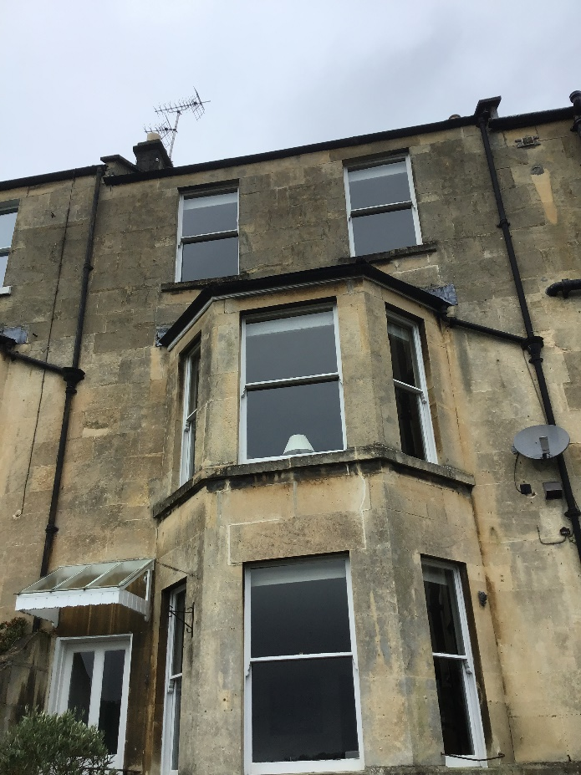
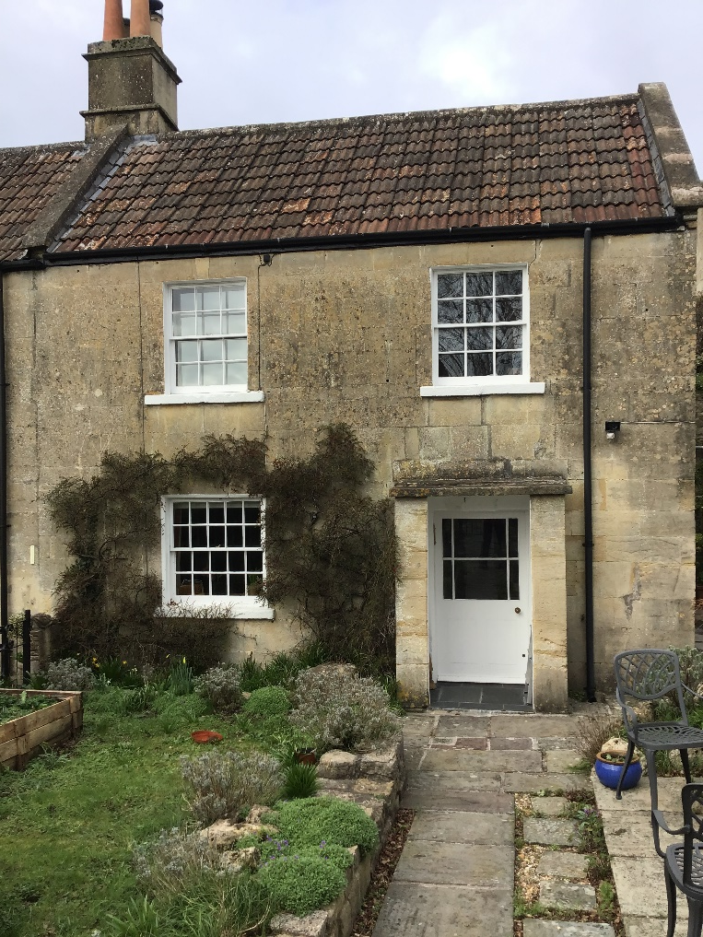
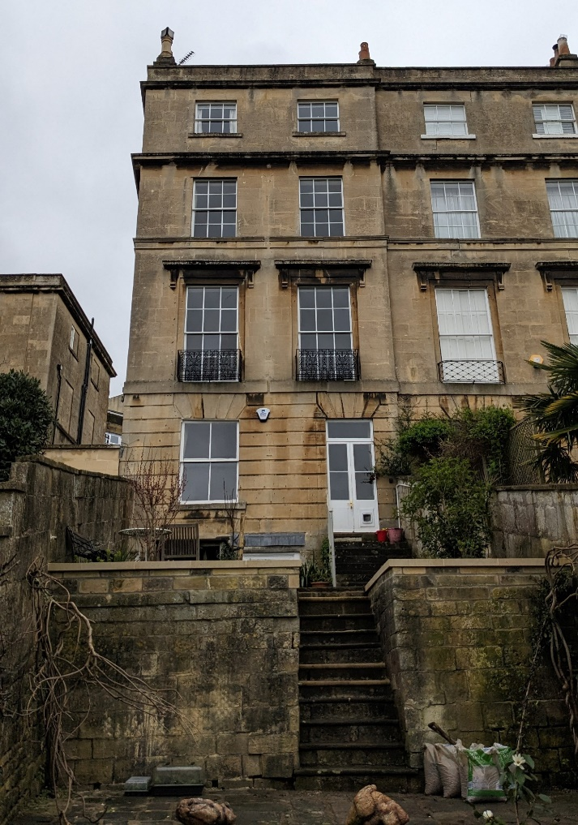
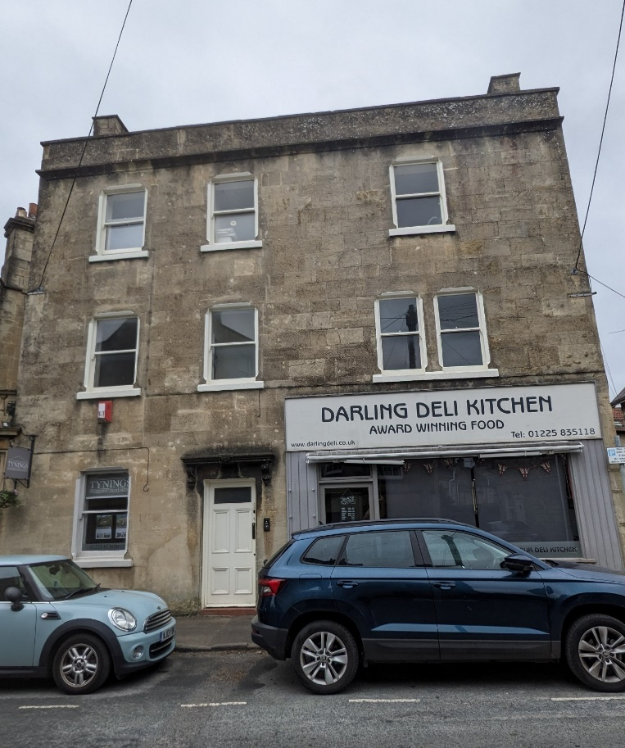
Level 0 Pre-App Site Visit & Listed Building Energy Champions
Subsidised on-site survey and guidance from B&NES Council & Bath & West Community Energy (BWCE).
New pre-app aimed at discussing works for the retrofit of a listed building – early stages of retrofit project.
Champion service for homeowners who agree to become a case study.
Chance for owner-occupiers to meet with professionals and ask questions!

Slide 30
Level 0 Pre-App & Energy Champions – Typologies
60%
Terraced properties
76%
Owner-Occupiers

Slide 31
Level 0 Pre-App & Energy Champions – Initial Findings
Notes:
Most popular measures discussed – window upgrades. Also, some interest in internal wall insulation and upgrades to loft insulation.
Large focus on building maintenance where it was found that building performance had been affected by areas of fabric disrepair, damp, or previous harmful alterations (e.g. tanking, cement render).
Where certain measures may not be appropriate, such as replacement windows, alternatives have been discussed such as secondary glazing – finding alternatives to address a problem.

Slide 32
Level 0 Pre-App & Energy Champions – Initial Findings
Notes:
Most popular measures discussed – window upgrades. Also, some interest in internal wall insulation and upgrades to loft insulation.
Some consideration of heat pumps and on-site renewables, but more frequent consideration of improving existing heating systems, either with new boilers, new radiators, or new heating networks (e.g. underfloor heating).

Slide 33
Level 0 Pre-App & Energy Champions – Initial Findings
ASHP:
67%
Double Glazing:
52%
Solar PV:
30%
Recommended Retrofit Options?
Secondary Glazing:
100%
Floor Insulation:
50%
Internal Wall Insulation:
48%
Loft Insulation:
100%
Notes:
Most popular measures discussed – window upgrades. Also, some interest in internal wall insulation and upgrades to loft insulation.
Some consideration of heat pumps and on-site renewables, but more frequent consideration of improving existing heating systems, either with new boilers, new radiators, or new heating networks (e.g. underfloor heating).

Slide 34
Level 0 Pre-App – Conservation Officer Recommendations
“Where existing windows are non-historic, the principle of replacement or retrofit with more thermally efficient glazing is acceptable. Any replacement window should be appropriately detailed and finished […]”
“Building fabric which is in a poor condition will naturally be less efficient and may have an adverse impact on the energy savings of a retrofit project. Ongoing maintenance is vital to ensure building fabric is dry and in good condition.”
“Other options may be considered such as the use of secondary glazing.”
“The principle of solar panels is welcomed within the inner roof valley, where installation would be concealed from public views of the listed building and its terraced setting within the Conservation Area.”
“[…] it is unlikely that solar slates would be viable in this location. The chimney stack, bay window roof, and dormer are all features that cast shadows at certain times of day and would limit solar gain.”
“There is little to no surviving internal historic finishes, and there is clear evidence of later alterations. The installation of internal wall insulation would therefore result in no loss of historic fabric and would be acceptable.”

Slide 35
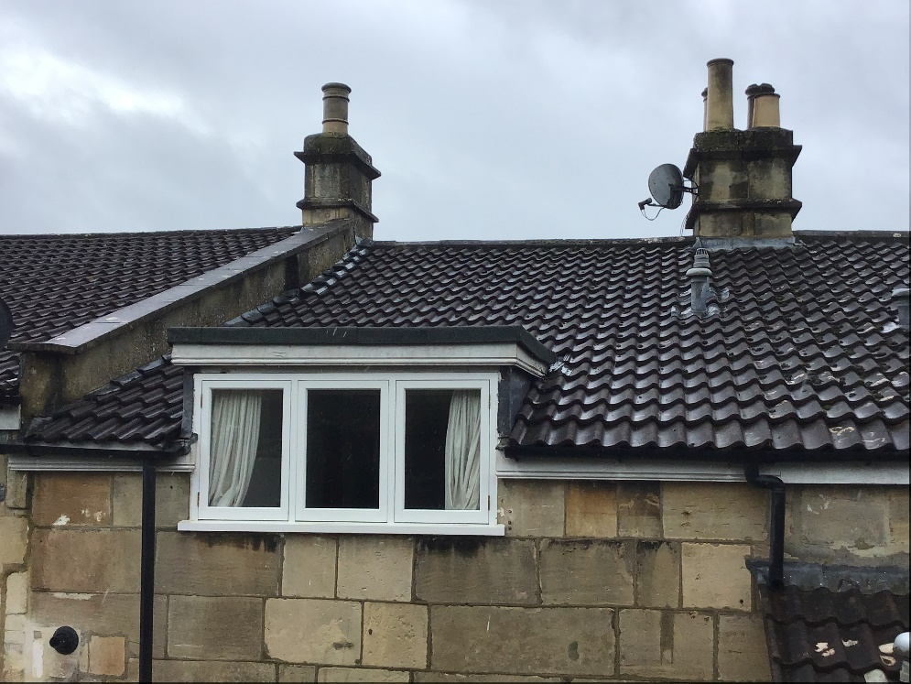
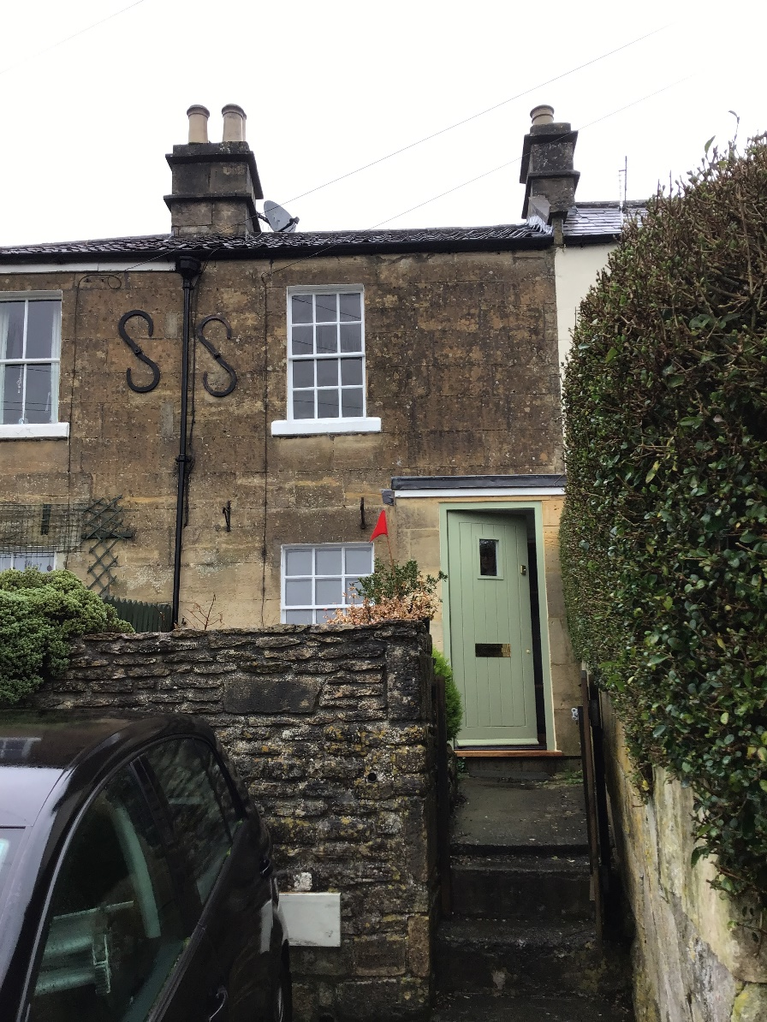
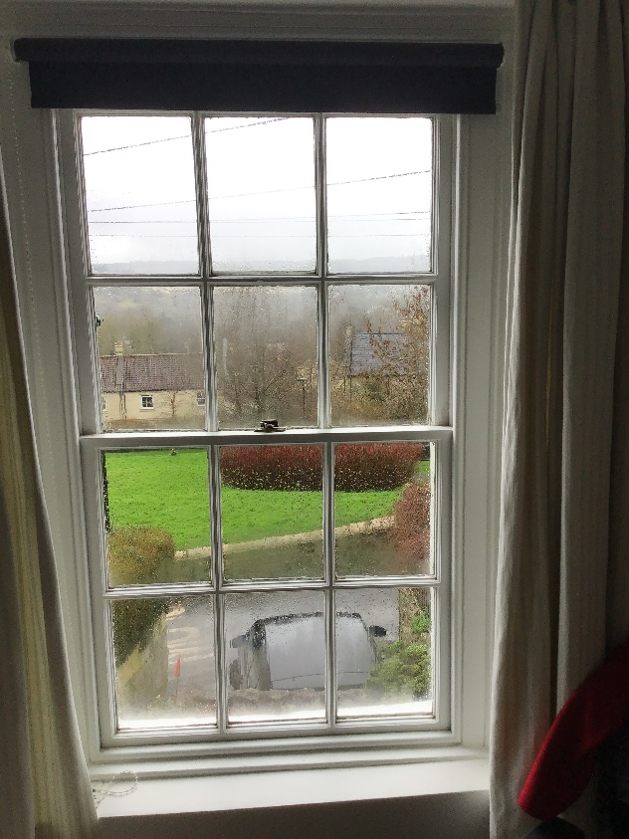
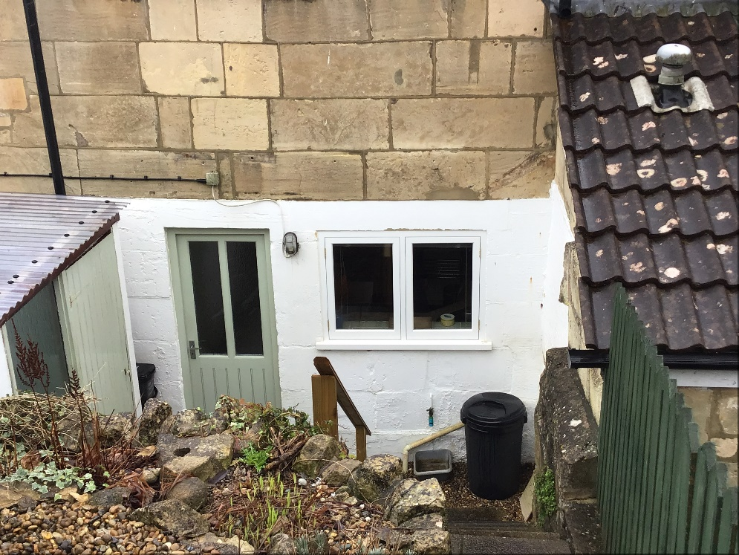
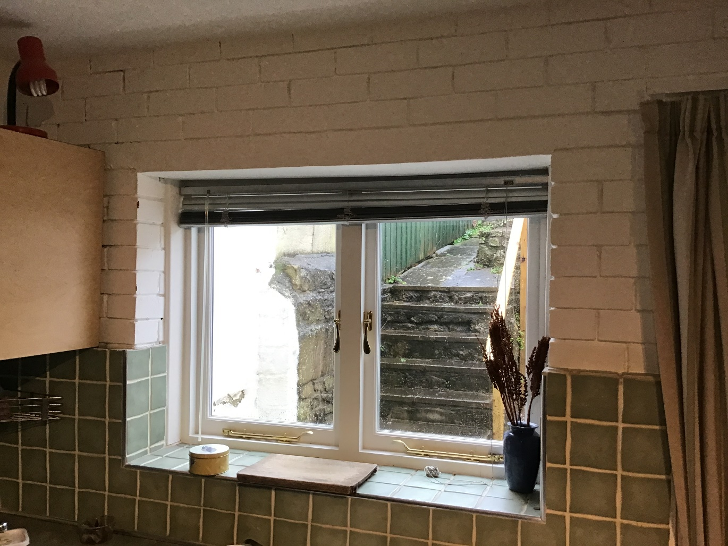
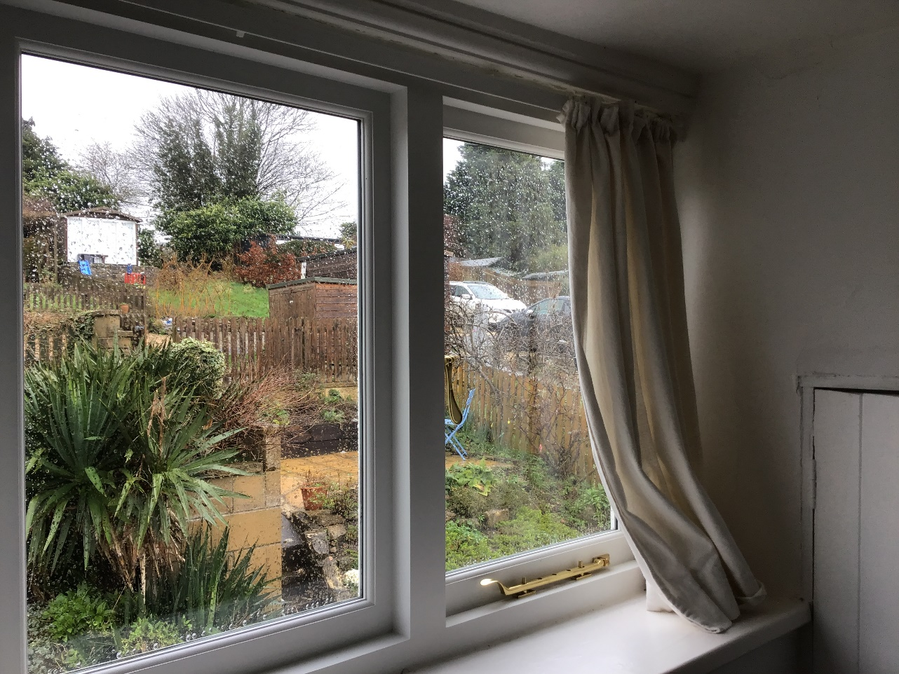
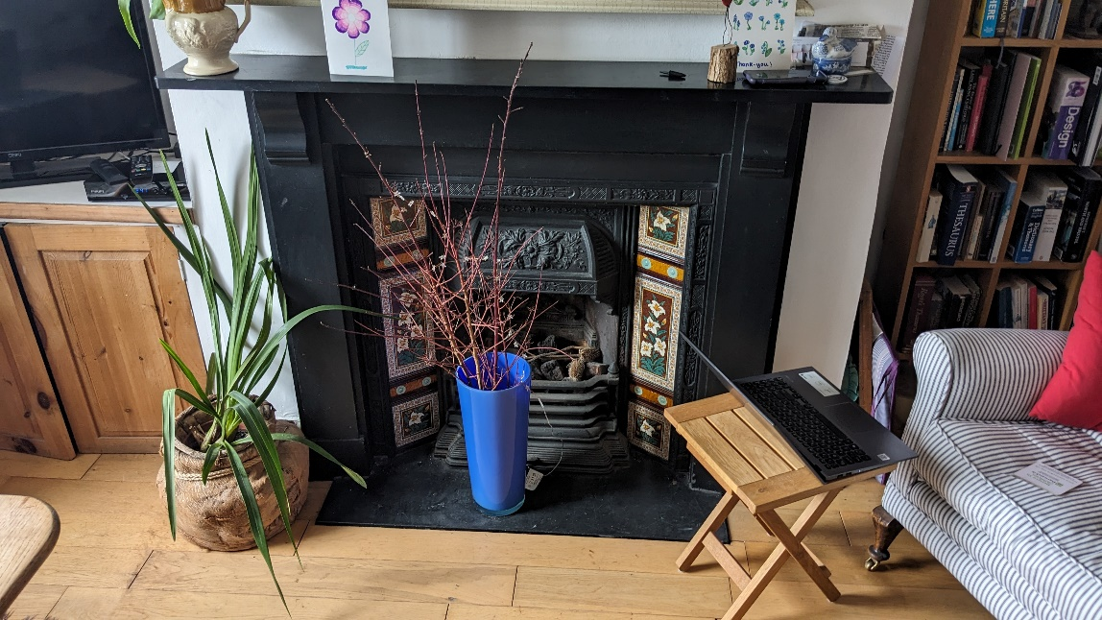
Case Study: 97 Bailbrook Lane
Age: | Early 19th century
Listing: | Grade II (91-113, Bailbrook Lane)
Building Type: | Two storey mid-terrace
Bedrooms: | 2
Wall Type: | Solid wall Bath stone ashlar
Planning History: | 20/04607/LBA: Replacement of rear ground & first floor windows with double glazing (consent)

Slide 36
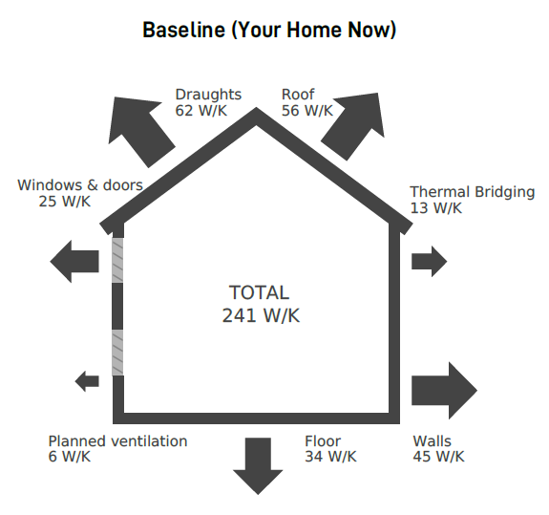
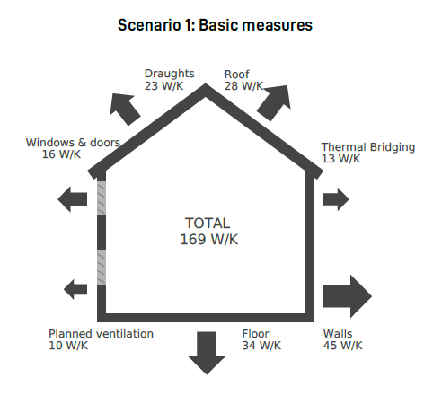
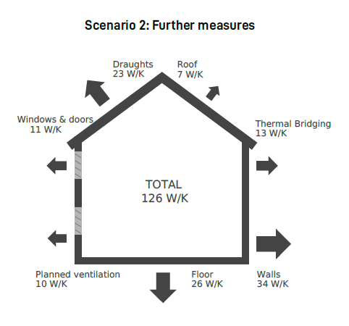
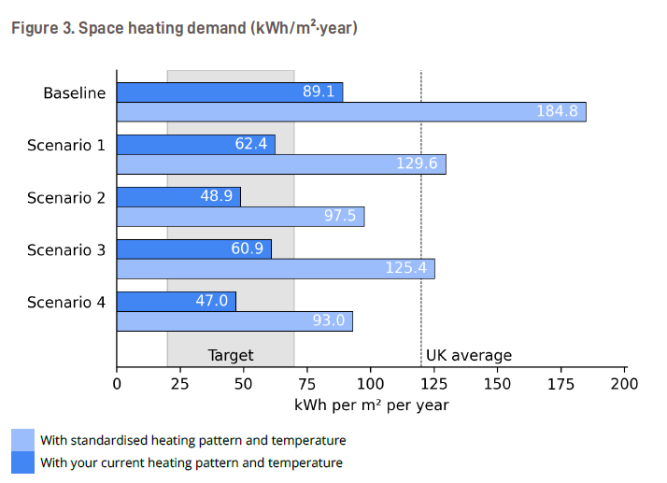
Case Study: 97 Bailbrook Lane
Key Areas of Alteration: | Modern kitchen fittings, including new floor and internal brick slip overlay of rear wall Replacement of rear windows with double glazed casements Internal drylining of rear bedroom and modern replica skirting 20th century additions of rear dormer and replacement front porch Sash windows replaced in 1970s
Retrofit Proposals: | Replacement sash windows – slim-profile/vacuum glazing Secondary glazing Internal wall insulation to rear kitchen wall, rear dormer, and porch Update loft insulation Underfloor insulation ASHP in rear courtyard Potential for ground-mounted solar array to the rear (pending further assessment of visual impact and setting)
Notes:
Space heating demand:
Basic measures – 30% decrease
Further measures (without heat pump or solar) – 45% decrease
Heat pump included – 47% decrease (note would completely cut proposed use of gas, and use of electricity would go up to compensate)
Carbon emissions:
Basic measures – 21% decrease
Further measures (without heat pump or solar) – 32% decrease
Heat pump and solar included – 84% decrease

Slide 37
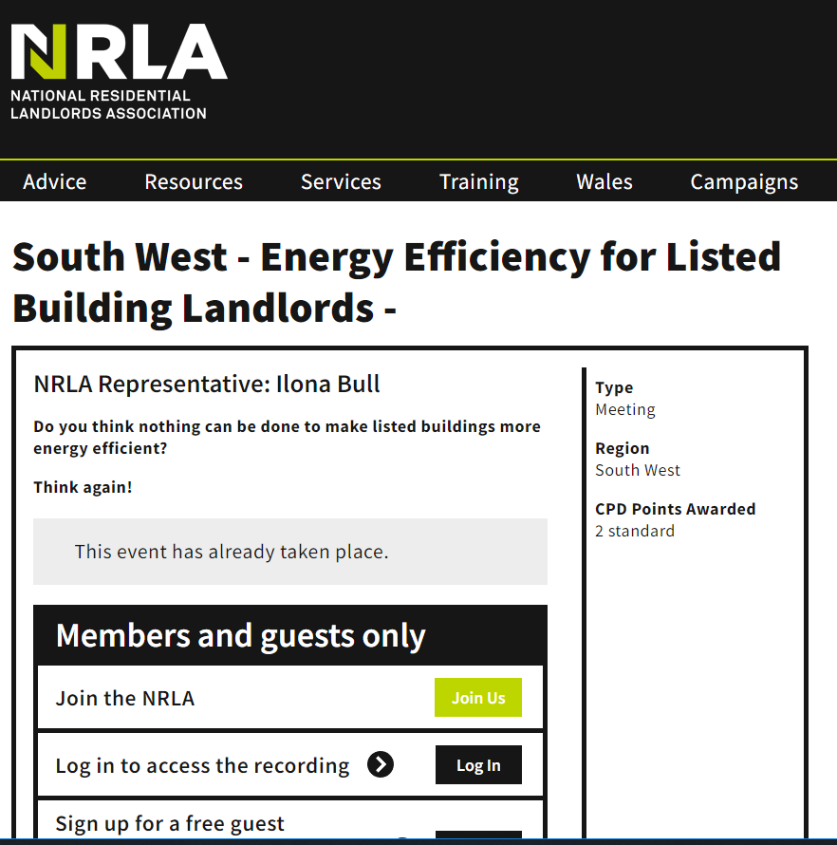
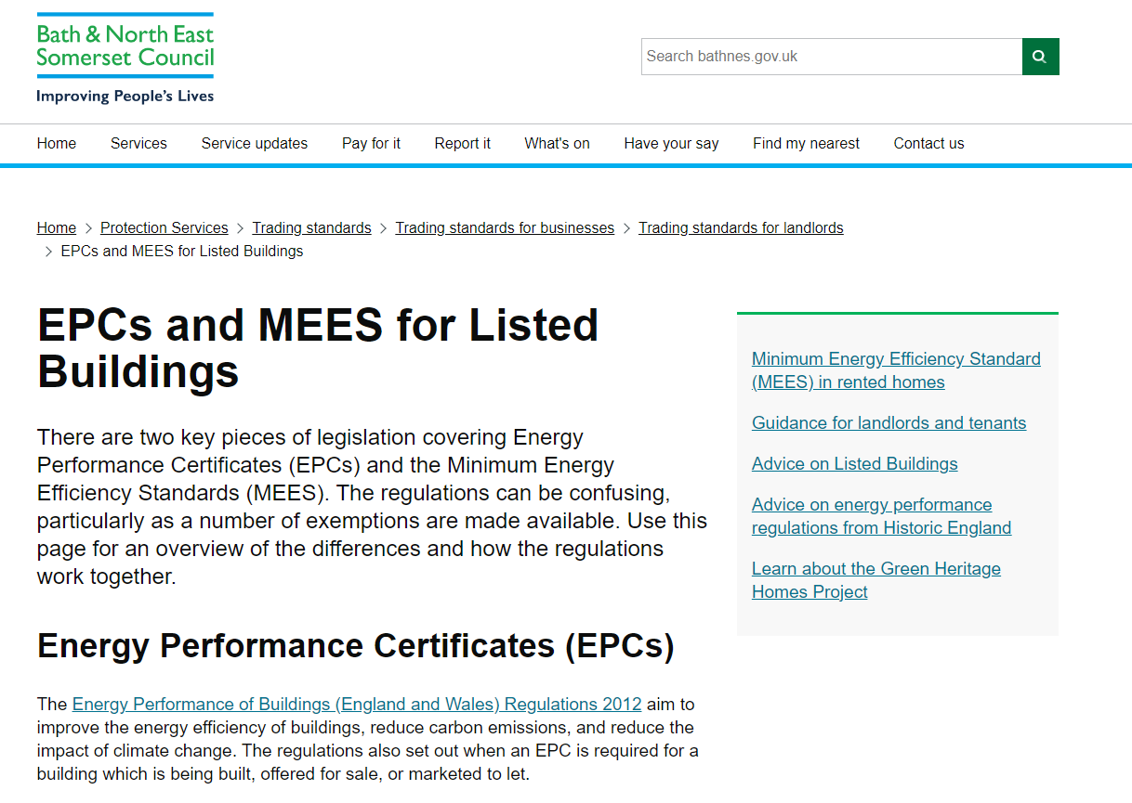
Landlords – Minimum Energy Efficiency Standards (MEES)
Engagement with private/social landlords – online webinars.
Landlord participation in level 0 pre-apps – Champion examples.
Listed building consent process is the same for properties used as private/social rentals.
Additional requirement of MEES – upcoming proposals for EPC C by 2030. Listed buildings are not automatically exempt.

Slide 38
Project Findings & Next Steps
Importance of facilitating in-person discussion.
Increased availability of centralised resources and information – make retrofit guidance easier to find.
Listed building consent – ‘yes you can!’
Next steps: progress case studies to completion & guidance for other Councils to take similar action.

Slide 39
Kate Elliott-Rudder and Neil Best
Centre for Sustainable Energy

Slide 40


‘Not-Yet-Green’ Open Homes
An alternative approach to green open homes
for old and traditional buildings

Slide 41

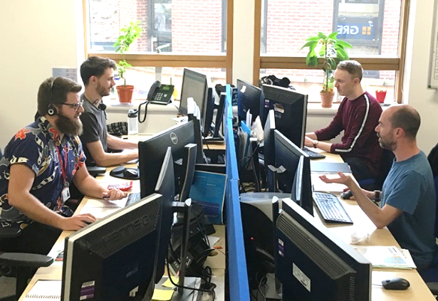
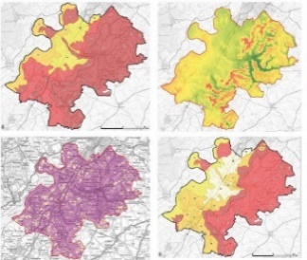
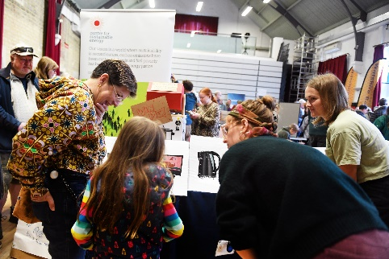
About CSE
CSE supports people and organisations across the UK to tackle the climate emergency and end the suffering caused by cold homes.
Large charity ~140 staff
Established in 1979
Approximately 130 projects running at any time

Slide 42

West of England Local Energy Advice Demonstrator (LEAD)
CSE has been trialling new and innovative approaches to providing in-person advice to overcome barriers to retrofit.
Targeting hard-to-reach households and hard-to-treat homes, particularly traditionally built homes.
CSE has partnered with Bath and West Community Energy (BWCE) and Bristol Energy Network (BEN).
This presentation will outline some of our learning so far…
Notes:
As part of our LEAD project, we have been trialling new and innovative approaches to providing in-person advice.
Hard-to-reach households can mean those who are particularly isolated or rural or digitally excluded. But it also includes people who don’t know what ‘retrofit’ means or who feel they are unable to make significant home improvements. This can be because of concern around costs, lack of confidence or worries about the disruption caused by building work.
Hard-to-treat homes are those that aren’t typically thought of as eligible for retrofit, for example, older or listed buildings, park homes, off-gas homes, or homes in conservation areas.
CSE has partnered with Bath and West Community Energy (BWCE) and Bristol Energy Network (BEN).

Slide 43
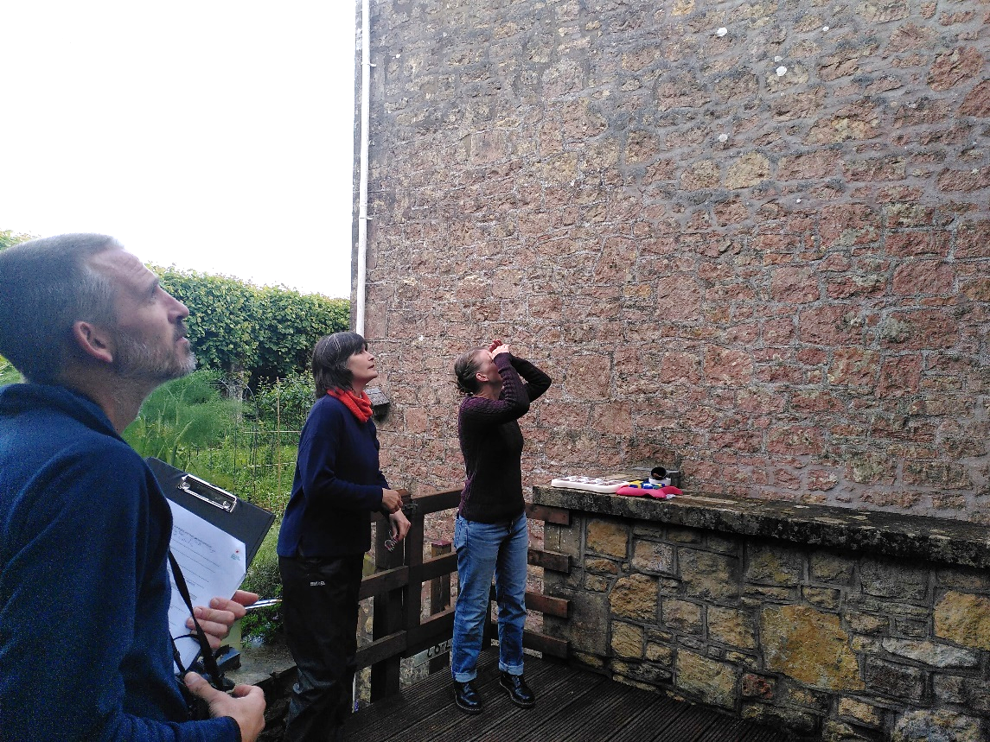
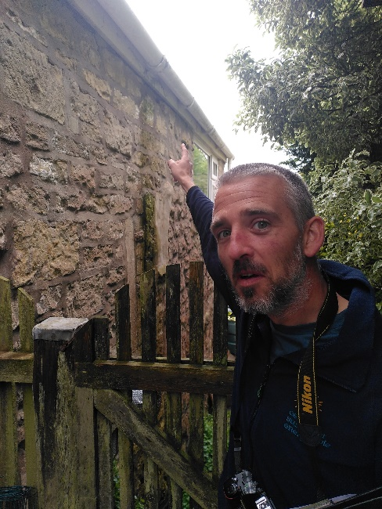
Not Yet Green Open Homes
Showcase homes that are yet to be retrofitted.
CSE staff lead tours on damp, disrepair and past measures done to the home, and advise homeowners on the best approach for energy efficiency improvements.
Notes:
Green Open Homes have been part of community efforts encouraging retrofit for decades now. The goal of green open home events are for neighbours to inspire others by opening up their homes for a day and showing visitors what energy efficiency or sustainable measures they’ve taken, and offer the honest truth of how they got to where they are.
Through the LEAD project, we’ve focused on traditional and hard to treat buildings. The LEAD project has allowed us to pilot a new frame on the regular green open home model – the not yet green open home.

Slide 44
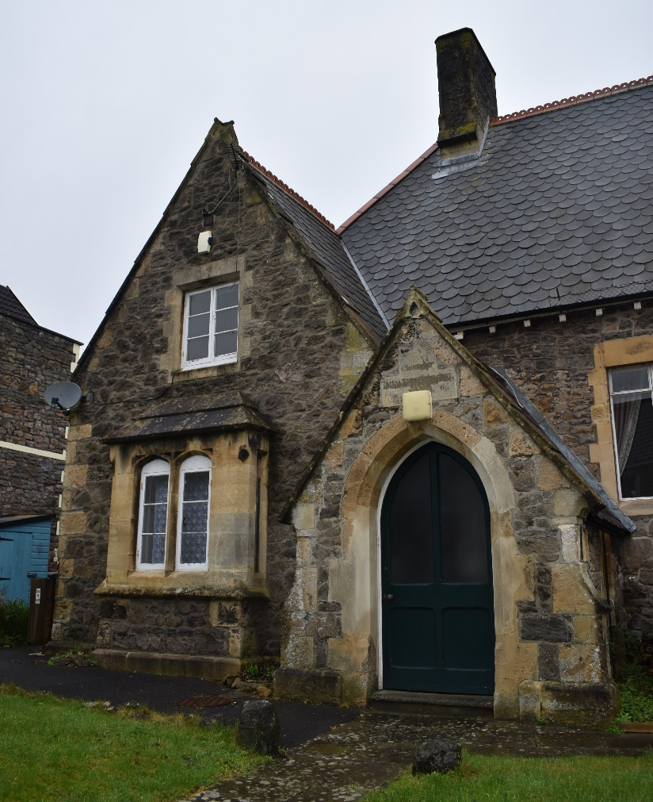
Case study: Sustainable Clevedon Not-Yet-Green Open Home
Grade II listed 1890s cottage in town centre.
Local people visiting touring a house similar to theirs, discussing damp and mould issues, and getting an idea of where to start with making energy efficiency improvements.
Notes:
Working with Sustainable Clevedon we hosted an open home day with a twist, the home that was opened happened to be a traditional building that’s Grade II listed, thankfully it’s unoccupied as it’s suffering from a few damp issues.
We chose this as we felt it would be useful for local residence to take a tour around a house that’s similar to theirs, discuss what’s causing some of the damp and mould issues, and hopefully get an idea of where to start with making improvements.

Slide 45
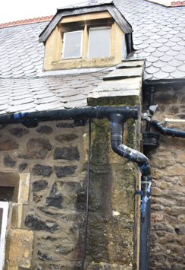
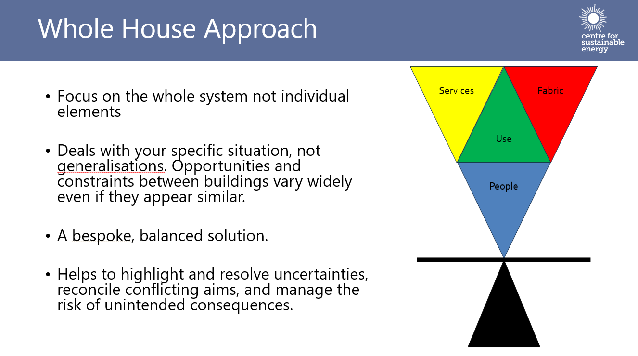
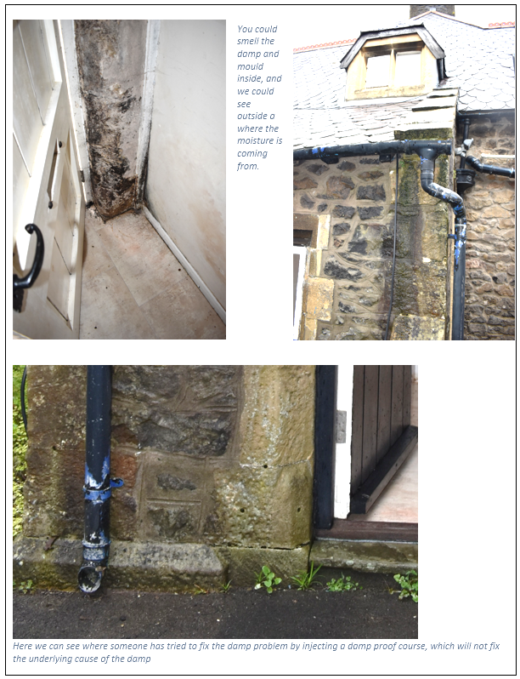

Notes:
Kate
Steve and I had 4 sessions during the day, each with a presentation on the basics of building retrofit, followed by a guided tour of the home. Just over an hour for each group.
In the presentation we outlined what we would be looking for, and then
On the tour we identified and discussed some of the usual suspects that often lead to damp and mould, leaking gutters, faulty drainage, lack of repair and maintenance, inappropriate damp proof injections, inappropriate cement pointing and plasters, poorly fitted roof insulation, and lack of ventilation provision.
Following on from the tour we had lots of questions and discussion, it seems some of the issues mentioned seem to be pretty common yet finding suitable advice and help to deal with these issues is tricky.
And as always at community events there are tales of woe and lessons to be learnt from past retrofit mistakes which always makes for good learning.

Slide 46



Notes:
In practice this is what it looked like ^
The outcomes of the day were promising. People were generally intrigued to learn more about dealing with issues first, having presumed that retrofit only meant insulation and heat pumps. This quote showed that people were reconsidering what they needed to be doing in their homes.

Slide 47

Public response
Visual elements worked well combined with small groups and plenty of discussion time.
Visitors were surprised to learn about the importance of repairs and moisture management.
There is a preconception that retrofit only refers to heatpumps and that older homes need a lot of insulation.
I discovered that what I assumed should be my next steps for eco renovation are probably incorrect, and I need to have a rethink!
Notes:
The outcomes of the day were promising. People were generally intrigued to learn more about dealing with issues first, having presumed that retrofit only meant insulation and heat pumps.
This quote showed that people were reconsidering what they needed to be doing in their homes.
This is key because we want to prevent poorly informed retrofit or maladapted retrofit.

Slide 48
Why a Not Yet Green approach?
Bespoke approach is better for traditional homes.
Focus on dealing with common house issues attracts a wider range of visitors beyond those able to pay for low carbon technology.
In-person advice combined with hands on learning has greater impact, especially for the delicate topic of issues in the home.
Focusing on repairs and damp management for homeowners as retrofit first steps avoids promoting maladaptation.
Notes:
A bespoke approach to older, traditional homes. Old homes have had lots of work done by owners over the years so it’s important to look at all the different elements and focus on what you’re dealing with before adding new works.
Some people in our area are dealing with inappropriate past retrofit measures, such as wall insulation, which has made their homes more damp. Sometimes these people are opening their homes as part of traditional green open home events, with the best of intentions – but adding insulation does not solve all problems, and this is a common example of people mal-adapting their homes to be more energy efficient. We were concerned that Green Open Homes can over simplify advice to home owners which is less helpful for owners of old homes. The one-size-fits all approach to retrofit is not suitable for the large variety of homes in the UK.
Additionally, Green Open Homes can be swung towards superhomes, passiv homes, which are less relatable, and the focus on green or eco terms means that the audience is narrowed to people already committed to investing a fair amount of money into carbon reduction measures.
Not Yet Green Open Homes is open to a wider audience of people and is more relatable. It avoids promoting maladaptation by showing valuable repairs and damp management insights for homeowners as a first step before retrofit. It serves as a good starting point for what to look at, what to consider etc.

Slide 49
Reflections
People have preconceptions about what retrofit means – and it restricts what they think they can achieve if they think retrofit is just heat pumps and insulation
With traditional buildings, focusing on repair makes sense to people and changes their thoughts about next steps
People learned that their next step mightn’t be the best one.
Focusing on repairs, having the visuals in front of them – counter balances the culture of attaining the symbol of achievement (insulation, solar panels).

Slide 50



What is maladaptation?
Notes:
Image on the right comes from the Chartered institute of builders (CIOB) Technical information sheet on retrofitting buildings, and shows that expanded polystyrene (EPS) which is commonly used on traditional buildings is not suitable as it’s vapour impermeable and may end up causing more hard than good.
Guidance from Historic England - Minimise harm and risk of maladaptation
An understanding of how a building performs is essential to avoid proposals which result in maladaptation, such as increasing the likelihood of damp through providing inadequate ventilation. Certain retrofit strategies, particularly those designed specifically for modern construction, are not appropriate for historic buildings.

Slide 51


Why do we need to be aware of maladaptation?
Notes:
It’s a growing problem
Bad for the environment
Waste of money
Causes misery
Harmful to health
Harmful to our buildings

Slide 52



Dry vs Wet
Traditionally built solid stone wall that allows for moisture to evaporate.
Impermeable cement render can trap moisture within the wall
© Cliff Blundell, Precious Inheritance
Notes:
Inappropriate modern materials
So what happens when you put impermeable materials on the outside of a historic building
Wet wall = cold wall
Rotting timbers

Slide 53




Installers have incentives to sell people measures which may not be appropriate for their home
People are eager to take action on energy efficiency
There is a need for engagement with impartial advice at this point to prevent maladapted retrofit
Notes:
At the event we also had frank conversations with people talking about retrofit measures in their home which hadn’t worked as well as they’d been promised – for example spray foam on people’s roof timbers making it impossible to get home insurance or a mortgage as the surveyor can’t see the roof timbers.
These are examples of home in Clevedon where the owners had a home survey from an insulation company which recommended external wall insulation. Their home is up on the sea front, and their cavity walls were filled with urea formaldehyde insulation about 30 years ago. The surveyor did not consider the faulty (and also, dangerously emitting) formadehyde based insulation. And so this household had external wall insulation fitted at a high cost. But they are still dealing with damp and mould inside and the external wall is already darkening with damp. And the old, wet cavity wall insulation is crumbling carcinogens into their loft space. To fix the problems they will need to take all the external wal insulation off and remove the cavity insulation, which would come at significant cost.
Installers have incentives to sell measures which may not be appropriate given the condition of buildings, but which are recommended, for example by an EPC certificate. Installers may not have a reason to consider a whole house approach, especially when only some measures are government funded. And it’s quite difficult for people to know what to do, they are bombarded with information.
This is why not yet green open homes are so important – they are a way to receive impartial advice BEFORE retrofit work which can prevent unintentional, costly maladaptation.

Slide 54


Wind-Driven Rain and Flooding
Community engagement on damp
Notes:
GOH are a good way to talk about the incredibly unsexy issue of damp.
With climate change, there is a higher prevalence of storms. The instances of rain driven by storms hitting the sides of homes instead of the rooves means that there is more pressure on gutters, drainage systems and the walls, or fabric, of buildings to cope with the excess wind driven rain. Especially traditional homes which have been inappropriately rendered or insulated.
Cold damp walls lose heat faster than dry walls, and damp walls with insulation added on may never dry out properly, leading to mould and health problems for residents. This is why retrofit needs to consider damp and repairs as part of energy efficiency measures, and why not-yet-green open homes can play an important role in increasing the visibility of these issues and, crucially, helping people to think about their whole home before they retrofit.
Sources:
(Royal Meteorological Society (2021) The State of the UK Climate 2020. https://www.rmets.org/metmatters/state-uk-climate-2020
https://www.metoffice.gov.uk/research/climate/maps-and-data/about/state-of-climate
Record-breaking rain more likely due to climate change - Met Office
Research : Characterisation of building exposure to wind-driven rain in the UK and evaluation of current standards – ScienceDirect

Slide 55
Conclusion
It's genuinely hard for people to know what to do and where to start.
Every traditional home is slightly different, and a narrow focus on EPC ratings and insulation is inappropriate when damp and repairs aren’t considered.
Impartiality, expertise and in-person advice by organisations like CSE compliments the open home approach, and makes a huge difference for owners of traditional homes.
  Where to start
  How to avoid maladaptation
  How to protect their unique home
Notes:
Third sector leading the way
Impartial advice
Looking at a home in disrepair rather than a “super home” with flashy measures = avoiding mistakes by starting with whole home approach
We’ve run these events in two North Somerset villages and are building up

Slide 56





Notes:
Lydia & Kate at a community event in Dundry
Online retrofit training for GOH home openers
GOH in Clevedon coming up this weekend
Portishead ENERGY Expo next weekend
Sherlock Homes resources for young people about retrofit

Slide 57
Sara Grimes
Bath and West Community Energy

Slide 58


Utilising Skills & Partnerships
Sara Grimes
Bath & West Community Energy
This Photo by Unknown Author is licensed under CC BY-SA

Slide 59

Contents
Skills gap:
  Sector wide
  Experts
Upskilling with Green Heritage Homes
  Partnership
  Training
  Joint Working
  Peer to Peer
  Simplifying

Slide 60

The Skills Gap: Whole Sector
Retrofitting traditional buildings is different.
Listed buildings = a further lens needed
Patchy knowledge amongst non-specialists
Built environment professionals
Installers
Notes:
Built environment professionals & installers
Not required to have training in conservation or retrofit to be a built environment professional or installer
* If they get a historic retrofit case, they go to the ‘experts’ for advice, however the experts speak different languages

Slide 61

The Skills Gap: The Experts
Two distinct expert disciplines informing the sector and clients
Retrofit professionals
Conservation Professionals
Notes:
Retrofit professionals
May or may not understand historic buildings – PAS 2035 – Level 3 course.
Listed buildings - Often overly or insufficiently ‘conservative’ in what they recommend to clients, unable to do basic heritage assessment to advise on what might be suitable
Conservation Professionals
Expert knowledge of how the building has been constructed and how to keep it functioning as intended
Intimate understanding of what makes the buildings special
Concerned about change and harm – unintended consequences ‘once it’s gone it’s gone forever’
U Values etc a foreign language

Slide 62

Project Aim: Create a shared, positive understanding
Conservation
Energy

Slide 63

Upskilling: Partnership
Energy and conservation professionals working together
Bath & West Community Energy
Centre for Sustainable Energy
People Powered Retrofit
B&NES Council Planning – Conservation
Bath Preservation Trust

Slide 64

Upskilling: Being Trained
All energy and conservation assessors did
Level 3: Retrofitting Historic Buildings
Bespoke training from Green Register/ Nick Heath
Notes:
Getting trained
- Being trained together – having a baseline of understanding

Slide 65

Upskilling: Joint working
Co-create content: webinar, videos, factsheets. Challenge = simplify
Practice together ‘Listed Building Champions’ had simultaneous visit from a Conservation Officer and a Retrofit Assessor; corroborated report

Slide 66

Upskilling: Peer to Peer
Best messenger for own networks
Conservation Officer: RTPI, London Councils, colleagues
BWCE: Community Energy England, Toolbox Talks for built environment professionals
Expert Homeowner: Listed Building Champions- Case studies, communicate

Slide 67

Upskilling: Simplifying
Professionals and householders need a simple way to grasp the concepts. Presented in:
Webinars and Spotlight Sessions
Factsheets
Videos: Walls, windows, heat pumps, solar, simple measures, understand your building, landlords.

Slide 68


Slide 69

Do get in touch!
info@bwce.coop

Slide 70


Slide 71
Contact us and sign up to our newsletter
www.swnetzerohub.org.uk
swnetzerohub@westofengland-ca.gov.uk
South-West-Net-Zero-hub
Sign up to the rest of the webinar series https://www.swnetzerohub.org.uk/knowledge/events/lead-webinars/

Slide 72





TCPA’s work on planning for climate change
Website: https://www.tcpa.org.uk/areas-of-work/climate-change/
Twitter/X: @theTCPA
LinkedIn: uk.linkedin.com/company/tcpa

