Slide 1
A model for Community energy collaborative working
The Far SW Retrofit Consortium LEAD Project
Justin Bear and Dan Godfrey
Notes:
I’m Justin, he’s Dan
Here to talk about collaborative working with community energy.
I’m going to talk about:
who we are
Why we should foster collaboration at a community level
Some successful partnerships between CE & private sector
Our LEAD project – a collaboration of 6 CE organisations. Why, how and what have we learned.

Slide 2

Plymouth Energy Community
A charity and social enterprise, with a cooperative ethos.
We exist to empower our community to create a fair, affordable, zero carbon energy system with local people at its heart

Slide 3




Our Mission
Bring local people and organisations together to tackle fuel poverty and the climate crisis.
Increase local ownership and influence over local energy solutions.
Improve community confidence to engage in the zero carbon transition.
Enable people to heat and power their homes affordably.

Slide 4
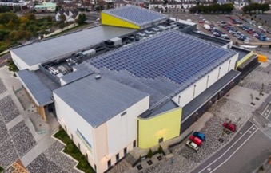

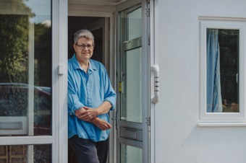
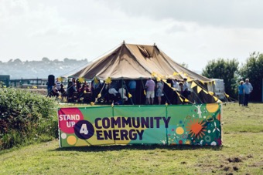
Our activities
Operate and expand 5MW of solar power in the city.
Provide 1:1 support to 1,600 fuel-poor households annually, saving £800k.
Helped 320+ low-income households' access £4m+ for retrofits since 2021.
Turnover £2.2m+ with over 30 staff.
Innovate and pilot new approaches to create change.
Champion a fair, low-carbon city through community and strategic leadership.

Slide 5

Local retrofit hubs
“Recommendation 111 - Government should support establishing retrofit hubs by 2025 to bridge the gap between households and suppliers”
Mission Zero Review
“Developing lasting partnerships and creating a culture of collaboration with other local authorities, regional agencies, social housing providers, academia, training providers, local businesses and community groups will be time consuming but will reap rewards over the medium term.”*
LGA Local Authority Domestic Retrofit Handbook 2023
*Bold text added by slide author
Notes:
Local Retrofit Hubs are important
What is a retrofit hub – it will look different in every place but for me it can be one stop shops, or effective collaboration of the organisations working on retrofit in a local area.
LEAD has been an important project that has invested in these hubs
Wider policy has been hostile to the concept of local retrofit hubs:
Top down
Households as passive recipients to take or leave measures
failed to invest in local capacity to deliver
driven the worst excesses of the industry
Lots of reasons why local hubs are important but for us, one is particularly important – restoring trust and building demand
If we seek to implement a 6fold increase in retrofit, will households follow? (HUG2 example)
This is why local hubs are important AND why community energy leadership within these hubs is beneficial

Slide 6
The value of community energy in local delivery
Trusted
Talking to the public already about energy
Integrate retrofit programmes with other support
Hyper local – understand the local people and their housing
Community focussed – can represent resident experience

Slide 7
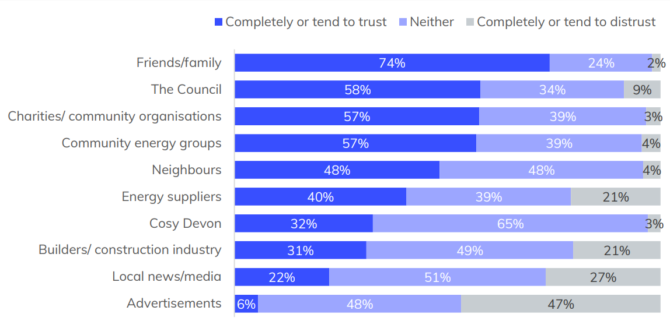
Survey of 4818 households in Devon

Slide 8

Collaboration in grant funded retrofit

Slide 9

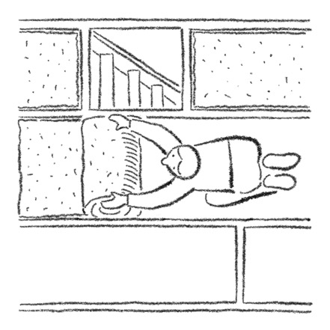
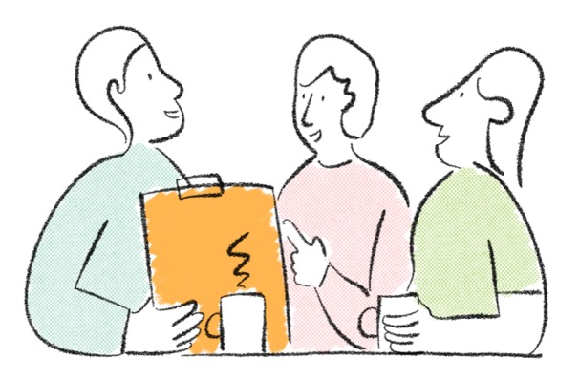
Community energy role – trusted advice
Community energy as a trusted, local ‘lead generator’
Notes:
The traditional model for community energy in ECO delivery and local authorities is to get them doing the ‘people’ bit at the start of the journey.
Referral fees model with ECO installers
Pitfalls – little transparency over what is available for people and if customers get support. Big reputational risks. Generally, loss making. Compromises integrity.

Slide 10
LA Scheme Delivery – advice role
Local Authority
Community Energy Partner
Procured Installer
Trusted first contact for residents
Check and balance on installer power
Doesn’t solve the problems inherent in Tier 1 contractor led delivery
Can be reputationally risky for Community Energy
Subcontractors
Recruiting households
Assessment
Design
Sign off
Advice and eligibility
Coordination
Installation
Evaluation and QA
Notes:
Partner model in LAD/HUG
Pitfalls – no control over installers, significant reputational risk, often undervalued and overworked.
Advantages for scheme delivery – honest broker for council about state of the scheme and installer performance, more latitude to handle complaints and issues before they become entrenched issues, better customer experience, better customer recruitment.
Both models help to recruit households based on the involvement of community groups, but they do not offer any control or empower the community group.

Slide 11
LA Scheme Delivery –
Retrofit Services role
Local Authority
Community Energy Partner
Procured Installer
Designer
Embedding a trusted partner throughout the customer journey
Robust checks and balances on QA, led by trusted organisation
Minimises installer involvement, enabling inclusion of non-T1 contractors in the scheme.
A lot of coordination between partners needed – clarity on who is leading this and responsible for it needs careful planning
Subcontractors
Recruiting households
Assessment
Design
Sign off
Advice and eligibility
Coordination
Installation
Evaluation and QA
Notes:
Something like this model has been in use by Devon County Council.
It’s a great example of how to work with community energy to deepen that relationship, increase capacity at a local level and reinforce the customer voice in delivery.

Slide 12
LA Scheme Delivery –
Community Energy
direct grants
PCC
Community Energy controlling customer journey
Open to all tiers of PAS2030/MCS installer – installer has minimised role
Installers only introduced to the scheme if vetted. Installers removed if not performing
Clarity of having an organisation leading delivery, with advantages of having checks and balances
PEC
Retrofit services company
Any vetted installer
Contract for works
Recruiting households
Assessment
Design
Sign off
Advice and eligibility
Coordination
Installation
Evaluation and QA
Notes:
This is the approach we are planning for WHLG, For previous schemes we’ve had coordination and design sit with the installer, so this is untested yet.
Contractually this is like the setup of something like the Green Homes Grant Voucher scheme, but with localised customer and installer support reinforcing delivery.
Key to how it works is it breaks down delivery to have the right specialists involved in the right bit of work. Customer handling specialists are supporting customers, heat pump specialist installers are doing heat pumps, Plymouth based assessors are doing assessments and technical surveys. Nobody is travelling across the country to stay in a cheap hotel for a few days of installation work.

Slide 13

What does Community Led retrofit look like?
Customer perspective:
How likely to recommend to friend or colleague 9.5 / 10 av.
How would you rate PEC’s service 4.8 / 5 av.
73% feel better about their home
64% feel more confident in managing energy usage
58% feel less worried about winter
Installer perspective:
“probably the smoothest scheme we’ve worked with. In particular, the quality of the leads … (and) where we've run into obstacles there has been a joint effort to find successful solutions” J&J Crump and Sons
The cost?
A&A costs within 15% of capital (SWF).
Capital costs 11% lower than national average.

Slide 14
Is this replicable?
Needs community groups that:
  Are experienced in delivering services to fuel poor households
  Understand retrofit and the PAS2035 process
  Have capacity to deliver a responsive, professional service to householders
  Understand the needs of local authorities and will work to deliver these
Local authority needs:
  To view community energy as a long-term collaborator, not an alternative contractor.
  To value the extra work and the outcomes of this (i.e. advice)
  To commit some funding at risk to invest in services

Slide 15

Far South West LEAD Project

Slide 16
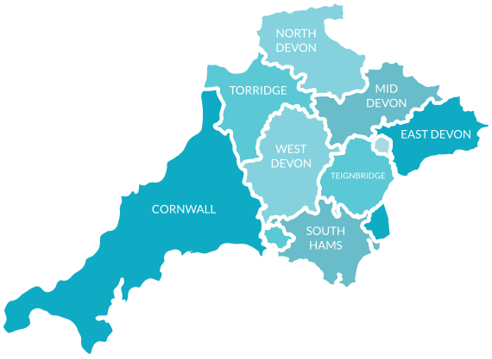






LEAD - Far South West Consortium
£1.4m awarded to a 6-partner consortium via LEAD.
Coordinated launch and development of an advice service.
Strong history of collaboration across partners and with the private sector.
Model for how to foster community energy to build resilient retrofit hubs

Slide 17
Project aims
A consortium delivering a consistent ‘funnel’ of services.
Partners working within this framework to customise services to meet local community needs.
Collaborative resource development to improve delivery.
Opportunities for mutual learning and relationship building.
A refined, impactful retrofit service established by March 2025.

Slide 18

The Advice funnel
Advice in the community
Friendly, customer led retrofit advice
Whole House Plan
Retrofit coordinator support to complete works

Slide 19
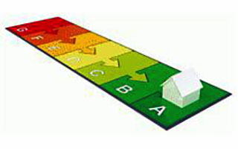

Our LEAD Project
IR
Airtightness
Whole House Plan
Retrofit Advisor
Retrofit Coordinator
MCS/trustmark installer
Traditional building renovation specialist

Slide 20
Advice focus
Supporting households on a low income
Supporting households less confident in accessing information online
Supporting households living in properties built before 1929

Slide 21

Why a consortium?
Regional hub model: Combines hyper-local benefits with the efficiency of a single regional contract.
Shared expertise: Pools skills and capacity effectively.
Integrated learning: Embeds knowledge-sharing within the project.

Slide 22

Project organisation

Slide 23
Project organisational structure
How to turn a consortium into a functioning project structure?
Clear from the outset that PEC didn’t have the resource to lead all elements of the LEAD project.
Neither did we want to:
  Project management responsibility
  Financial risk
  Reputational risk
  Lack of knowledge about local contexts where partners operate
Lessens the value that partners can contribute if one dominates, and we wanted to draw on the full breadth of experience and skills available to drive innovation.
We needed to try something new and innovative.

Slide 24
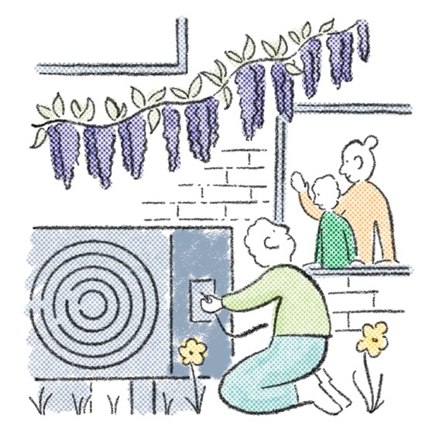
Project organisational structure
The risk with a collaborative project is that it either:
  Becomes a talking shop where little is achieved…
  Or a collection of individual projects that don’t fully utilise the value of collaboration and partnership.
Finding the sweet spot between delivery, discussion and collaborative creativity can be tricky!

Slide 25

Project organisational structure
In designing the organisational structure for our LEAD project, we took inspiration from a model called Living Systems.
This is a model that PEC has been experimenting with in recent years.
Key to our implementation of this model have been the formation of teams with a defined operational purpose within which they have the autonomy to make decisions and take action.
Teams are made up of individuals with an interest or skills relevant to the team’s purpose, regardless of their day-to-day job role.
Teams have a flat, non-hierarchical structure.
A written mandate – defining their purpose, accountabilities, decision making scope, membership.

Slide 26
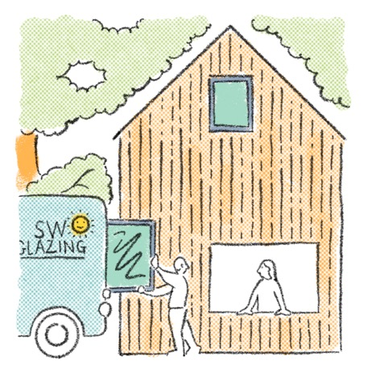
Project organisational structure
The Living Systems approach to organisation allowed decision making and action to be distributed and led by those in the consortium with best skillset to do so.
Each partner organisation would also be responsible for its own ‘mini-project’ in their geographical area and KPIs.
Vital to have:
  Effective channels of communication
  Coordination and organisation
  Decision making responsibilities
  Overarching project management functions
  Clarity on activities and tasks

Slide 27

Tamar (TEC)
South Dartmoor
(SDCE)
Plymouth City Council
Messaging & Comms
Devon County Council
Devon Community Energy Network
Project management
Data
Interconnector Forum
Plymouth (PEC)
Exeter (ECOE)
DESNZ
Target Market
Evaluation & Learning
Professionali-sing Service
Energy Saving Devon
Dartmoor Energy
Technical
Advisors
SWNZH
361
Cornwall (CEP)

Slide 28
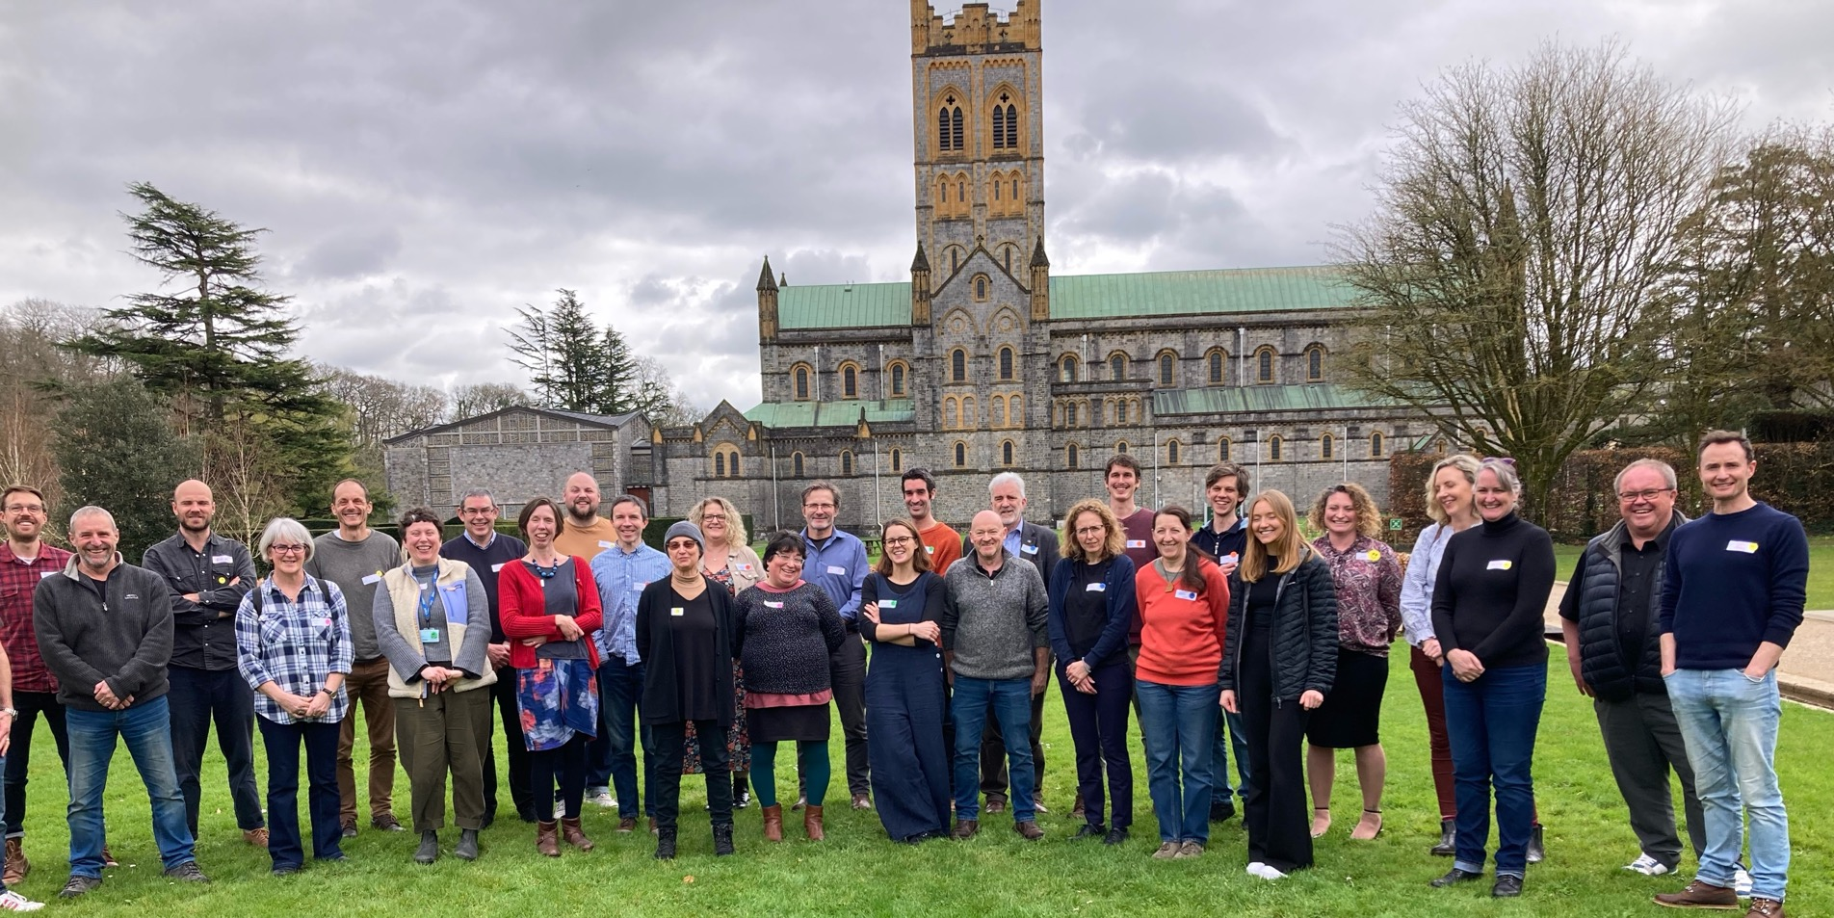

Slide 29

Project organisational structure
Important roles created and defined:
  Interconnectors
  Coordinators
  Organisation leads
  Project Managers (whole project and partner projects)
Each role has a written mandate.
Each team has a written mandate.
Accessible by all so that everyone understands clearly where responsibilities lie

Slide 30
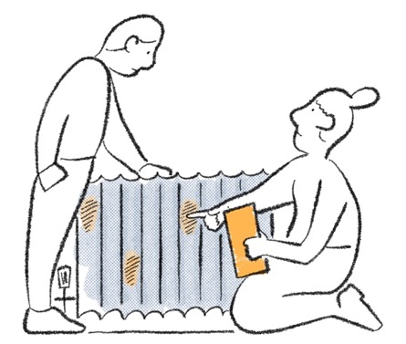
Project organisational structure
Teams meet as and when they need to – led by their Interconnector and Coordinator.
Monthly Interconnector Forums have 2 standing agenda items
  Team Updates
  Organisational Updates
Interconnectors prepare a standard slide template that prompts them to consider:
  Achievements
  Inter-dependencies
  Outstanding work items
  Risks
These form a ready-made summary of the project that can be taken back to teams/organisations where needed to facilitate good communication.

Slide 31

Project organisational structure
Social connection between teams
  We wanted to create a sense of a single LEAD team working towards delivering the projects aims
  Two consortium wide events – time to get to know one another
  Check-ins at start of meetings
  Strived to build a strong collaborative ethos, friendly, ‘in this together’, recognition that everyone is coming with different experience, skills and perspectives
Decision making processes
  PEC holding the relationship with the funder
  But… project decisions taken in the project teams and at the Interconnector Forum
Clarity of tasks/budgets/responsibilities
Shared resources – SharePoint, BookStack, Taiga kanban boards

Slide 32

Knowledge platform - bookstack
We use an open-source knowledge platform called Bookstack as a shared project resource.
Essentially a wiki that can be contributed to by project members – simple, clean and intuitive to use. Keeps things tidy!
Cheap to operate.
Allows modifiable guidance resources, e.g. how to complete claims, to be prepared and shared across all teams without the need for numerous email chains.
Also used as a shared notebook space by each project team

Slide 33
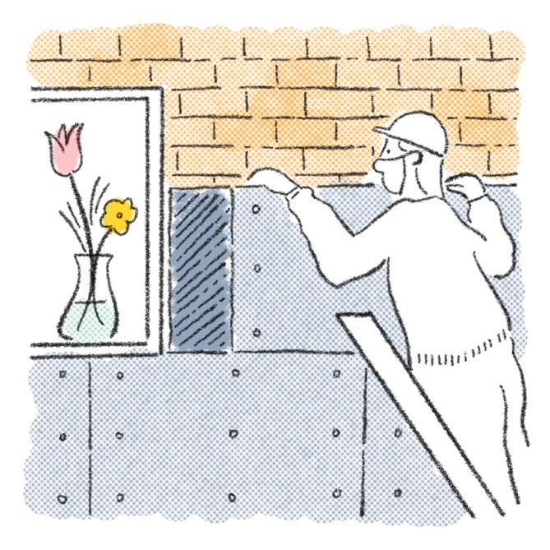
Kanban Board - taiga
Open-source Kanban Board software
Allowed a shared picture of what each team was doing and its progress.
Captures who is responsible for different tasks and their status.
Didn’t work as well as it could have but some teams found useful.

Slide 34
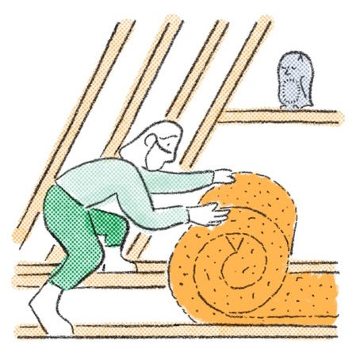
Lessons learnt
Communication is key to making this work.
Look out for work that overlaps.
Look out for 1 or 2 individuals picking up all the work.
Allow team membership to be flexible.
Allow team’s work remit to be open to change as project progresses.
Make space for experimentation and for things to evolve.
Interconnectors often become team leaders – be mindful of how/where this is happening.
It’s worked well for our consortium as a structure that fosters shared ownership and uses skills from across the consortium to innovate and problem solve.
But… not sure the team model is the best approach for all work areas. In future we may have more individuals funded to work on a particular work stream, directed by a Steering Group.

Slide 35
Project operational systems
Devolved system for managing:
  Budget
  Tasks
  Claims

Slide 36
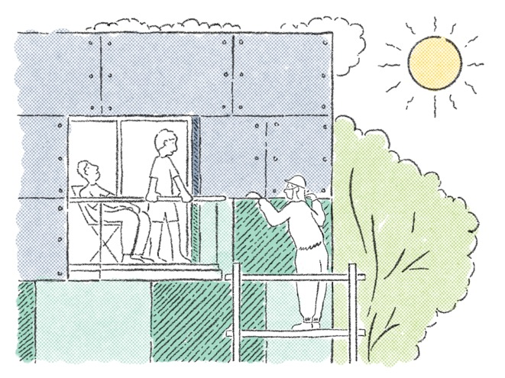
Budget management
With 6 partners delivering work, we needed a budget management approach that was clear and straightforward for PEC and the partners whilst meeting audit requirements.
Devolution of budget/task responsibility to the teams and organisations was key.
We decided to manage this largely from a ‘payment on delivery’ perspective (service KPIs, report completed, case studies generated, service established etc.).
There are also elements of ‘management’ payments and direct cost claims, but these are kept to a minimum.

Slide 37
Budget and task management
A single Delivery Budget spreadsheet runs to 450 individual task/budget lines
Easy to filter by Core Budget Area/Cost type/Unit Responsible/Year etc.
Captures starting and remaining budget values
Captures brief task description
Located on PEC’s SharePoint and accessible to all
Ensures single version of the truth
Enables tracking of spend against the agreed core budget lines in our Grant Agreement

Slide 38
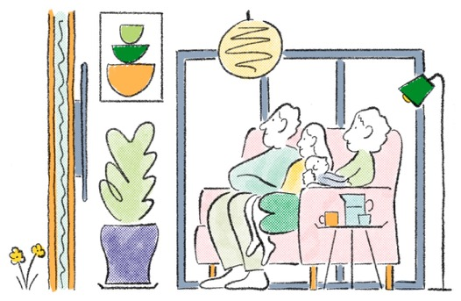
Budget and claims process
Our Delivery Budget spreadsheet forms the basis for our quarterly claims.
  We prepare a claim form for each team and organisation each quarter with available budget lines.
  Each team returns their claim form with their claim allocated to their budget lines.
  The claim form also captures a link to evidence supporting each claim line – saved to SharePoint.
  These are checked and approved by the PEC team.
  Team claims are allocated to each organisation depending on the staff involved in that team.
  Each organisation is provided with a claim summary that outlines what they should invoice for.
  A compiled claim is generated by PEC for submission.
This helps to generate a clear audit trail as we go, ensuring evidence is provided and can be easily tracked to support any lines queried.

Slide 39

Reflections

Slide 40


Project aims – how are we doing
A consortium delivering a consistent ‘funnel’ of services.
Partners working within this framework to customise services to meet local community needs.
Collaborative resource development to improve delivery.
Opportunities for mutual learning and relationship building.
A refined, impactful retrofit service established by March 2025.

Slide 41
Has it been effective at delivering?
Deliverable | Target
In person retrofit advice | 1570
Whole House Plans Completed | 299
People engaged in community | 10850
Measures installed | 440
Customer satisfaction | 80%
Target

Slide 42
Consortium Experience
Enabling – organisations have been able to grow services faster than if funded alone
Supported development – Peer learning has supported rich development of knowledge and understanding.
Wealth building – collaboration that will last beyond the project, making the region a fertile environment for retrofit services growth.

Slide 43
Risks in model
Financial risk – if deliverables are not achievable within the budget, project quickly becomes loss leader for partners.
Lack of control – PEC cannot compel any partner to devote resource to the project.
Unfair working groups – work falling on certain individuals more than others.

Slide 44
Our learning
Hub and spoke model delivers the best of hyper local with the funder experience of a single regional hub.
Decentralised delivery responsibility and budget gets the best out of a consortium…. If well thought out and carefully costed*.
Learning and development is accelerated by working in consortia of equals.
*And there is trust and a base level of competence in the consortium

Slide 45
Our learning
Centralisation is important for some things, like coordinating installers or large marketing campaigns.
Working groups aren’t always working. The shared knowledge is there but this doesn’t always translate to shared action.
Steering groups with well-resourced individual or small team delivering work may work better for some things.

Slide 46
Lead organisation role profile
Trusted by consortium
Willing to be robust with funder to make the project work
Good administrative skills
Comfortable creating a detailed budget framework
Comfortable in navigating flexibility within this framework
Able to hold the key project aims and objectives through the noise

Slide 47
Justin@plymouthenergycommunity.com
Dang@plymouthenergycommunity.com

