Slide 1
Innovations in Retrofit:
Retrofit as a service

Slide 2
Dr Laura Fogg-Rogers
University of West of England

Slide 3

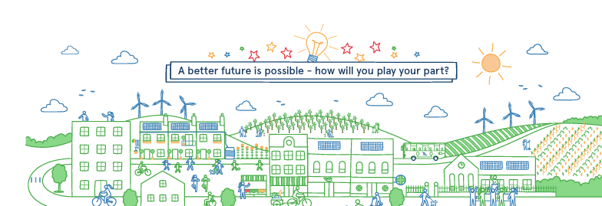






Community Engagement
Dr Laura Fogg-Rogers
Associate Professor for Engineering in Society, UWE-Bristol
https://people.uwe.ac.uk/Person/LauraFoggrogers
we-count.net
Notes:
Hello I’m Dr Laura Fogg-Rogers from UWE Bristol. So firstly the reason that we are here is that this is an urgent crisis – a Climate and Ecological Emergency. We have experienced the warmest September on record globally, and the impacts are being felt throughout the world – ice melting, epic floods, and global wildfires.

Slide 4




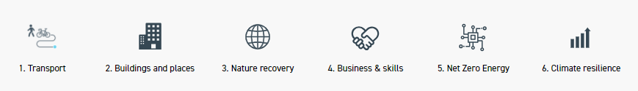
Net Zero by 2030
Transport - 45% reduction in vehicle miles
Energy – renewable energy for heating and hot water and no fossil fuels for all households
Waste – at least 65% of all waste is repaired, recycled or reused
Nature – enhance biodiversity by 30% through nature restoration, protection and enhancement
Notes:
https://www.bristolonecity.com/wp-content/uploads/2020/02/one-city-climate-strategy.pdf

Slide 5
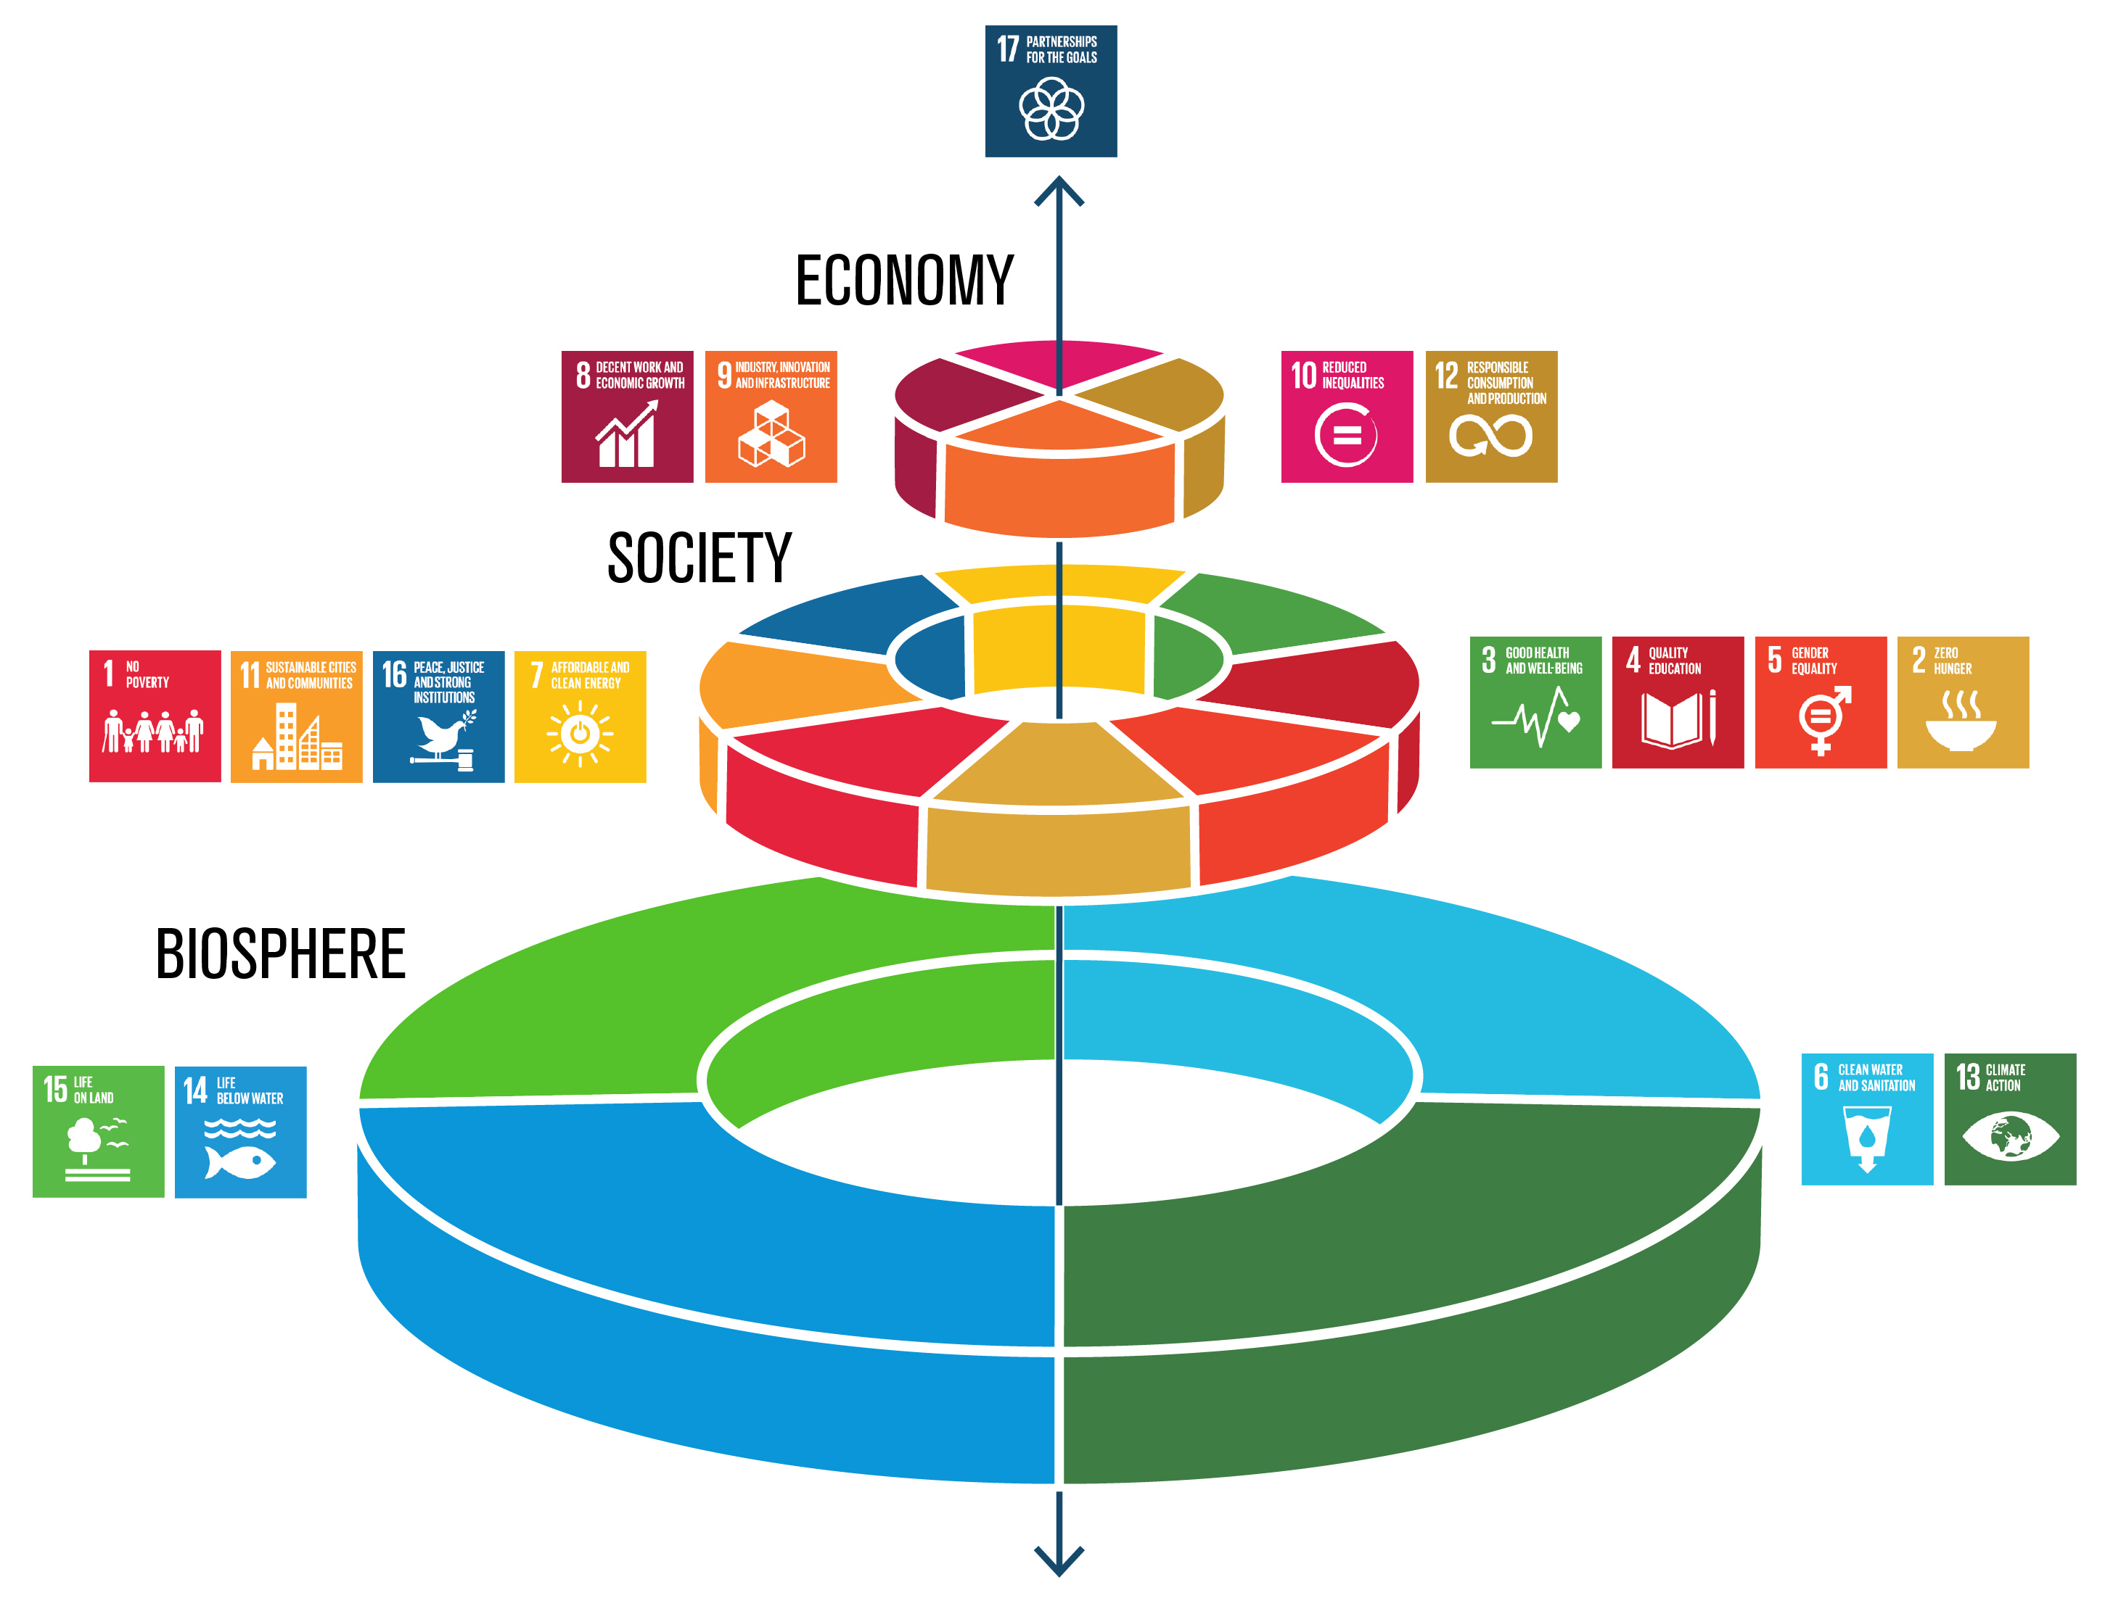
A just transition?
Action to enable a ‘just’ transition tries to combat inequality to bring about fairer outcomes as the world transitions to net zero carbon emissions, maximising the benefits of climate action and minimising the negative impacts for workers and communities.
Procedural
Distributive
Recognition
Restorative
Abram, S., Atkins, E., Dietzel, A., Jenkins, K., Kiamba, L., Kirshner, J., … Santos Ayllón, L. M. (2022). Just Transition: A whole-systems approach to decarbonisation. Climate Policy, 22(8), 1033–1049.
Notes:
Ask the students to think of examples for where this is happening at the moment? E.g. Internal combustion engine cars to electric vehicles

Slide 6
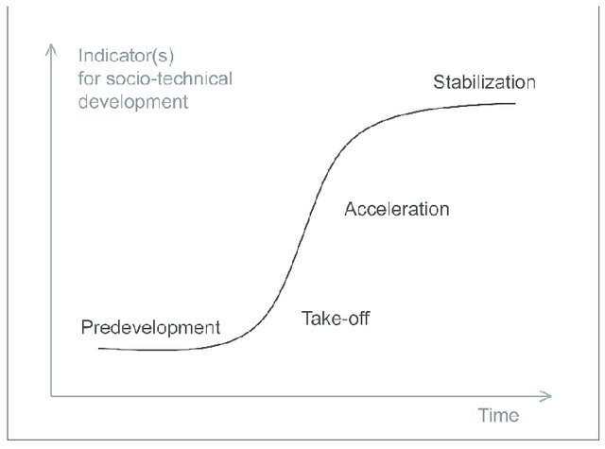
Socio-technical transitions
 | Endogenous Niche Momentum | Regime Tensions
Techno-economic | price/performance improvements as a result of R&D, learning by doing, scale economies, complementary technologies, and network externalities | technical failures, disruption of infrastructures, accumulating negative externalities (e.g., CO₂ emissions)
Business | new entrants or incumbents from other sectors are more likely to drive radical innovation than traditional incumbents. Their success may lead to “innovation races” when other firms follow a first mover | shrinking markets, economic difficulties in incumbent industries, loss of confidence in existing technologies and business models, reorientation toward alternatives
Social | growing support coalitions and constituencies improve available skills, finance, and political clout | disagreement and fracturing of social networks, defection of key social groups from the regime
Political | advocacy coalitions lobby for policy changes that support the niche innovation such as subsidies and supportive regulations | eroding political influence of incumbent industries, declining political support, removal of supportive policies, introduction of disruptive policies
Cultural | positive discourses and visions attract attention, create cultural enthusiasm, and increase socio-political legitimacy | negative cultural discourses undermine the legitimacy of existing regimes (e.g., coal and climate change, diesel cars, and air quality)
Geels et al 2017
The Socio-Technical Dynamics of Low-Carbon Transitions - ScienceDirect
Notes:
Ask the students to think of examples for where this is happening at the moment? E.g. Internal combustion engine cars to electric vehicles

Slide 7
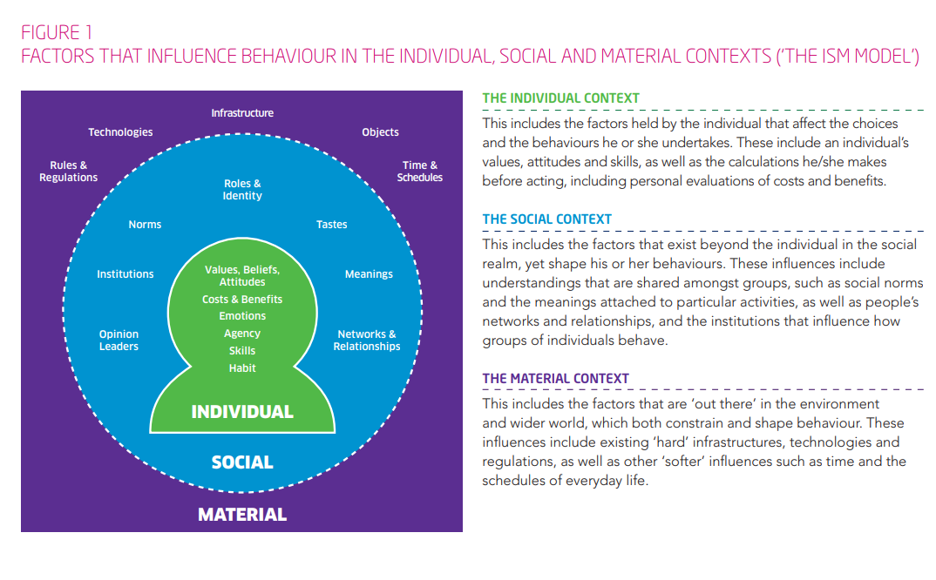
Influencing Behaviours - Moving Beyond the Individual : A User Guide to the ISM Tool (www.gov.scot)
Notes:
Behaviour change is enabled by our environment – but individual change is integral to collective change

Slide 8
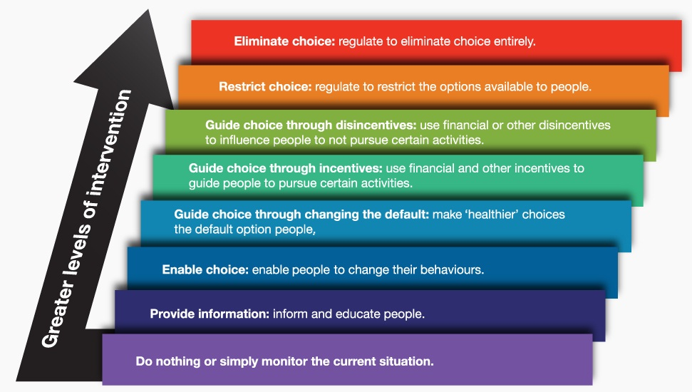
Nuffield Council on Bioethics. Public health ethical issues. London: Nuffield Council on Bioethics. 2007

Slide 9


Behaviour change usually focusses on individuals
First Home Buyer
Working Class background
Centre-right politics
Chatterton, T. and Wilson, C. (2014) The ‘Four Dimensions of Behaviour’ framework: A tool for characterising behaviours to help design better interventions .
Transportation Planning and Technology, 37 (1). pp. 38-61. ISSN 0308-1060
Fogg-Rogers, L.; Hayes, E.; Vanherle, K.; Pápics, P.I..; Chatterton, T.; Barnes, J.; Slingerland, S.; Boushel, C.; Laggan, S.; Longhurst, J.. Applying Social Learning to Climate Communications—Visualising ‘People Like Me’ in Air Pollution and Climate Change Data Sustainability 2021, 13(6) 3406 doi.org/10.3390/su13063406
Notes:
However, usual behaviour change tactics focus on individuals as rational beings able to make choices – presenting us with evidence and imploring us to make a change. However, research shows that these changes are short-term and one-off. To make long-term changes we need to integrate them into our social networks – we need to think of the multiple identities and groups that we all move in.

Slide 10
Social Cognitive and Social Identity Theories
“An individual's learning is not only related to their personal capabilities and experience, but also to their observations of others within the context of social interactions, experiences, and outside media influences”.
Fogg-Rogers, L., Sardo, A.M., Boushel, C. (2017). Robots vs Animals: establishing a culture of public engagement and female role modelling in engineering higher education. Science Communication
Social identity theory
Social categorization
Social identification
Social comparison
Social badges – in groups and out group
Tajfel, 1979
Social cognitive theory
Vicarious experiences
Mastery
Verbal persuasion
Emotional arousal
Bandura, 1977

Slide 11
Social Learning
“An individual's learning is not only related to their personal capabilities and experience, but also to their observations of others within the context of social interactions, experiences, and outside media influences”.
Fogg-Rogers, L., Sardo, A.M., Boushel, C. (2017). Robots vs Animals: establishing a culture of public engagement and female role modelling in engineering higher education. Science Communication
In group messaging
Relevant messengers (role modelling)
Positive experiences and emotions

Slide 12
Social learning through communities
First-home buyer
Bristolian
Woman
Working-class background
Chatterton, T. and Wilson, C. (2014) The ‘Four Dimensions of Behaviour’ framework: A tool for characterising behaviours to help design better interventions .
Transportation Planning and Technology, 37 (1). pp. 38-61. ISSN 0308-1060
Fogg-Rogers, L.; Hayes, E.; Vanherle, K.; Pápics, P.I..; Chatterton, T.; Barnes, J.; Slingerland, S.; Boushel, C.; Laggan, S.; Longhurst, J.. Applying Social Learning to Climate Communications—Visualising ‘People Like Me’ in Air Pollution and Climate Change Data Sustainability 2021, 13(6) 3406 doi.org/10.3390/su13063406
Centre-right politics
Notes:
However, usual behaviour change tactics focus on individuals as rational beings able to make choices – presenting us with evidence and imploring us to make a change. However, research shows that these changes are short-term and one-off. To make long-term changes we need to integrate them into our social networks – we need to think of the multiple identities and groups that we all move in.

Slide 13
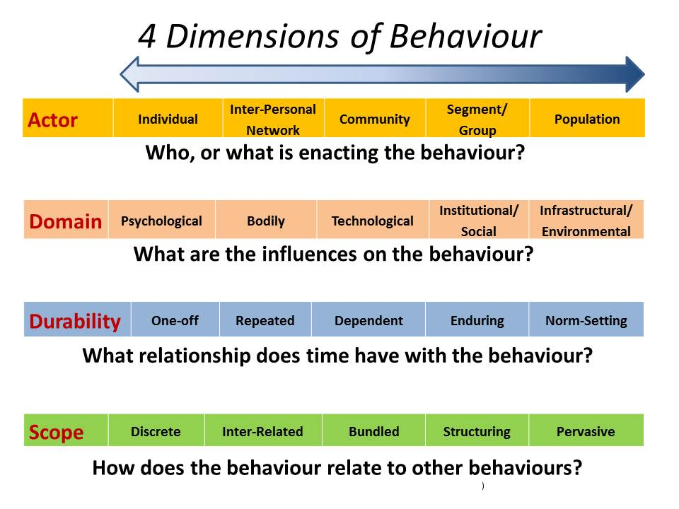
Chatterton, T. and Wilson, C. (2014) The ‘Four Dimensions of Behaviour’ framework: A tool for characterising behaviours to help design better interventions .
Transportation Planning and Technology, 37 (1). pp. 38-61. ISSN 0308-1060
Notes:
Social Practice Theory: Shove et al. (2012)
Social Cognitive Theory: Bandura(2011)
Behaviour Change Wheel: Michie et al. (2011)
“The Values Circumplex” from Schwatrz (2006) http://valuesandframes.org/
Societal behaviour change lasts longer and can have more impact.

Slide 14

Know your audiences
“The most contemporary view of learning is that people construct new knowledge and understanding within the context of what they already know and believe and do it only when they can see how the new information is relevant to them.”
Haven, K. (2007). Story Proof. Libraries Unlimited.
It is important to understand their preferences, interests, needs, concerns, fears, challenges, circumstances, habits, backgrounds, origins, beliefs…
Notes:
To communicate science well, you need to make your activity relevant to your audiences. It needs to sit within the context of what they already know and, crucially, what they believe, and you need to make your activity seem important and meaningful to them.

Slide 15
Know your audiences
Understanding these aspects of your different audiences is called ‘audience segmentation’ in social marketing, and market analysis in energy work.
Segmentations
Geographic
Demographic
Physical/medical
Psychographic
Attitudinal
Behavioural
Notes:
This is called audience segmentation in social marketing. It means breaking down your audience into different groups, using different characteristics relevant to your aims.
So you might look at where they live, who they are, their health, how they view the world, or how they behave. There are many different ways to segment audiences.
This can then be used to plan how your publics or audiences, might view an issue, and therefore how they might respond to your communication topics.

Slide 16
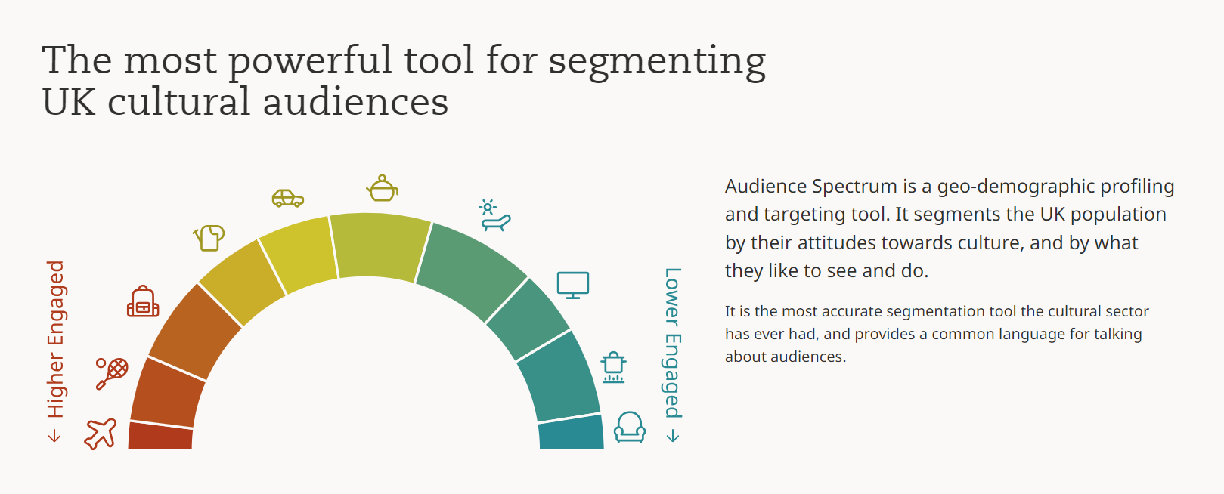
Audience Agency – Audience Spectrum
Audience Spectrum | The Audience Agency
Notes:
The Yale program on Climate Change Communication has classified the American public based on their attitudes to climate change science – and works with Six Americas in their communication styles – from Alarmed, to Concerned, to Cautious, Disengaged, Doubtful, and Dismissive.

Slide 17
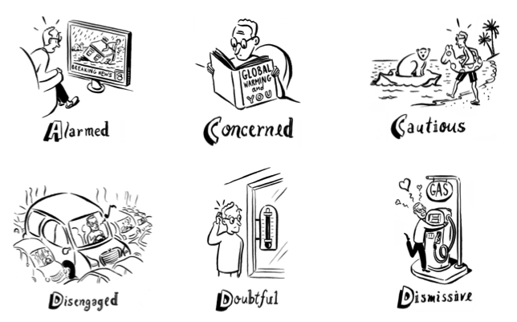
Global Warming’s Six Americas
Global Warming's Six Americas - Yale Program on Climate Change Communication
Artwork by Michael Sloan
Notes:
The Yale program on Climate Change Communication has classified the American public based on their attitudes to climate change science – and works with Six Americas in their communication styles – from Alarmed, to Concerned, to Cautious, Disengaged, Doubtful, and Dismissive.

Slide 18
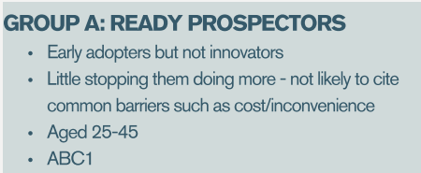
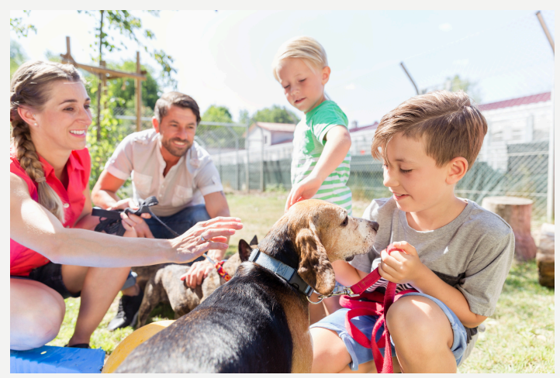
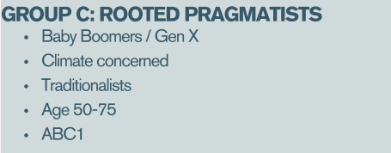
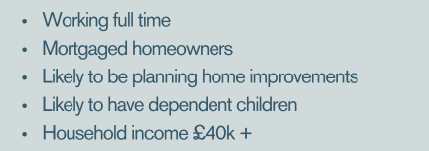

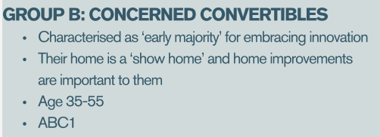

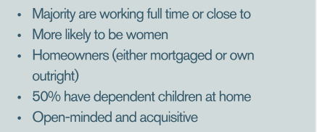
Plymouth Energy Community
    Plymouth Energy Community (PEC) | Understanding our retrofit clients
    FSWRC_MarketingMessagingToolkit_20240426 (svdcdn.com)
Notes:
The Yale program on Climate Change Communication has classified the American public based on their attitudes to climate change science – and works with Six Americas in their communication styles – from Alarmed, to Concerned, to Cautious, Disengaged, Doubtful, and Dismissive.

Slide 19
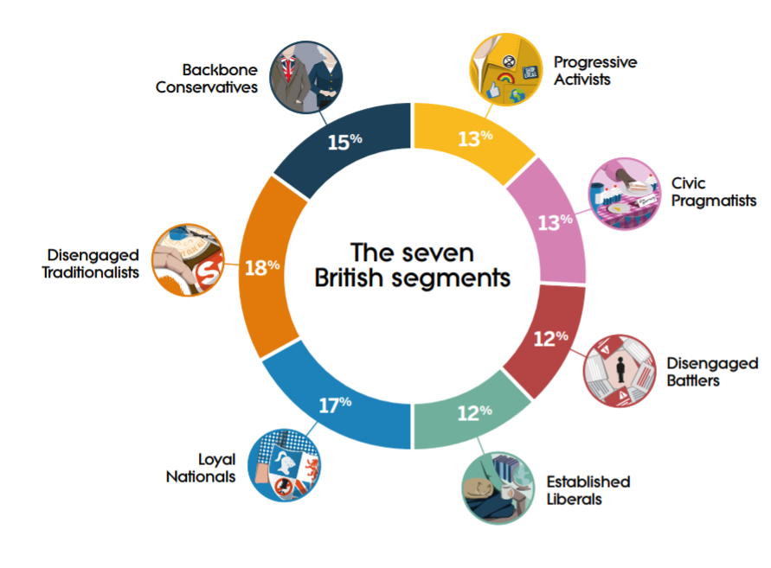
Britain Talks Climate
https://climateoutreach.org/britain-talks-climate/seven-segments/
Notes:
The most up to date climate segmentation in the UK is the Britain Talks Climate model – drawing on More in Common’s Core Beliefs model. The charity Climate Outreach conducted a survey with over 10,000 British adults alongside targeted focus groups to develop the Seven Segments – a model for understanding different audience’s attitudes to climate change and Net Zero. As with all segmentations, the conclusions are generalised and won’t apply at an individual level, but they can help to guide us in how to relate to audiences different from ourselves.

Slide 20
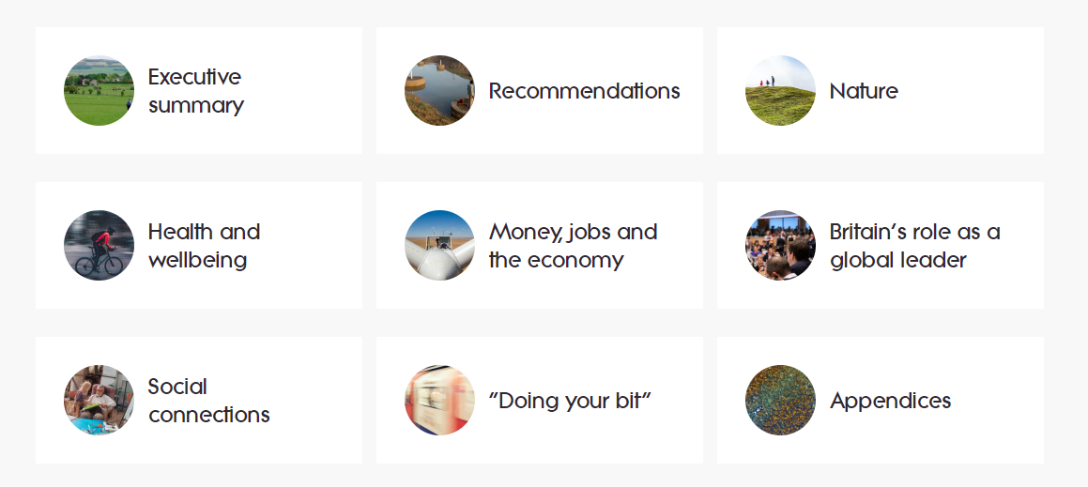
Uniting Frames
https://climateoutreach.org/britain-talks-climate/seven-segments/

Slide 21
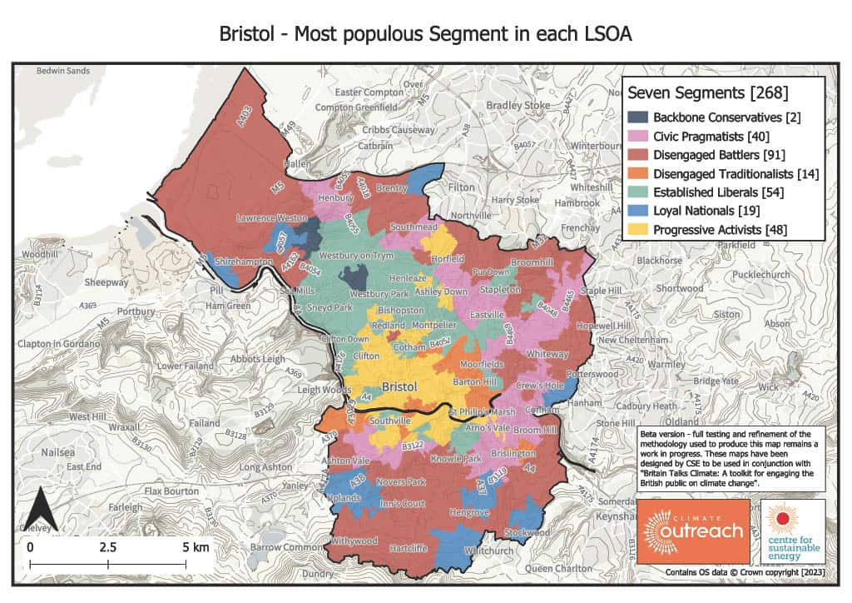
Mapping segmentations geographically
Targeted climate change messaging - Centre for Sustainable Energy

Slide 22
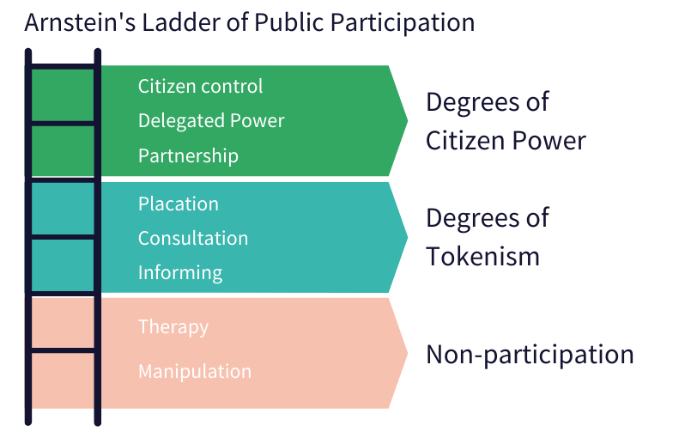
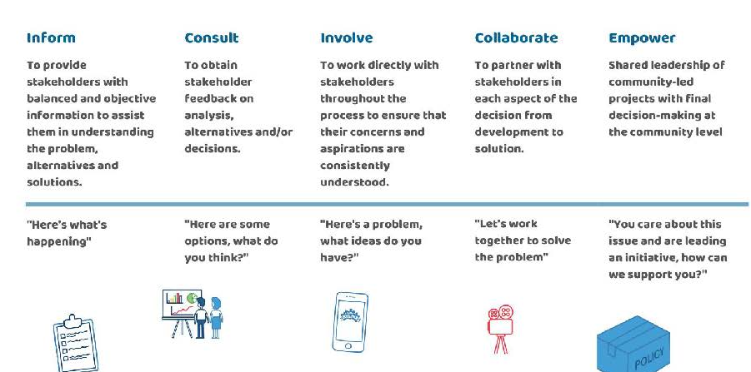
From consultation to co-development
https://cdn.ymaws.com/www.iap2.org/resource/resmgr/pillars/spectrum_8.5x11_print.pdf

Slide 23
Elliot Clark
Centre of Sustainable Energy

Slide 24
Seeing is believing
Demonstrating the tangible benefits of retrofit
Elliot Clark
Retrofit Assessor
22/01/2025

Slide 25
Why do retrofit surveys matter?
All properties are different, even those built at the same time.
An EPC is not fit for giving retrofit advice in many circumstances.
Occupants may have researched their options already…
… but they may not know the considerations for each option.
Notes:
1: Changes in internal layout, extensions, repairs over the years, different living situations
2: EPCs miss key info (e.g. ventilation) and are rudimentary. Someone may be surprised by the additional needs of ventilation when installing, say, UFI. UFI may not be suitable. Can often be wrong.
3: … and received the wrong information (e.g. don’t fill cavities) – independence is key
4: Especially the interplay between insulation and ventilation, or vapour open/vapour closed materials and when to use which.

Slide 26
How do we start?
Learn about homeowners’ circumstances and understand their motivations.
This is best done with a hybrid approach of a pre-survey questionnaire and then discussion, both at the booking stage and during the survey.
This also refines the approach we take when on site.
Notes:
1: the more information we can capture about a homeowner’s circumstances, the more bespoke advice can be. Reassures the homeowner. Is usually money (on bills/ROI), carbon, or comfort. Necessity at times (e.g. boiler needs replacing soon).
2: Pre-questionnaire, but then discussing answers more with the homeowner to find out the fine details. People are happier to speak in person, in-situ, than try and write down the specifics.
3: If the homeowner is open to a range of fabric EEM improvements, a full home retrofit survey & plan would likely be best choice. If they have a smaller budget, have already made some EE improvements or aren’t willing to do more disruptive improvements then a lighter touch survey is likely to be most appropriate.
Collaboration helps the homeowner feel involved and provides more chance for education, improves likelihood of undertaking improvements. Reinforces trust and our expertise

Slide 27
What tools do we use?
Full home retrofit survey & plan
Models heat loss from each material of property, can help to work out where to best put money for largest impact.
It helps homeowners to quantify potential bill savings and carbon reduction.
The report is comprehensive and presents a lot of information.
Lighter-touch survey & report
A more qualitative approach when compared with the full retrofit survey & plan.
A longer walk-around with the homeowner. More insight into their circumstances and more opportunity for education.
A summary report of all the aspects discussed in person.
Notes:
A report modelling heat loss and impact of different fabric measures
A collaborative walk through of the property and summary report of findings
Initially we used the HRP tool [that we use for our full surveys] exclusively. * explain why this didn’t always work *
Then created the lighter-touch survey & plan – explain why. Explain the benefits of collaborative walk-around, learning more about their property and what they’ve researched/discovered already.
More opportunity to educate homeowners on different elements of the property (e.g. why the material matters for filling cavities, or why lime render is advisable)
WHAT HAVE WE LEARNED
(That obtaining more information from the homeowner before the survey enables us to work out the best type of survey for them and their home (e.g. info about their aims, budget, EE improvements already made, level of disruption they’re prepared to accept)
(That a lighter-touch survey approach is more appropriate for some homeowners and their circumstances)
(the benefit of spending time with the homeowner discussing in depth about their property specifically.)

Slide 28
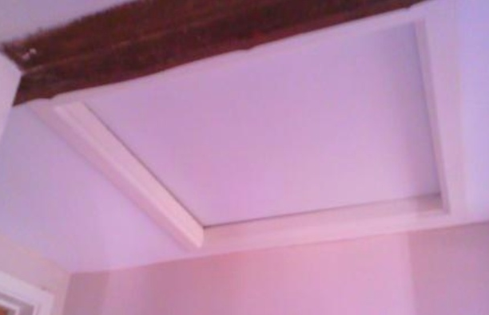
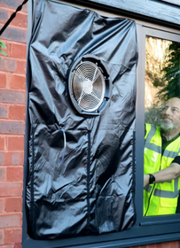
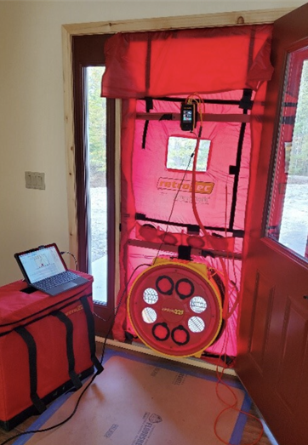
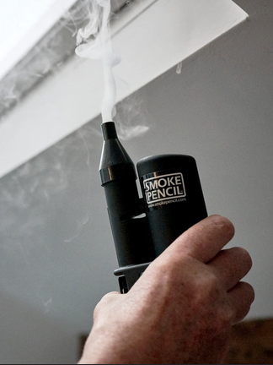
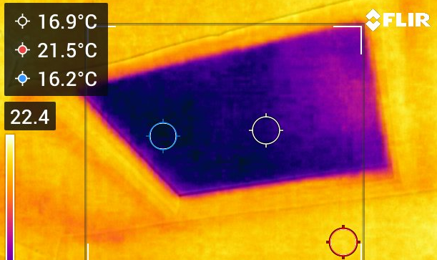
What tools do we use?
Thermography
Draught and leak checking
Notes:
*explain use of BTS’ leak checker or blower door + Smoke pencil [+ also use of TI in conjunction with TI]
makes the air loss (heat loss) tangible, can see and feel where it’s going.
WHAT HAVE WE LEARNED FROM THIS
Use of leak checker isn’t always feasible. Larger properties need BD. Also, oil aga’s not turned off, can’t do de-pressurisation
Restrictions on TI, especially internal vs external temperature differential.
Best ways to incorporate this additional HL information into our survey reports to enhance the advice we give to homeowners.

Slide 29
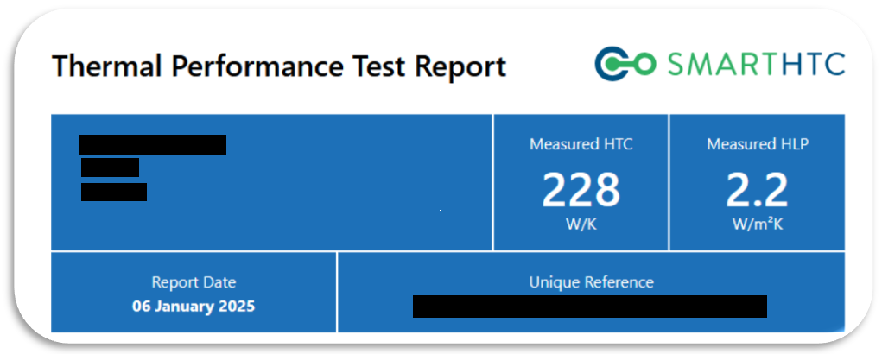
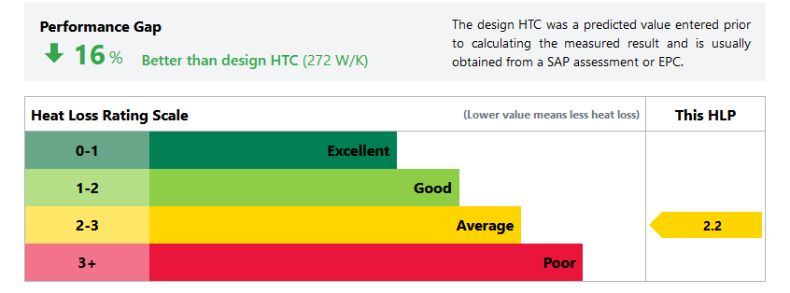
What tools do we use?
Home data logging & analysis
Use of data logging devices over a 3-week period.
The loggers record temp and relative humidity every 10 minutes.
Combines this with smart meter data & property characteristics.
Results in a performance gap between SAP assessment/EPC data and actual lived experience.
Notes:
Discussion of data logging. Advs and Disadvs that we encountered.

Slide 30
Barriers encountered
Homeowner expectations and prior knowledge.
The usefulness of the information.
Being ‘able to pay’ often isn’t accurate and doesn’t mean they are willing.
The ability to use the tools.
Notes:
1: Discussion of how homeowners may have been told x or y by a builder, or read about something online, and have a pre existing idea of how the survey will go. Or alternatively, have no prior understanding to retrofit and how interconnected properties are (though the latter is rarer). The hope that we may be able to sort all their heating problems. Maybe they’re underheating?
Fix: Communicate at the start of the assessment what will be covered, and what we might be able to identify. Keep constant communication open rather than “getting on with the survey”
2: Refer back to changing the options to full FP and lighter touch FP [better info before the survey to work out the best survey to meet the homeowner’s needs]. By simplifying some of the advice whilst keeping it specific to the property, it reduces the barrier for the homeowner to take action. Full survey can be information overload for some recipients.
3: A lot of people wanting low disruption but high impact. EWI/IWI, ASHP good examples. Somewhat fixed with the lighter touch survey, as we can learn this early on and provide lighter touch survey. Education helps overcome this in part, talking about the whole house approach. MENTION HEATPUMPMONITOR AND RETROFIT PATTERN BOOK
4: How not all tools can be used. 3 week test requires gas as it can be measured. Thermo and 3 week require colder weather. Leak checker not always suitable for windows. Oil Aga’s prevent
Extra notes: writeup about educating clients on the whole house approach, to discourage single measure installs when budget permits more.
Able to pay doesn’t equate to willing to pay: EWI, IWI and especially ASHP are good examples of this. Able to pay isn’t often used by us, use the term “self funded” instead.
Education is good for overcoming this barrier. Mention of the website heatpumpmonitor.org to show people that they do work in solid wall properties
More difficult with traditional properties, property significance/aesthetic is important. Concerns over detailing with EWI (mention retrofit pattern book)

Slide 31
Key learning points
On-site tools can have a big impact on engagement.
The largest impact can be from the conversations.
Homeowners don’t often know the way measures can interact.
There’s a want for truly independent advice.
Notes:
1: as titled, seeing is believing, and especially the use of thermography and air testing shows homeowners something tangible. Though, not always feasible unfortunately (barriers)
2: It may seem obvious, but homeowners engage more with education relevant to their property. Tailoring the level of advice (full survey or lighter touch) to them ensures they’re not over/underwhelmed with the data. They will generally know their property better than you will in one visit…
(That obtaining more information from the homeowner before the survey enables us to work out the best type of survey for them and their home (e.g. info about their aims, budget, EE improvements already made, level of disruption they’re prepared to accept)
(That a lighter-touch survey approach is more appropriate for some homeowners and their circumstances)
(the benefit of spending time with the homeowner discussing in depth about their property specifically.)
3: Bias towards individual measures, e.g. PV and battery or insulation, less consideration for ventilation with insulation,
4: Homeowners really value the independent personalised advice. No one likes being sold to…

Slide 32
Thank you for listening
Elliot Clark
Futureproof Bristol
futureproof@cse.org.uk

Slide 33
Lisa Beaney
Testlands and Green Isle of Wight

Slide 34

Promoting success to show the value offered by the community sector.
Notes:
Collaboration with the private sector.

Slide 35
Background
Testlands' is focused on improving the wellbeing of its community, particularly children, young people, and families in Southampton. We aim to empower and rejuvenate local young people through sports and other well being-focused activities. We strive to collaborate with local sports clubs and other like-minded partners to foster physical health, mental resilience, and community engagement.
Testlands partnered with Green Isle of Wight CIC to offer Energy Advice. Testlands Wellbeing Hub is based in Green Lane, Southampton and it is from this hub that the Southampton Energy Team operate.
Notes:
Collaboration with the private sector.

Slide 36
Enabled us to compare and learn from two very diverse demographics
Test different methods of providing energy advice
Work with commercial organisations to develop a sustainable model
Project
Notes:
Collaboration with the private sector.

Slide 37




5975 people attending events, talks & drop-in sessions
LEAD project summary
1270 people provided with in-person advice
Notes:
Figures as at 31/12/2024 – project started Feb 2024.
We were behind our targets for the first few months. We have changed our approach and learnt from our mistakes.

Slide 38
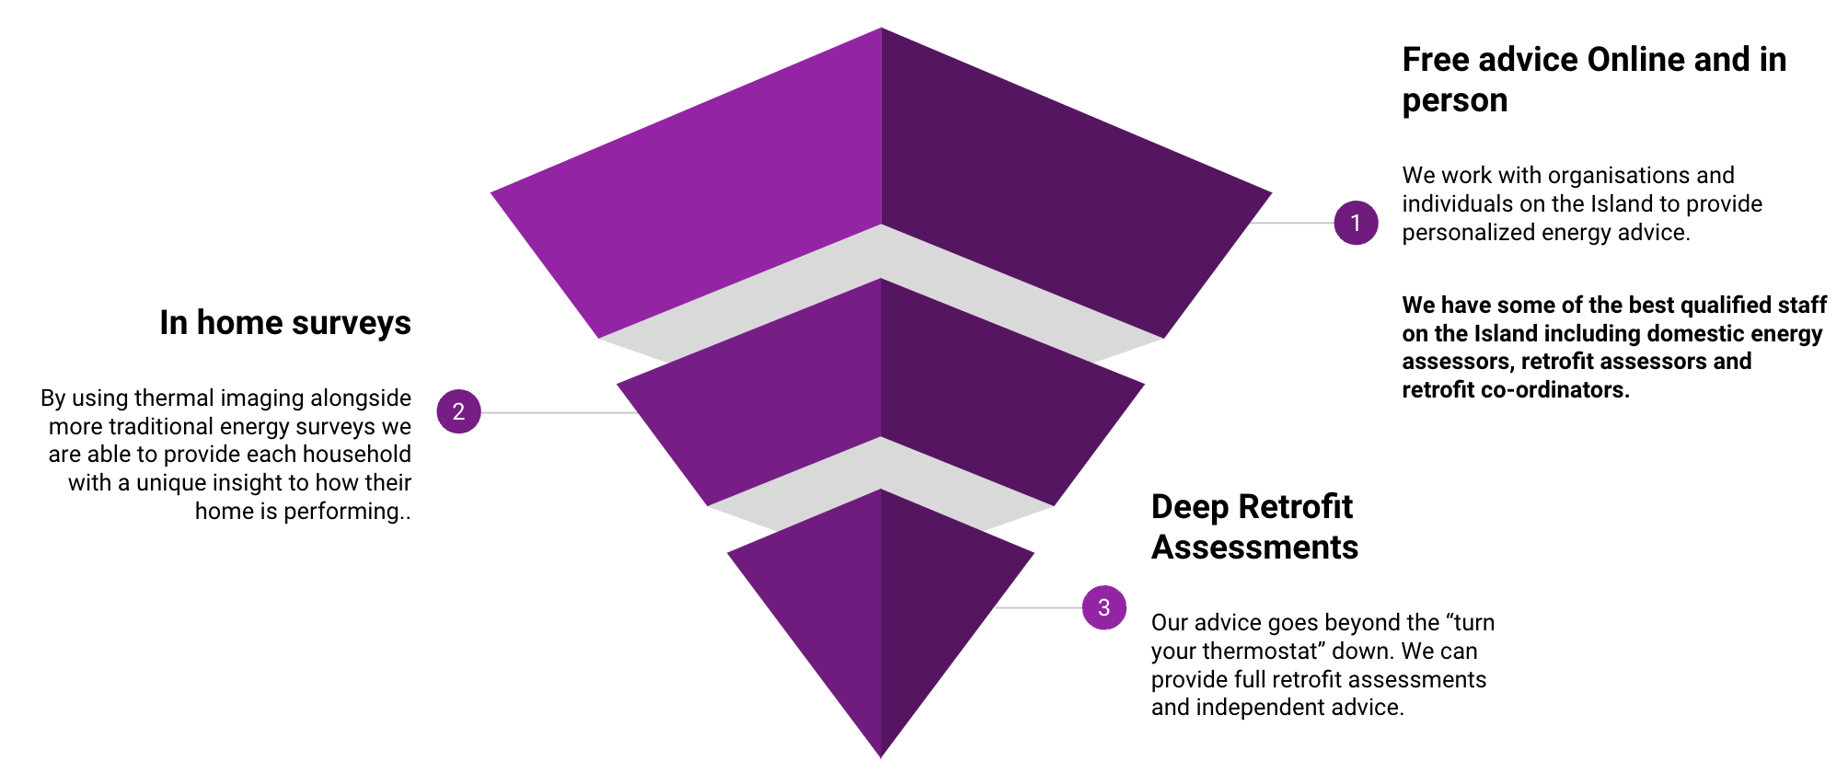
What we offer -
GREEN IOW CIC | OCTOBER 2024

Slide 39
Marketing & Collaboration
Notes:
Collaboration with the private sector.

Slide 40



Press releases – regular press releases with a clear “call to action”. Audio clips & photos included to be used in news bulletins
Marketing
Case Studies – Images then used in Social Media adverts linking back to the case study. We have to show REAL people!
Outreach – Regular attendance at groups builds trust. Trust leads to engagement.
Notes:
Each time a press release is sent out we notice a spike in enquiries. Since changing our social media advertising to include case studies we have had an increase in people booking home visits.
Work with a professional marketing company.
Consistency in branding and message.
Tried different approaches and learnt from what works and what doesn’t. Started with 2 marketing teams – in-house team in SO, external company on IOW
Targeted different groups in SO & IOW – learnt from our mistakes!

Slide 41


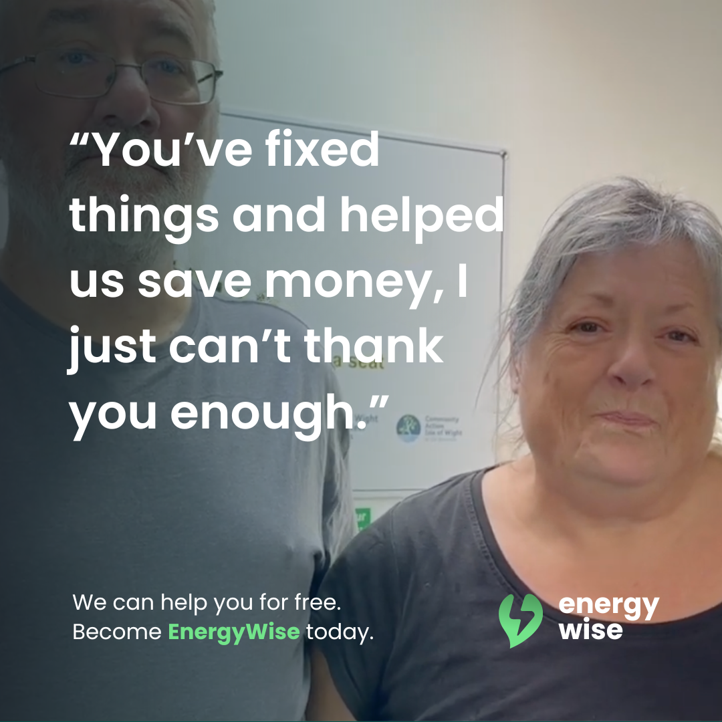
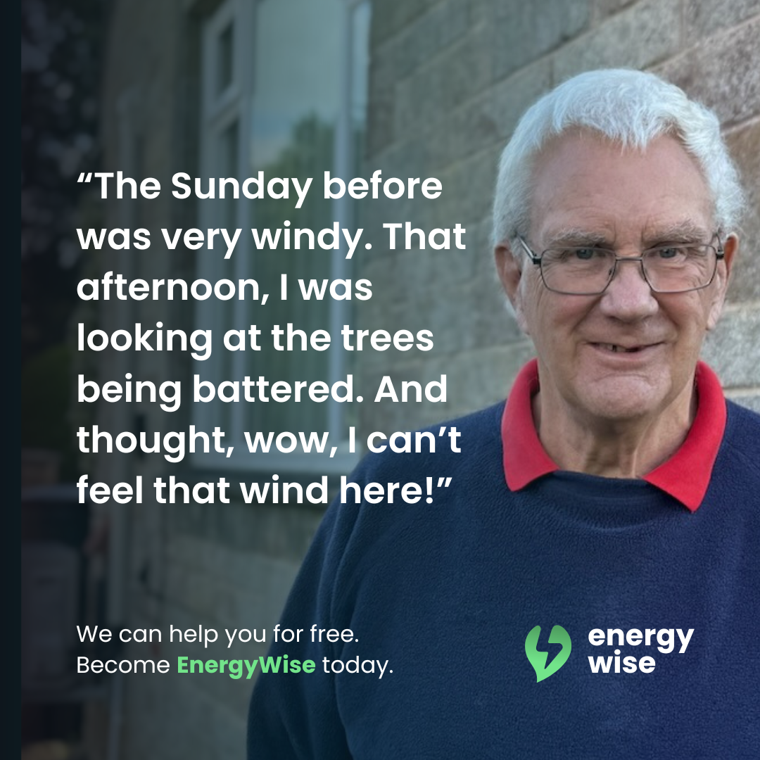
Notes:
Signed releases to use the words and images online and in marketing materials. Image on the left is our first advert, the next two are the recent ones that are linked to the case studies. Have to avoid people thinking it is a scam. We want to be seen as local rather than national – we understand the local issues that people face.

Slide 42
TRUST
Notes:
Collaboration with the private sector.

Slide 43
Fear of change and new technology
Uncertainty as to what can be done
Doubt as to the efficiency of new systems/changes
Notes:
This is where the regular attendance at Outreach sessions works – build trust – supply regular information.
We have made a lot of the changes to our own homes and will invite some of our clients in to our own homes.
Retrofit is also disruptive – we talk about this beforehand so the client can prepare for it.

Slide 44






Customer journey
01
02
03
04
Initial advice –Outreach/talk/drop-in
We make the referral to the grant scheme
We complete the Retrofit Assessment & EPC if needed
Follow-up visit after installation of measures ie ASHP, Solar
Notes:
We are the bit in the middle that pulls it all together and helps ensure the client has an easier experience.
Steps 2,3 & can earn us money
Step 2 – referral fees from the grant funding scheme (HUG2 £100 per referral)
Step 3 – Retrofit Assessment £160 - £200
Step 4 – Post visit assessment £75
After Step 4 we are still available to carry on supporting the client, this could be helping them make sure they are on the best tariff, making sure their heating is programmed properly.

Slide 45
Working with commercial organisations
We work with Agility ECO and retrofit companies to provide referrals and services
This work is paid, and we act as the “glue” to bring together all parts of the process
Notes:
There may not always be government funding available.
We have to promote what we do, shout about our success stories and share the case studies.
It’s not just about what you do. It is about what you are SEEN to do.
Commercial organisations are good at what they do. They are brilliant at installing “stuff” but don’t have the expertise to help people along the whole journey.
PAS 2035 was designed to give the client confidence. By having an independent, trusted, organisation separate from the installer can help build this trust.

Slide 46
Retrofit is a journey, not an event…

Slide 47
Q&A

Slide 48
Contact us and sign up to our newsletter
www.swnetzerohub.org.uk
swnetzerohub@westofengland-ca.gov.uk
South-West-Net-Zero-hub
Sign up to the rest of the webinar series https://www.swnetzerohub.org.uk/knowledge/events/lead-webinars/

