Slide 1
White Label Presentation: Audience segmentation
This slide deck is available to use under Open Government Licence (OGL) v3.0
You can use or adapt the slides for your own presentations, including branding
Images are not permitted for extraction and use in other formats
Citations and credits within the slides must remain in place – this relates to the original copyright for content, e.g. images, and terms are provided in the notes
Slide notes provide a suggested script or prompts to accompany presentations
Please visit South West Net Zero Hub online for other LEAD Toolkit resources
Notes:
This presentation has been partly informed by content delivered for the LEAD Webinars on ‘Retrofit as a Service’ and ‘Retrofit, Engagement and Communication’, particularly presentations by Dr Laura Fogg-Roberts from the University of the West of England and by Plymouth Energy Community.
References
https://www.swnetzerohub.org.uk/knowledge/events/webinars/innovations-in-domestic-retrofit-advice/

Slide 2
What is audience segmentation?
Large audience → smaller groups
Tailoring messages and services for these smaller groups
Culture – values, interests
Circumstances – income, tenure, household structure, housing type
Tailored message = better engagement
Notes:
Audience segmentation is about splitting a larger audience into smaller groups with shared characteristics.
You can then tailor your services and messages for these smaller groups, making your offer more appealing to them.
Good segmentation considers both cultural and circumstances – making sure your message resonates with your audience, but also that your service meets their needs.
Tailoring your message for audience segments can lead to better engagement, and ultimately to more people taking steps with retrofit.

Slide 3
Defining your audience
Your project:
Geographical constraints?
Existing target audience?
If project is geographically based, with no audience defined:
Understand who is in your area
Split these into smaller groups
Prioritise an audience, or run multiple campaigns
Notes:
You may already have a defined audience because you work in a certain geographical area, or with people living in particular circumstances.
If you know where your service will run, but don’t have a particular audience in mind, it’s important to find out who lives there, to identify groups with different characteristics, and then to either prioritise one of these groups or run multiple campaigns to appeal to different groups.
Taking this approach will boost engagement with your project.

Slide 4
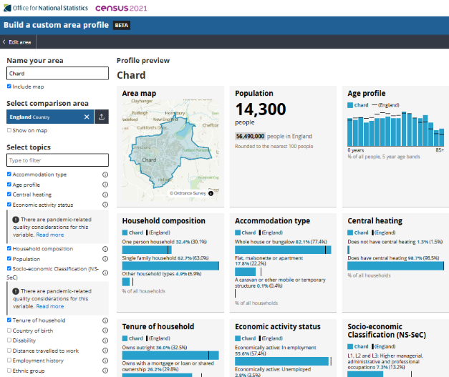
Finding out who lives here
Local knowledge + data (check assumptions, fill gaps)
Dataset examples (others are available)
Experian Mosaic data
Widely used, profiling at Output Area level
Fee required
Profiling data services with specific relevancy to retrofit
e.g. Parity Pathways, Britain Talks Climate Maps (CSE)
Fee required
ONS local area mapping
Free, based on Census 2021
Raw statistics, not profiles
… then use to target your services, messages and messaging channels
ONS Build a custom area profile
Notes:
Even if you have good local knowledge, it can help to check your assumptions using local data.
Experian Mosaic data is widely used as a basis for profiling local audiences in detail, for all sorts of purposes – but it does cost money.
There are also fee-paying services available that can help. A couple of examples are Parity Pathways for local authorities, which combines housing stock and socio-economic data, or Britain Talks Climate mapping by the Centre for Sustainable Energy (CSE), applying Climate Outreach’s Britain Talks Climate insights to Mosaic data.
The Office of National Statistics (ONS) offers a free mapping service for Census 2021 data, allowing you to choose a geographical area (down to Output Area level) and building a profile for this using a list of commonly-used options.
Other Census data, as well as various other data, is available for free via ONS’s Nomis portal.
References
Experian Mosaic data: https://www.experian.co.uk/business/platforms/mosaic/segmentation-groups/
Parity Pathways: https://parityprojects.com/platform/pathways/
Climate Outreach’s Britain Talks Climate: https://climateoutreach.org/britain-talks-climate/
CSE maps based on Britain Talks Climate: https://www.cse.org.uk/data-innovation/targeted-climate-change-messaging/
ONS local area mapping tool: https://www.ons.gov.uk/visualisations/customprofiles/draw/
Nomis: https://www.nomisweb.co.uk/

Slide 5
Designing and targeting services
Key considerations:
Tenure
Grant eligibility
Disposable income
Access:
Digital inclusion
Literacy or English language skills
Notes:
Your services need to meet the needs of your audience.
Tenure is critical – renters have very limited options if their landlord is not onboard.
If your audience is likely to be eligible for benefits-based retrofit grants such as ECO, they may need help accessing these.
If your audience is self-funded, their disposable income level will influence the type of service they may want – from whole house retrofit assessments to behaviour change advice.
It is easy to underestimate how many people are affected by barriers such as not having internet access, or low literacy. These people may need services with additional support.

Slide 6
Creating your message
What matters to your audience?
Key drivers:
Lower bills
Warmth and health
Environmental impact
Property value
Image © Severn Wye 2024, shared under CC BY-NC-ND 4.0
Notes:
When tailoring your message, think about what drives your audience.
Saving money on bills is important across nearly all audiences, including for people influenced by other factors.
Warmth and health are key motivators for people who are experiencing problems with cold homes and damp.
Those who are already comfortable in their homes may be motivated by using less energy for the environment.
Property value, such as through raising the EPC rating, is of most interest to landlords and people looking to sell their home in the near future.
Copyright info
Marketing example: Severn Wye 2024, shared under CC BY-NC-ND 4.0: https://creativecommons.org/licenses/by-nc-nd/4.0/

Slide 7
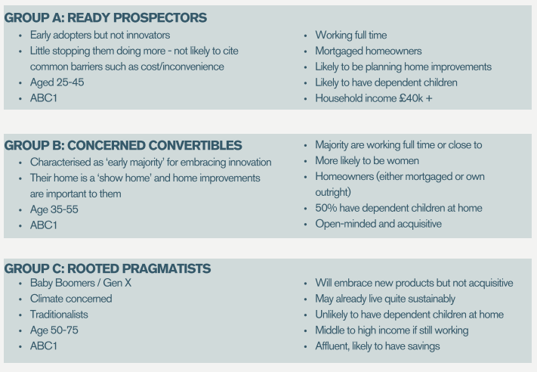
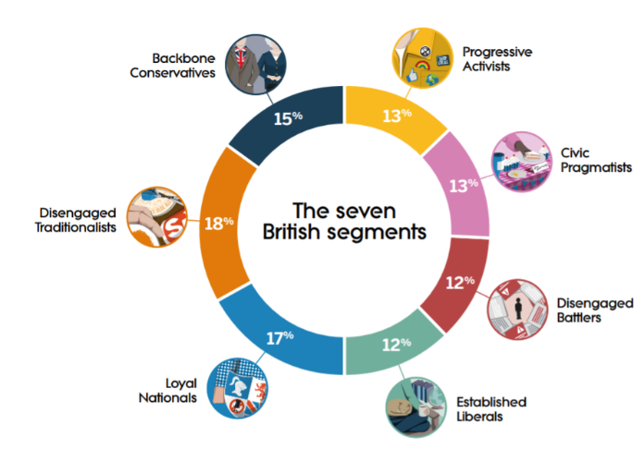
Audience segmentation – research examples (1 of 2)
LEAD Market Segmentation Report
Far South West Retrofit Consortium
Britain Talks Climate Climate Outreach
Notes:
There is existing research identifying different audiences that can help you with crafting your message and your choice of language.
As part of their LEAD project, Far South West Retrofit Consortium (led by Plymouth Energy Community) commissioned a market segmentation report and messaging toolkit for market segmentation in the South West, which identified three audiences likely to engage with retrofit at different life stages. The research report and toolkit are freely available online.
Britain Talks Climate is a well-regarded communications toolkit developed by Climate Outreach, which segments the British public based on their values and everyday concerns, and how this affects their attitudes towards climate change. The toolkit includes guidance on the best messages, language and messengers to influence each group. The toolkit is freely available online.
References
LEAD Market Segmentation Report: https://plymouthenergycommunity.com/about/news/understanding-retrofit-clients/
Climate Outreach’s Britain Talks Climate: https://climateoutreach.org/britain-talks-climate/

Slide 8
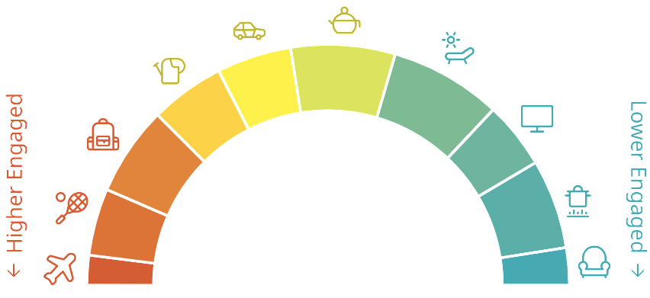
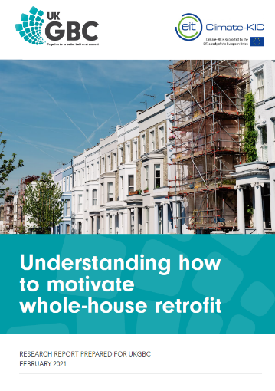
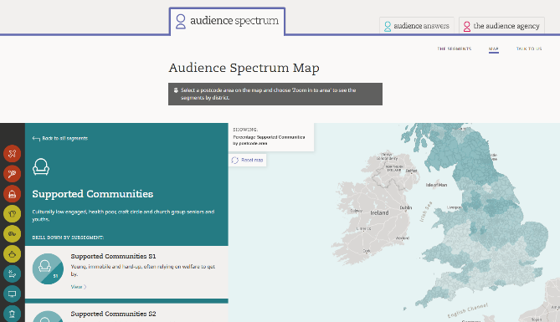
Audience segmentation – research examples (2 of 2)
Report on motivating whole-house retrofit
UK Green Buildings Council
Audience Spectrum
The Audience Agency
Notes:
The UK Green Buildings Council commissioned a report around whole-house retrofit, published in 2021. This report contains a wealth of advice when created messages for a range of audiences. The report is freely available online.
The Audience Spectrum, created by The Audience Agency, is a free online tool based on cultural engagement, but can give insights helpful to reaching different groups. This is also freely available online.
References:
UK Green Buildings Council: https://ukgbc.org/resources/consumer-insight-understanding-how-to-motivate-whole-house-retrofit/
The Audience Agency’s Audience Spectrum: https://audiencespectrum.org/

Slide 9
Language matters!
“I’d like a warmer home and to help protect the environment for future generations”
“I’d like to improve my home, and make it warmer and cheaper to heat”
“I’d like to invest in my property and futureproof it”
“If it’s free, there must be a catch – you don’t get something for nothing”
Notes:
The language you use is important. If your message doesn’t resonate with your audience, they will not engage – even if your service could really help them.
Some of the tools mentioned in the previous slides give more advice on words and phrases to use – or to avoid – with different audiences.
For example, lower income families may respond better to messages using language around warmth and lower bills, but landlords are more interested in investing in and futureproofing their property.

Slide 10
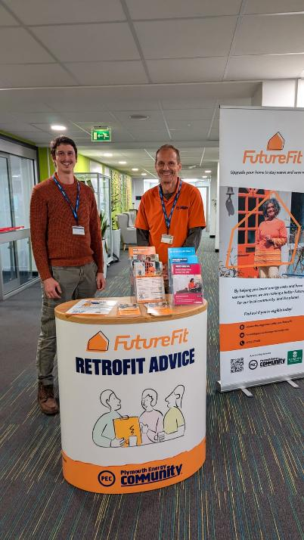
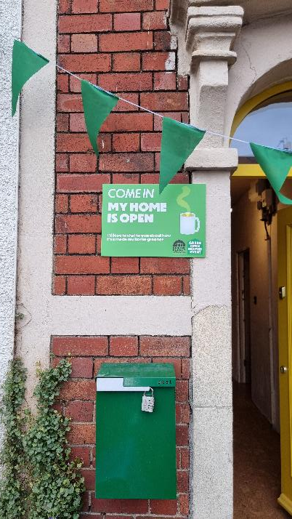
Delivering your message
How?
Digital, face-to-face, outdoor adverts
Where?
Places your audience already goes
When?
Trigger points, convenience
Who?
Trusted messengers
Image © Bristol Energy Network | Plymouth Energy Community, shared under CC BY-NC-ND 4.0
Notes:
Once you’ve identified your audience, designed your offer and created tailored messages, you need to get those messages to your target audience. Think about how you could do this – online advertising may work well for wealthier, time-pressed households, but offline audiences or those who are more cautious about scams may need face-to-face engagement. Meet your audience in places they already go – physically or online.
People are more likely to consider retrofit at certain times in their life, or in the year – for example, people who are struggling with day-to-day living are unlikely to want energy advice in the summer. Giving time to receive advice also needs to be convenient – for example, it’s hard to engage parents while they are looking after young children.
Trusted messengers are also very important, and these will vary between audiences. Local authority endorsement can help build trust; working with a local community group that already has personal relationships with your audience, or building a community champion network of people who can influence their peers, can help reach people who wouldn’t otherwise engage.
Copyright info
Left photo: Bristol Energy Network 2024, shared under CC BY-NC-ND 4.0: https://creativecommons.org/licenses/by-nc-nd/4.0/
Right photo: Plymouth Community Energy 2024, shared under CC BY-NC-ND 4.0: https://creativecommons.org/licenses/by-nc-nd/4.0/

