Slide 1


White Label Presentation: Designing the retrofit customer journey
This slide deck is available to use under Open Government Licence (OGL) v3.0
You can use or adapt the slides for your own presentations, including branding
Images are not permitted for extraction and use in other formats
Citations and credits within the slides must remain in place – this relates to the original copyright for content, e.g. images, and terms are provided in the notes
Slide notes provide a suggested script or prompts to accompany presentations
Please visit South West Net Zero Hub online for other LEAD Toolkit resources
Notes:
This presentation has been partly informed by content delivered for the LEAD Webinars on ‘Power in Partnerships’ and ‘Retrofit as a Service’, particularly presentations by Plymouth Energy Community and Green Isle of Wight.
References
https://www.swnetzerohub.org.uk/knowledge/events/webinars/innovations-in-domestic-retrofit-advice/

Slide 2
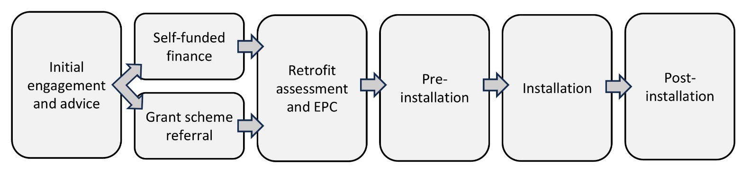
Retrofit process
Customer journey → helping people travel along the process
Consistent point of contact throughout process → builds trust, gets results
Notes:
This slide gives a broad overview of the retrofit process.
When designing a retrofit service, it’s important to consider how this service will fit into the whole process – whether you will be helping people throughout the process, or providing an intervention to help people overcome a barrier at a particular stage.
Best results often occur with a full-journey approach, especially if the householder has a consistent trusted point of contact who can give them the resources and confidence they need to keep progressing towards completion.
If you’re only going to provide support for part of the process, it’s important to consider how your service will dovetail with others.

Slide 3
Roles within the retrofit process
 | Local authority | Community | Installer / private sector
Recruiting households |  | 
Advice and eligibility |  | 
Retrofit assessment |  |  | 
Retrofit coordination |  |  | 
Retrofit design |  |  | 
Installation |  |  | 
Sign-off | 
Evaluation and quality assurance |  |  | 
Notes:
This slide suggests some of the roles that can be taken on by a community energy organisations within a local authority-owned retrofit scheme.
Simpler, entry-level projects for community groups might just deal with household recruitment and initial advice and eligibility checks.
If a community organisation decides to take on some of the more technical roles, there’s an advantage to be had in extending this impartiality to other stages of the process, particularly when it comes to installation design, evaluation and quality assurance.
Within a local authority scheme, installers might be part of a framework contract with the local authority, which can give more certainty around availability and pricing, and handle vetting upfront. Another approach is an installer vetting scheme, where households can still shop around for quotes and installers can be more easily dropped if the quality of their work or services is poor – but this approach does require more ongoing management (e.g. maintenance of an installer directory).
References
Adapted from Plymouth Energy Community’s LEAD Webinar presentation ‘Power in Partnerships’: https://www.swnetzerohub.org.uk/knowledge/events/webinars/innovations-in-domestic-retrofit-advice/

Slide 4






Initial engagement and advice
Identify your audience
Tailor messages and services
Engage your audience
Provide initial advice
Image © Centre for Sustainable Energy 2024 | Green Isle of Wight CIC 2024, shared under CC BY-NC-ND 4.0
Notes:
Community organisations are ideally placed for the first stage.
Audiences will differ in what services they need, how they can be reached, and what messages and language will engage them.
It’s important to understand who your audience is from the start, and tailor your messages and services to suit them, to get the best engagement.
Trigger points are particular times when people are most receptive to retrofit messages, and include other major renovations or moving house.
The LEAD Toolkit has more information and factsheets on different methods for engaging with audiences, such as community outreach or community champions.
Entry level advice can focus on easy wins like behaviour change, repair and maintenance, draughtproofing and better use of heating controls.
These are good starting points for any household. For some, this basic advice is necessary to build trust and confidence in advice, before suggesting options for insulation or new heating systems.
This is also a good time to talk about what grants might be available.
Copyright info
Top photo: Centre for Sustainable Energy 2024, shared under CC BY-NC-ND 4.0: https://creativecommons.org/licenses/by-nc-nd/4.0/
Bottom photo: Green Isle of Wight CIC 2024, shared under CC BY-NC-ND 4.0: https://creativecommons.org/licenses/by-nc-nd/4.0/

Slide 5

Financing retrofit
Grant-funded
Self-funded
Eligibility varies based on:
Benefits received
Technology proposed
Funding typically from:
Energy Company Obligation (ECO)
Local authorities
Central government schemes
‘Able-to-pay’ is misleading term
Many middle-income cannot afford deep retrofit
Funds often come from:
Savings
Remortgaging
Inheritance
Notes:
If a household can be referred into a grant scheme to help finance retrofit, it’s important to know early on, as any retrofit assessment or suppliers used in the next stages of the process will need to be appropriately qualified and compliant with grant rules.
Grants for retrofit are typically aimed at:
reducing fuel poverty, by helping people in receipt of benefits, or
reducing the cost of newer technologies (such as heat pumps) to boost uptake and help establish a market.
Availability changes over time, as the retrofit market changes and government policy responds in kind.
Large and medium sized energy companies have a well-established legal requirement to provide funding for households through the Energy Company Obligation.
There is often geographical variation too, as local authorities make different decisions about investing in local retrofit.
The self-funded sector is often referred to as ‘able to pay’, but this is misleading as many people in this group cannot afford more advanced retrofit. They may need advice on other options, such as suggesting remortgaging as a route to financing retrofit, or they may need time to save up after receiving a retrofit assessment.

Slide 6

Retrofit assessment and EPC
Retrofit assessment shows next steps
Services should be provided by a qualified professional retrofit assessor and comply with PAS 2035 requirements
If accessing grants (e.g. ECO), must follow PAS 2035 to claim
EPC needed when building, selling or renting a home, must be from accredited assessor
Image © Severn Wye 2024, shared under CC BY-NC-ND 4.0
Notes:
The retrofit assessment process, which often involves an Energy Performance Certificate (EPC) assessment alongside, requires a depth of skill.
Qualified assessors are recommended, and must be used if you’re accessing grants or producing an EPC.
If the assessment is for a traditional building (built before 1919), it’s important to use an assessor who understands how energy and moisture work in older buildings, to ensure that recommendations are not made that could damage the building fabric, cause damp and compromise thermal performance.
References
https://www.ofgem.gov.uk/environmental-and-social-schemes/energy-company-obligation-eco/energy-company-obligation-eco-supply-chain
https://www.gov.uk/selling-a-home/energy-performance-certificates
Copyright info
Photo: Severn Wye 2024, shared under CC BY-NC-ND 4.0: https://creativecommons.org/licenses/by-nc-nd/4.0/

Slide 7




Pre-installation support
Finding an installer TrustMark education Vetted sources and registers
Understanding quotes Quote review to help compare Gives confidence to progress
Nudging progress along Six-month follow-up
Image © Plymouth Energy Community 2024, shared under CC BY-NC-ND 4.0
Notes:
Once a household has had a retrofit assessment and decided to go ahead with installation, they may need additional support.
TrustMark is the quality scheme running under PAS 2035, so households accessing grants will need a TrustMark accredited installer. Many households will need information and education about TrustMark and other quality assurance schemes.
There may be an existing local authority framework, register or other vetting scheme for installers in your local area, or you may want to establish one as part of your project.
Householders often find quotes from installers hard to understand, and it can be hard to make comparisons when they are not clearly like-for-like. A quote review service is a really helpful way to give householders confidence to understand the information and decide whether to proceed. Otherwise, they may get stuck at the quote stage, being unsure of whether the work specified is the right work for a reasonable price.
Plan to follow up on retrofit assessments and advice, to help nudge households along, and help with any problems that have arisen. Six months is a good timescale, though progress can take much longer, especially for self-funded audiences trying to secure the necessary funds.
Copyright info
Photo: Plymouth Energy Community 2024, shared under CC BY-NC-ND 4.0: https://creativecommons.org/licenses/by-nc-nd/4.0/

Slide 8

Installation support
Onsite help during installation is sometimes useful
Many people lack confidence in briefing contractors, and need help to build trust
Image © West of England Combined Authority, shared under OGL 3.0
Notes:
For many households, this stage won’t be required.
However, for particularly vulnerable households, or for households undertaking complex and costly, they may benefit from an impartial onsite presence to help them feel confident when dealing with contractors and reduce anxiety.
Copyright info
Photo: West of England Combined Authority, shared under OGL 3.0 https://www.nationalarchives.gov.uk/doc/open-government-licence/version/3/

Slide 9
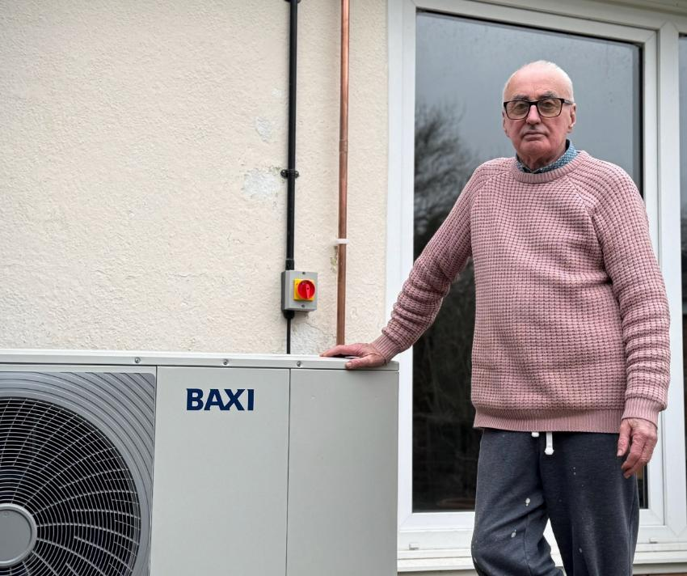
Post-installation support
Education on load-shifting behaviour → best value from new systems
Heat pumps
Solar systems
Battery systems
Advice on how to use new heating controls or apps
Image © West of England Combined Authority, shared under OGL 3.0
Notes:
Once the installation is complete, depending on the technology, householders might need additional help to get the best out of their new systems.
For example, heat pumps don’t warm houses quickly like gas boilers, and need a different approach to heating timing.
If the household has a new solar or battery system, they may need help to plan when to use electricity generated onsite, when to store it, and how to get the best out of time-of-use tariffs.
Many people will also need help understanding new controls or apps - particularly audiences who are older, offline or have low literacy levels.
Copyright info
Photo: West of England Combined Authority, shared under OGL 3.0 https://www.nationalarchives.gov.uk/doc/open-government-licence/version/3/

