Slide 1
White Label Presentation: Traditional building retrofit
This slide deck is available to use under Open Government Licence (OGL) v3.0
You can use or adapt the slides for your own presentations, including branding
Images are not permitted for extraction and use in other formats
Citations and credits within the slides must remain in place – this relates to the original copyright for content, e.g. images, and terms are provided in the notes
Slide notes provide a suggested script or prompts to accompany presentations
Please visit South West Net Zero Hub online for other LEAD Toolkit resources
Notes:
With thanks to Bath & North East Somerset Council for commenting on drafts of this document.

Slide 2
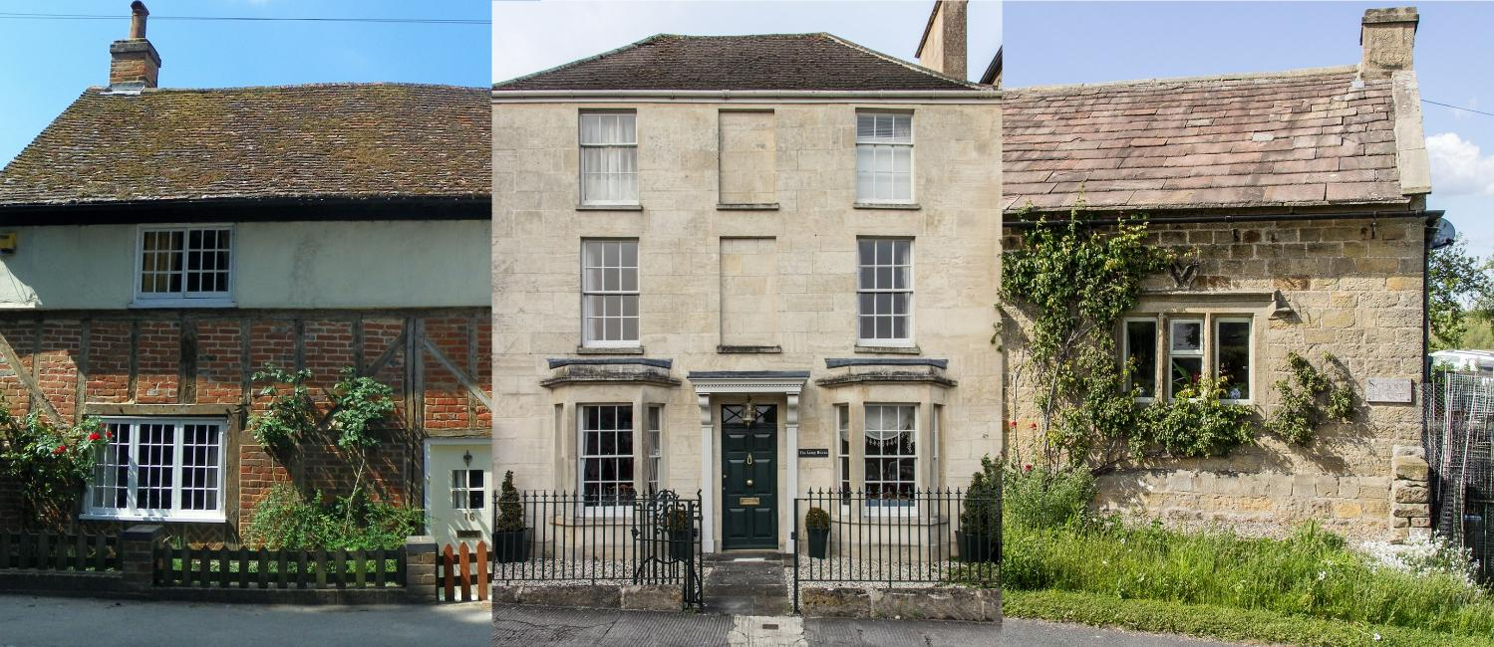
What are traditional buildings?
Images © Peter O’Connor 2015 | Billy Wilson, 2019 | Billy Wilson, 2019. All shared under CC BY-SA 2.0
Built before 1919 • Solid wall construction • Natural materials (e.g. stone, brick, timber)
Notes:
Traditional buildings are usually defined as being built before 1919, with a solid wall construction, and typically made of natural materials such as stone, wood and brick.
Copyright info
Left photo: Peter O’Connor 2015, shared under CC BY-SA 2.0: https://creativecommons.org/licenses/by-sa/2.0/
Middle photo: Billy Wilson 2019, shared under CC BY-SA 2.0: https://creativecommons.org/licenses/by-sa/2.0/
Right photo: Billy Wilson 2019, shared under CC BY-SA 2.0: https://creativecommons.org/licenses/by-sa/2.0/
Image sources
Left photo: https://www.flickr.com/photos/anemoneprojectors/24414749121/in/photolist-4oKE7j-KRTkp1-K7gX8w-AnPsCu-DcrYjn-6xDEc5-oFEqjC-9DUHuL-bWmeQW-JdKWpw-opctpH-nNEDw8-bWm4UC-bap5cn-oFG52x-opd4mt-bWm67q-p6vsyj-83fpKm-83csZ6-a5wM3k-a8am7X-a7DTt9-6xRKWf-awBsWN-83e2UG-CLeqND-qg6Bj6-bU5qUx-pr3kw3-7MVNJH-a7fsDe-Jh13PD-6AQ81Z-a7ymsv-oEmhsr-awyW7v-f75miJ-K5gypT-oiadYC-zJySRz-euDgCF-boZH9R-bbScTP-83cd9p-ietCDP-83rkKB-JdHuiM-ozDMR6
Middle photo: https://www.flickr.com/photos/billy_wilson/49269878073/in/photolist-2i4P1dr-2iULbZ1-2oXhejY-pFsme-2irPzeC-2iVMKEe-2iEjXLr-2j7d1vU-2inyjzC-2iFRiEW-2iTCynZ-2iUkbPc-2mmZw16-2ity5TK-2iGssso-2hT4dKs-2irnMcx-2iuZBeJ-2mfHE4n-2i5ri42-2kep1N5-2hCr6JW-2qDbxHK-2jqkgZs-2i74DkH-2jnsfHK-2jbjKbn-2iTFvVj-eF4jxP-2iEhVNV-2iqGzr3-2hpX8oD-2oG8osZ-2iR6kJ8-2jP6j9B-2m2w2jc-2hT9nub-2j9wGhE-2hTa4RY-2hTaWFV-UcaLQn-jXLo41-2iFVkR5-2nj8Tym-2iyrmvf-2iTBe4N-2iVr6Df-2i4LstS-2gzaUHN-qENFvL
Right photo: https://www.flickr.com/photos/billy_wilson/49946244916/in/photolist-2j6zyvJ-2jcTqNE-2pAqB65-2iFQyJW-2jcnbvL-gijmy-aTMAs8-2iM6MLR-2iYgXnL-hiasGx-2j9FD8S-2iYjAUU-2j7d1vU-2jcTqUb-2iFzw8X-2okK9tE-2i3BJ5k-2i3zueR-2i3WGPH-LCm7qD-pBg8Dv-2j2rwXV-2i76nFG-2j6yJzi-2j97VAf-2i9cowQ-28wJfbb-qENFvL-2iFg1h2-56G4K2-5nH7Qu-yHq4h-z5yFS-2iZV8fR-2j6zUKY-dUkpj3-Ji5J6q-5ApY3M-5nzfVZ-v3NYFk-2i78MB3-2iY1zUu-2m9jh6h-2j13YVV-2j1ao7w-2iZQMjH-2iXW9o3-2mh8Hfz-2jaZaVc-2j2q6Nc

Slide 3
Why retrofit traditionally built homes?
Retrofit creates far fewer carbon emissions than demolition and rebuild to modern standards, due to embodied carbon in materials
Too many traditionally built homes to ignore in working towards net zero
People living in these buildings need affordable-to-run, healthy homes
Image © Bath and West Community Energy 2024, shared under CC BY-NC-ND 4.0
Notes:
Retrofit creates far fewer carbon emissions than demolition and rebuild to modern energy standards, because of the embodied carbon in existing building materials. This is true for both traditionally built homes or more recent buildings.
We can’t afford to ignore traditionally built homes when decarbonising the housing sector, as 17.1% of all homes fall into this category.
It’s also important that people living in these buildings are able to keep their homes healthy and damp-free, without running up huge energy bills.
References
Retrofit vs rebuild: embodied carbon: https://ukgbc.org/news/what-is-embodied-carbon-in-construction/
Total dwellings in England (31 March 2023): https://www.gov.uk/government/statistics/dwelling-stock-estimates-in-england-2023/dwelling-stock-estimates-england-31-march-2023
Traditional dwellings (pre-1919) in England: https://historicengland.org.uk/advice/planning/housing
Copyright info
Photo: Bath and West Community Energy 2024, shared under CC BY-NC-ND 4.0: https://creativecommons.org/licenses/by-nc-nd/4.0/

Slide 4
How many homes are affected?
25.8 million dwellings in England
Traditionally built | Conservation area | Listed buildings
4.4 million dwellings 17.1% | 2.8 million dwellings 10.9% | 357,400 dwellings 1.4%
Notes:
How many traditional and designated homes does England have? This slide indicates the scale of the challenge, and why we cannot ignore traditional buildings.
References
Total dwellings in England (31 March 2023): https://www.gov.uk/government/statistics/dwelling-stock-estimates-in-england-2023/dwelling-stock-estimates-england-31-march-2023
Traditional dwellings (pre-1919) in England: https://historicengland.org.uk/advice/planning/housing
Dwellings in conservation areas in England: https://historicengland.org.uk/images-books/publications/adapting-historic-buildings-energy-carbon-efficiency-advice-note-18/heag321-adapting-historic-buildings-energy-carbon-efficiency
Listed dwellings in England (rounded from 357,376 from 2021 data): https://historicengland.org.uk/research/heritage-counts/heritage-and-environment/pathway-to-net-zero/historic-buildings

Slide 5
Listed building and conservation area retrofit
Conservation Area | Grade I Listed | Grade II* Listed | Grade II Listed
Places in settlements valued for historic character | Buildings of outstanding or national architectural or historic interest | Particularly significant buildings of more than local interest | Buildings of special historic or architectural interest
Interior changes do not require consent | Exterior and interior changes require listed building consent
Planning permission likely required for development works affecting external appearance
Article 4 directions may remove Permitted Development Rights, especially (but not only) in conservation areas
There is no automatic exemption from having an Energy Performance Certificate (EPC) and meeting minimum standards (e.g. for rental properties)
Notes:
Conservation areas are “places in villages, towns and cities which are especially valued by people for their historic character and appearance. What makes them special is the combination of buildings, streets, spaces and history which combine to make them unique and special places to live and work.” The focus is on how the building contributes to the local area’s character and appearance; hence the focus is on exterior features.
Listed buildings are “buildings of special architectural or historic interest with legal protection.” The vast majority of listed buildings that are also homes fall into the Grade II listed category. As features of historic significance are often internal as well as external, consent is required in both instances.
Changes that might affect the special architectural or historic interest of a listed building, such as retrofit, must be approved through planning. Where planning permission is required, the same general approach should be taken with works to unlisted buildings in conservation areas as with listed buildings.
National guidance on permitted development rights includes information on where usual rights do not apply to conservation areas. Local planning authorities can further restrict permitted development rights in conservation areas through issuing what is known as Article 4 directions. The best approach for householders is often to speak directly to their local planning authority for clarification on what is allowed.
It’s sometimes assumed that listed buildings don’t need an EPC, and that listed buildings that are also rented homes aren’t required to meet the legal EPC rating requirements under the Minimum Energy Efficiency Standards (MEES). This is only true if the energy efficiency measures required to meet minimum standards would unacceptably affect the building’s heritage significance or meet excessive cost thresholds. In many cases, MEES will still apply.
References
https://historicengland.org.uk/advice/heritage-at-risk/conservation-areas-at-risk
https://historicengland.org.uk/listing/what-is-designation/listed-buildings
https://www.gov.uk/government/publications/permitted-development-rights-for-householders-technical-guidance
https://historicengland.org.uk/images-books/publications/conservation-area-appraisal-designation-management-advice-note-1
https://www.bathnes.gov.uk/epcs-and-mees-listed-buildings

Slide 6
What is historic or heritage ‘significance’?
Historic value Connecting us to past people, events or activities |  | Evidential value Providing evidence about the past
Aesthetic value Giving people a sensory or intellectual experience through its design |  | Communal value Providing meaning for the people and community
Notes:
The criteria for assessing heritage significance are historic, evidential, aesthetic and communal.
Assessment of significance is required for planning permission in conservation areas and listed building consent. Retrofit that harms heritage significance is not good practice in any traditional building, and is unlikely to gain planning permission or listed building consent.
References
https://www.cse.org.uk/resource/love-your-old-home
https://historicengland.org.uk/images-books/publications/adapting-historic-buildings-energy-carbon-efficiency-advice-note-18

Slide 7
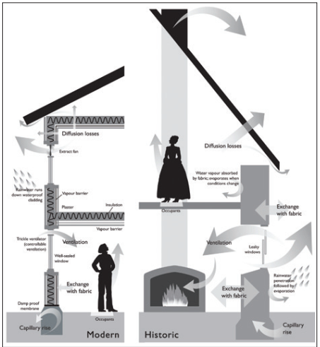
Why is traditional building retrofit different?
Buildings heat up and cool down more slowly
Moisture moves differently
Rain, groundwater and condensation moves through vapour-permeable fabric of natural materials
Relies on sun, wind, heat and ventilation to stay dry
In good condition, balance is maintained
Disrepair and changes in ventilation, heating and fabric (including inappropriate retrofit) can result in overheating, damp and mould, and compromise insulation
Image credit: Robyn Pender, English Heritage 2010
Notes:
Energy and moisture move differently in traditional buildings compared to modern ones, and it’s easy to end up with damp, mould, poor thermal performance, high bills and damaged building fabric if done in the wrong way.
Even when older buildings are in good condition, there may be issues caused by changes in how a building is occupied, heated, and ventilated compared to when it was originally built. These often include higher levels of internal humidity, an expectation for higher levels of airtightness, and a move away from ‘low and slow’ heating (such as solid fuels) to short ‘bursts’ of radiator heating in selected rooms.
Traditional buildings, in most cases, cannot reach the same levels of airtightness as a modern building.
Retrofit measures need to sustain fabric permeability – this includes use of vapour permeable measures and retention of ventilation routes for air flow (e.g. through lofts and under floors).
Measures for retrofit also need to be balanced against impact to historic fabric. For example, internal wall insulation may result in loss of internal decorative finishes and cornicing; and replacement windows may result in loss of historic joinery or glazing. Unlisted traditional buildings do not have the same planning restrictions and works may be undertaken. For listed buildings, and externally for buildings in conservation areas, restrictions are in place in terms of what retrofit measures may be considered acceptable.
This is why it’s important that retrofit advice and installation should never be given to owners of traditional buildings, particularly listed buildings, without a good understanding of these principles.
Retrofit that works with traditional buildings, often using natural materials, can provide good levels of insulation, a dry home, lower bills and a much-reduced carbon footprint.
References
Adapted from content supplied by Tamar Energy Community for the LEAD Webinar Series.
Copyright info
Credit: Robyn Pender, English Heritage 2010. Widely reproduced online; presumably under Open Government Licence (OGL) v1.0: https://www.nationalarchives.gov.uk/doc/open-government-licence/version/1/open-government-licence.htm

Slide 8
How to prioritise traditional building retrofit?
LAST
 | Renewable energy sources
 | Energy reduction and fabric upgrades
 | Repair and maintenance
FIRST
Notes:
This hierarchy of priorities is an indicative guide – in practice there may be overlap between them, or some later actions may need to be fast-tracked (such as replacement of an end-of-life boiler).
The first planned actions for traditional buildings should be repair and maintenance – the impact of this on energy use is often underestimated. Actions such as fixing leaky gutters can have significant impact on damp issues and improve thermal performance.
The next stages should focus on reducing energy and improving the building fabric. This could include quick wins such as draughtproofing and behaviour change. Insulation is an important action, but the appropriateness of insulation measures (such as their potential impact on heritage features) and choice of materials should be considered carefully. Cooling and ventilation should be considered alongside insulation, to avoid introducing damp issues or overheating.
Finally, renewable energy generation for heat and power should be considered.

Slide 9
Insulating traditional buildings - examples
Windows – ‘likely’ to receive planning permission*:
*Historic England guidance
 Draughtproofing
 Secondary glazing
 Slimline or vacuum double glazing within historic frames
 New double glazing in appropriate materials and style if replacing modern frames
Image © Bath and West Community Energy 2024, shared under CC BY-NC-ND 4.0
Notes:
There are many options for retrofitting traditional buildings, but care is needed to preserve features of historic significance and ensure retrofit materials and methods do not harm the building’s historic or natural fabric.
The following two slides suggest typically acceptable retrofit options for insulation listed buildings as practical examples, according to the Historic England Advice Note (HEAN) 18: Adapting Historic Buildings for Energy and Carbon Efficiency. (Not all listed buildings will be able to accommodate all of these actions, as it depends on the historic significance of their existing features.) Note that these principles are also likely to apply in conservation areas.
For example, there are several options available for windows, including draughtproofing, secondary glazing and slimline or vacuum double glazing within historic frames (though installing upgraded glazing within historic frames is often impractical). If the existing windows are not historic features, new double glazing is likely to be allowed provided appropriate materials and styles are adopted, usually in wood. There may be requirements around detailing and colour to ensure consistency with local historic styles.
Local authorities will apply national guidance to the local context of specific applications, and should always be consulted for permitted development. Planning and conservation officers should be able to advise (sometimes for a fee) whether planning permission or listed building consent is needed, and any requirements or recommendations to help retrofit proposals gains planning permission.
References
https://historicengland.org.uk/images-books/publications/adapting-historic-buildings-energy-carbon-efficiency-advice-note-18/
Copyright info
Photo: Bath and West Community Energy 2024, shared under CC BY-NC-ND 4.0: https://creativecommons.org/licenses/by-nc-nd/4.0/

Slide 10
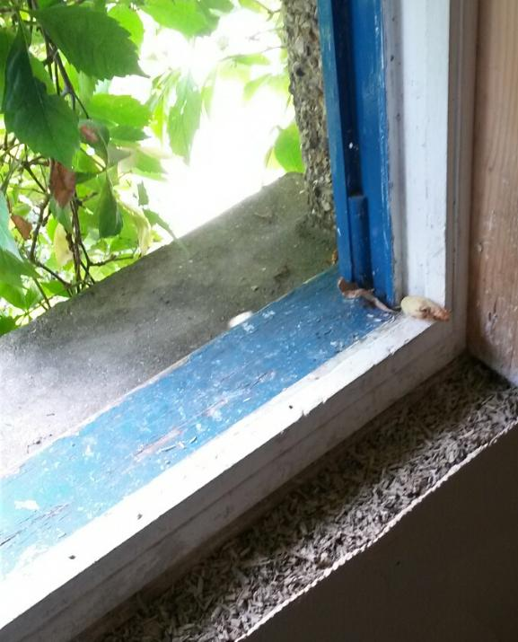
Natural materials often have lower embodied carbon than artificial alternatives
Floors, roofs and walls – ‘likely’ to receive planning permission*:
*Historic England guidance
 Floor insulation
 Loft insulation
? Internal wall insulation
Sometimes acceptable in listed buildings
Planning permission usually not needed in unlisted buildings
 External wall insulation
Rarely permitted for listed buildings or in conservation areas
Image © Ruth Gerrard 2015, shared under CC BY-NC 4.0
Notes:
When insulating floors, roofs and walls in traditional buildings, only vapour-permeable systems should be considered, and sufficient ventilation must be retained.
Floor insulation and loft insulation will generally be acceptable in listed buildings and conservation areas, depending on the historic significance of these features.
Internal wall insulation is only sometimes permitted in listed buildings. In conservation areas, in unlisted buildings, internal works do not require planning permission (but they should refer to buildings regulations). It’s essential that internal wall insulation, plaster and finishes use appropriate, breathable materials or there is a risk of damp become trapped in the walls, leading to mould problems and potential deterioration of the wall fabric.
External wall insulation is rarely permitted in listed buildings, or in unlisted buildings within conservation areas.
References
https://historicengland.org.uk/images-books/publications/adapting-historic-buildings-energy-carbon-efficiency-advice-note-18/
Copyright info
Photo: Ruth Gerrard 2015, shared under CC BY-NC 4.0: https://creativecommons.org/licenses/by-nc/4.0/

Slide 11
What is the planning and consent process?
Permitted development | Pre-application | Application | Listed Building Consent
• No fee • Permission not needed • Check national legislation on permitted development • Article 4 directions may remove rights in conservation areas | • Fee (variable) will usually apply • Local planning authority officers give advice and/or feedback on proposals before a formal application • Service will vary locally - check | • Fee will apply • Local Planning Authority will assess against national and local requirements • Conservation Officer may become involved if a heritage asset is affected | • No fee • In parallel with planning permission • Conservation Officer usually makes decision, based on national legislation, planning framework and local policy
Notes:
Note that is a criminal offence to:
Not comply with a formal enforcement notice for unlisted building works done in a conservation area without planning permission
Undertake any works to a listed building without listed building consent
References
https://historicengland.org.uk/images-books/publications/adapting-historic-buildings-energy-carbon-efficiency-advice-note-18
https://www.bathnes.gov.uk/pre-application-advice-and-development-team
https://historicengland.org.uk/advice/planning/consents/conservationareaconsent
https://www.lichfielddc.gov.uk/planning/planning-enforcement-faq/5
https://historicengland.org.uk/advice/planning/consents/lbc

Slide 12
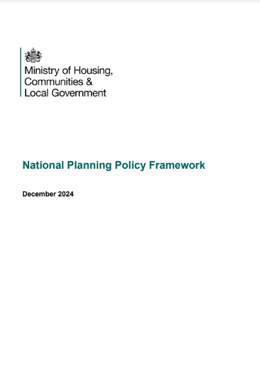
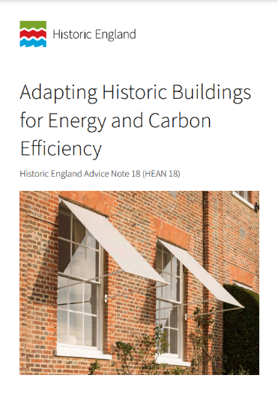
Key documents
National Planning Policy Framework
Historic England Advice Notes
Local Plans
Supplementary Planning Documents
Permitted Development Rights for Householders
Any local guidance – speak to your local planning authority for details
Notes:
Decisions will be made by local planning authorities in compliance with the National Planning Policy Framework.
Historic England is a non-departmental public body. Its Advice Notes provide practical, detailed advice on how to implement national policy and guidance.
Local Plans guide decisions on future development proposals, based on national policy alongside local needs and opportunities.
Supplementary Planning Documents are local documents providing more detail and guidance on the policies within an adopted Local Plan.
National guidance on permitted development rights for householders includes information on where these differ in conservation areas.
Finally, your local planning authority can advise on any local guidance.
References
https://www.gov.uk/government/publications/national-planning-policy-framework--2
https://www.planningaid.co.uk/hc/en-us/articles/203126442-What-is-a-Local-Plan
https://www.gov.uk/guidance/plan-making
https://historicengland.org.uk/advice/planning/planning-system
https://historicengland.org.uk/images-books/publications/adapting-historic-buildings-energy-carbon-efficiency-advice-note-18
https://www.gov.uk/government/publications/permitted-development-rights-for-householders-technical-guidance
Copyright info
Images reproduced from public documents under Open Government Licence (OGL) v3.0: https://www.nationalarchives.gov.uk/doc/open-government-licence/version/3/

