Slide 1
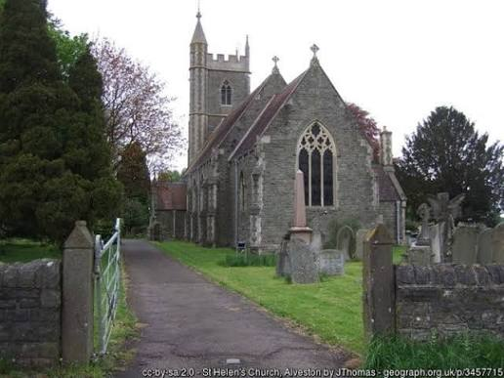
David Moss – Energising Britain
Hybrid ASHP & Gas,
St. Helen Alveston

Slide 2
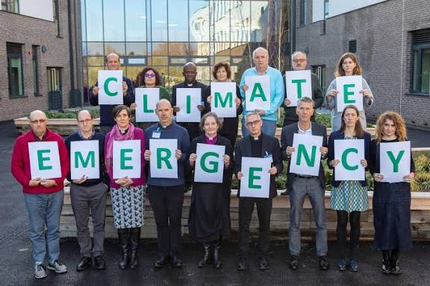
CONTEXT
November 2019
Declaration
Bristol Diocese

Slide 3
Net Zero to be achieved by 2030 (set by General Synod of the Cof E in 2020)
Energy audits and grants
Fossil fuels out
Biodiversity in
Solar installations & decarbonization for all buildings
Gas out
Electricity in

Slide 4
Timeline to Hybrid – Cost £75K Grants £40K
Grant funding deadline 31-03-2025
2019 Energy report ESOS – continue with gas
2023 Heating replacement first considered
2023 Quotation Halos IR. National grid could not supply electricity
7/2024. New energy report ESOS – ASHP Air to Water
8/2024. Bristol Diocese another energy report Inspired Energy
8/2024 Inspired energy suggest Air to Air. Planners say “No” Grade 2
9/2024 Heating engineers suggest Bosch ASHP
10/2024 Bosch survey not enough power for AHSP alone hybrid system
1/2025 Planning obtained but National Grid said no to Bosch ASHP
1/2025. Bosch referred us to Viessmann ASHP National grid Yes
2/2025. Viessmann ASHP taken of the market, other ASHP cost £90K
3/2025. Viessmann supplies 2 ASHPs commission 4/4/2025

Slide 5
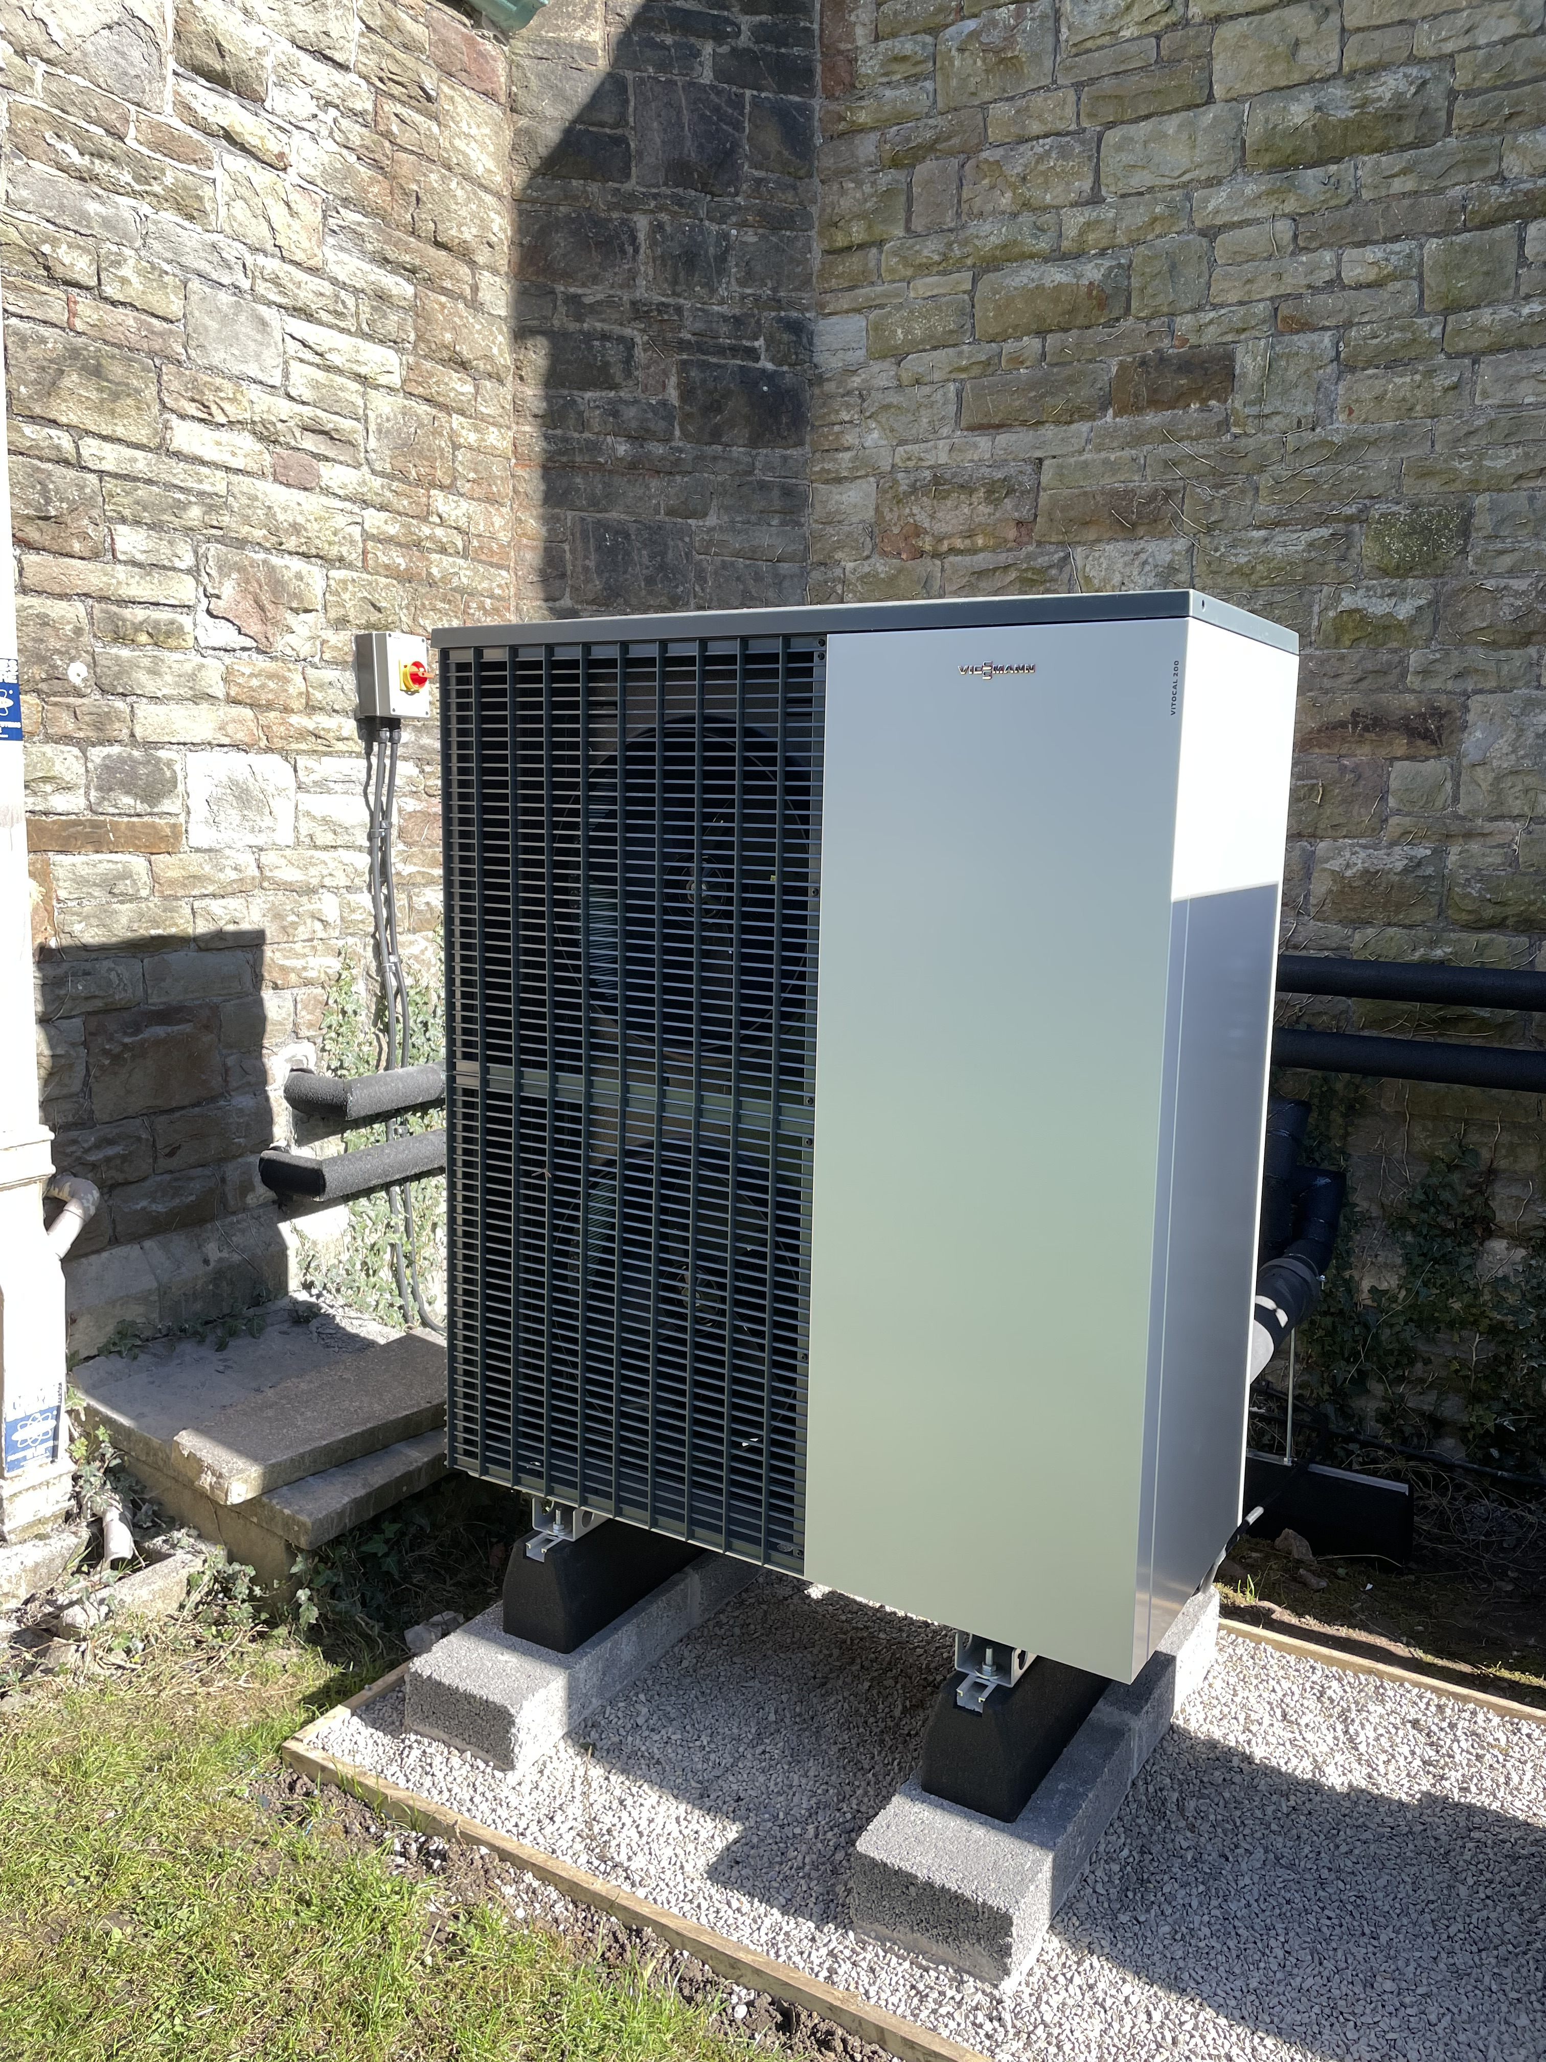
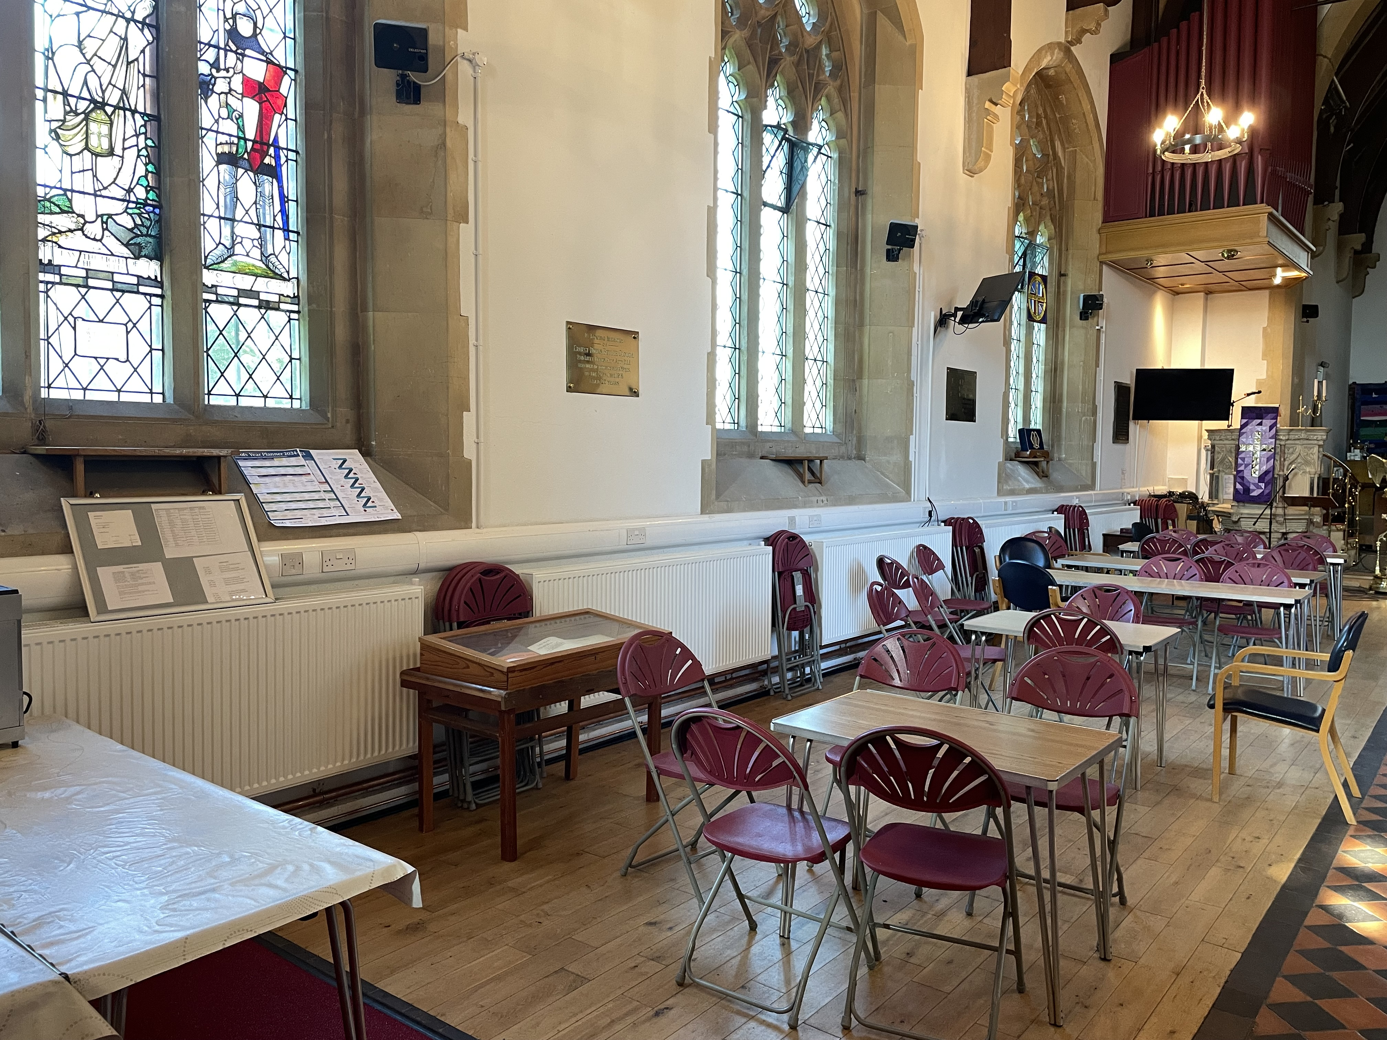
Lessons learnt
Don’t be too idealistic
Don’t be put off by the hurdles
Be open to new ideas.
Green gas is on the way
Hold onto the vision

Slide 6
Old System 90,000KWH Gas
New System 11,451 KWH Gas
17,567 KWH
Electric

